Slide 1

The Utah Economy in 2022
Fundamentals and Insights
Economic Report to the Governor
January 13, 2022

Slide 2
Setting the Stage
Economic disruptions from lingering pandemic, particularly impacting supply
Massive fiscal and monetary policy response, primarily geared to demand
Trends
  Strong acceleration of some previously-existing trends
  Creation of new trends, such as a goods rediscovery

Slide 3
Three Recurring Takeaways
Take Care of Your People
Be Prepared for Economic Re-sorting
Care for Those Left Behind
Kem C. Gardner Policy Institute
DAVID ECCLES SCHOOL OF BUSINESS UNIVERSITY OF UTAH

Slide 4
Part One:
Major Economic Indicators

Slide 5
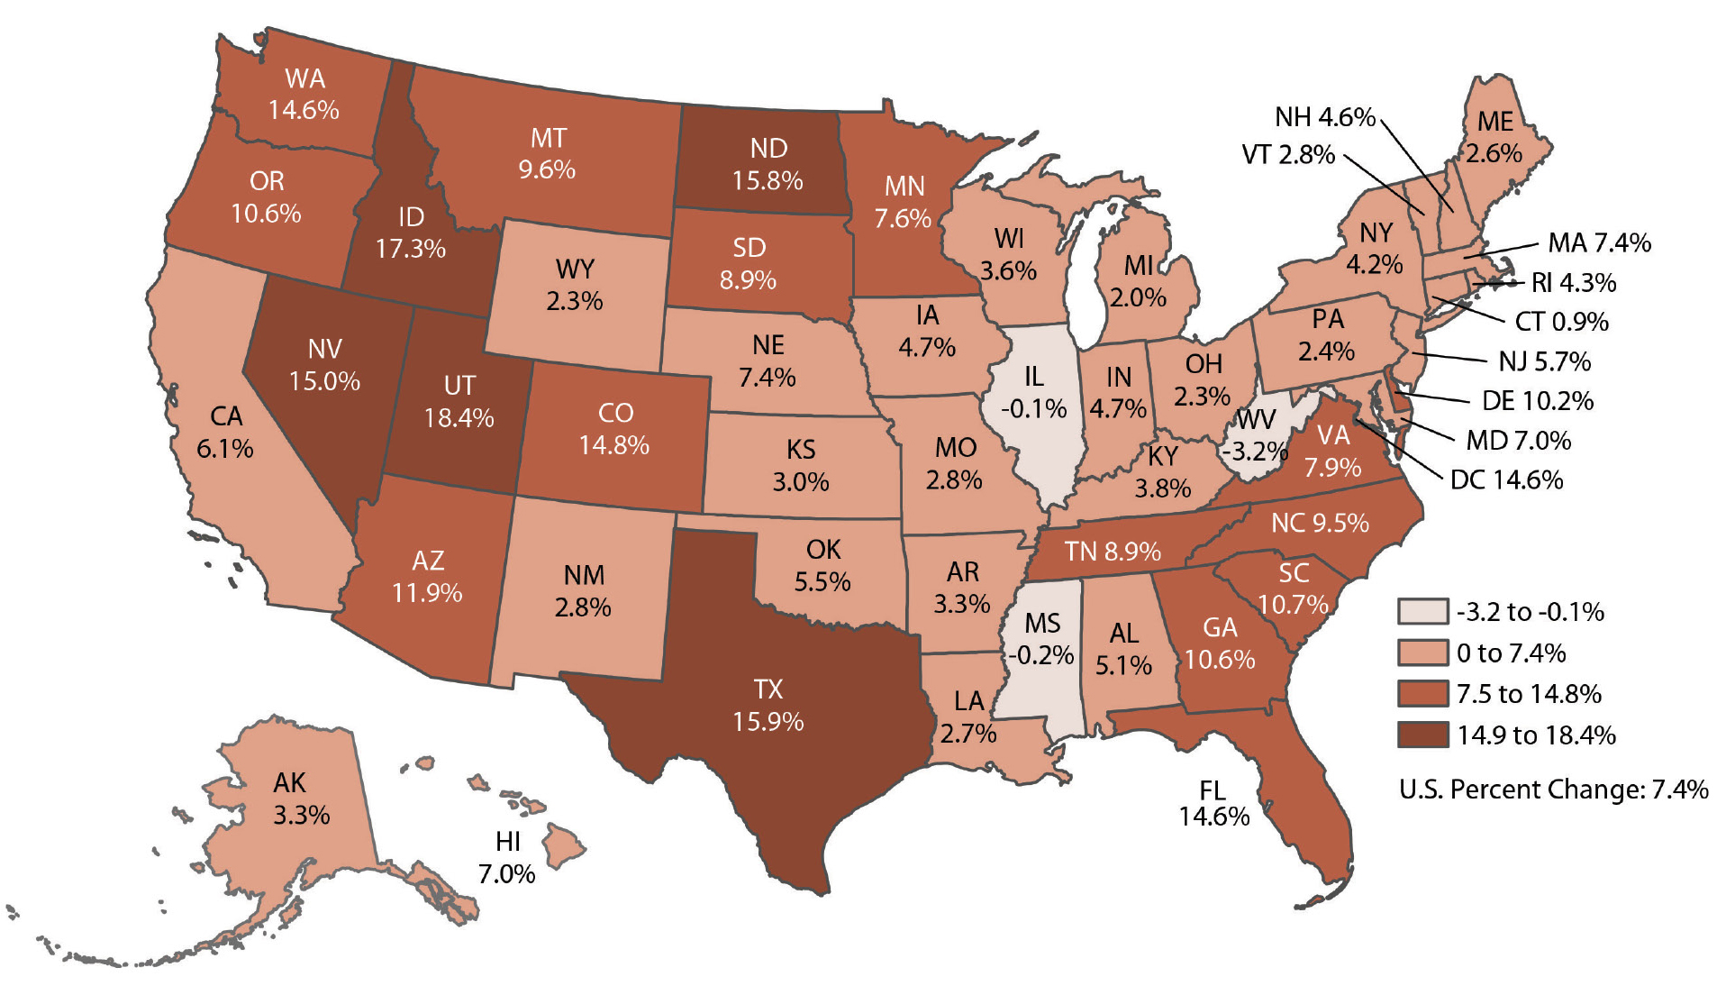
Utah’s Population Growth Rate Leads the Nation
Percent Change, 2010-2020
Source: 2020 Apportionment Data, U.S. Census Bureau

Slide 6
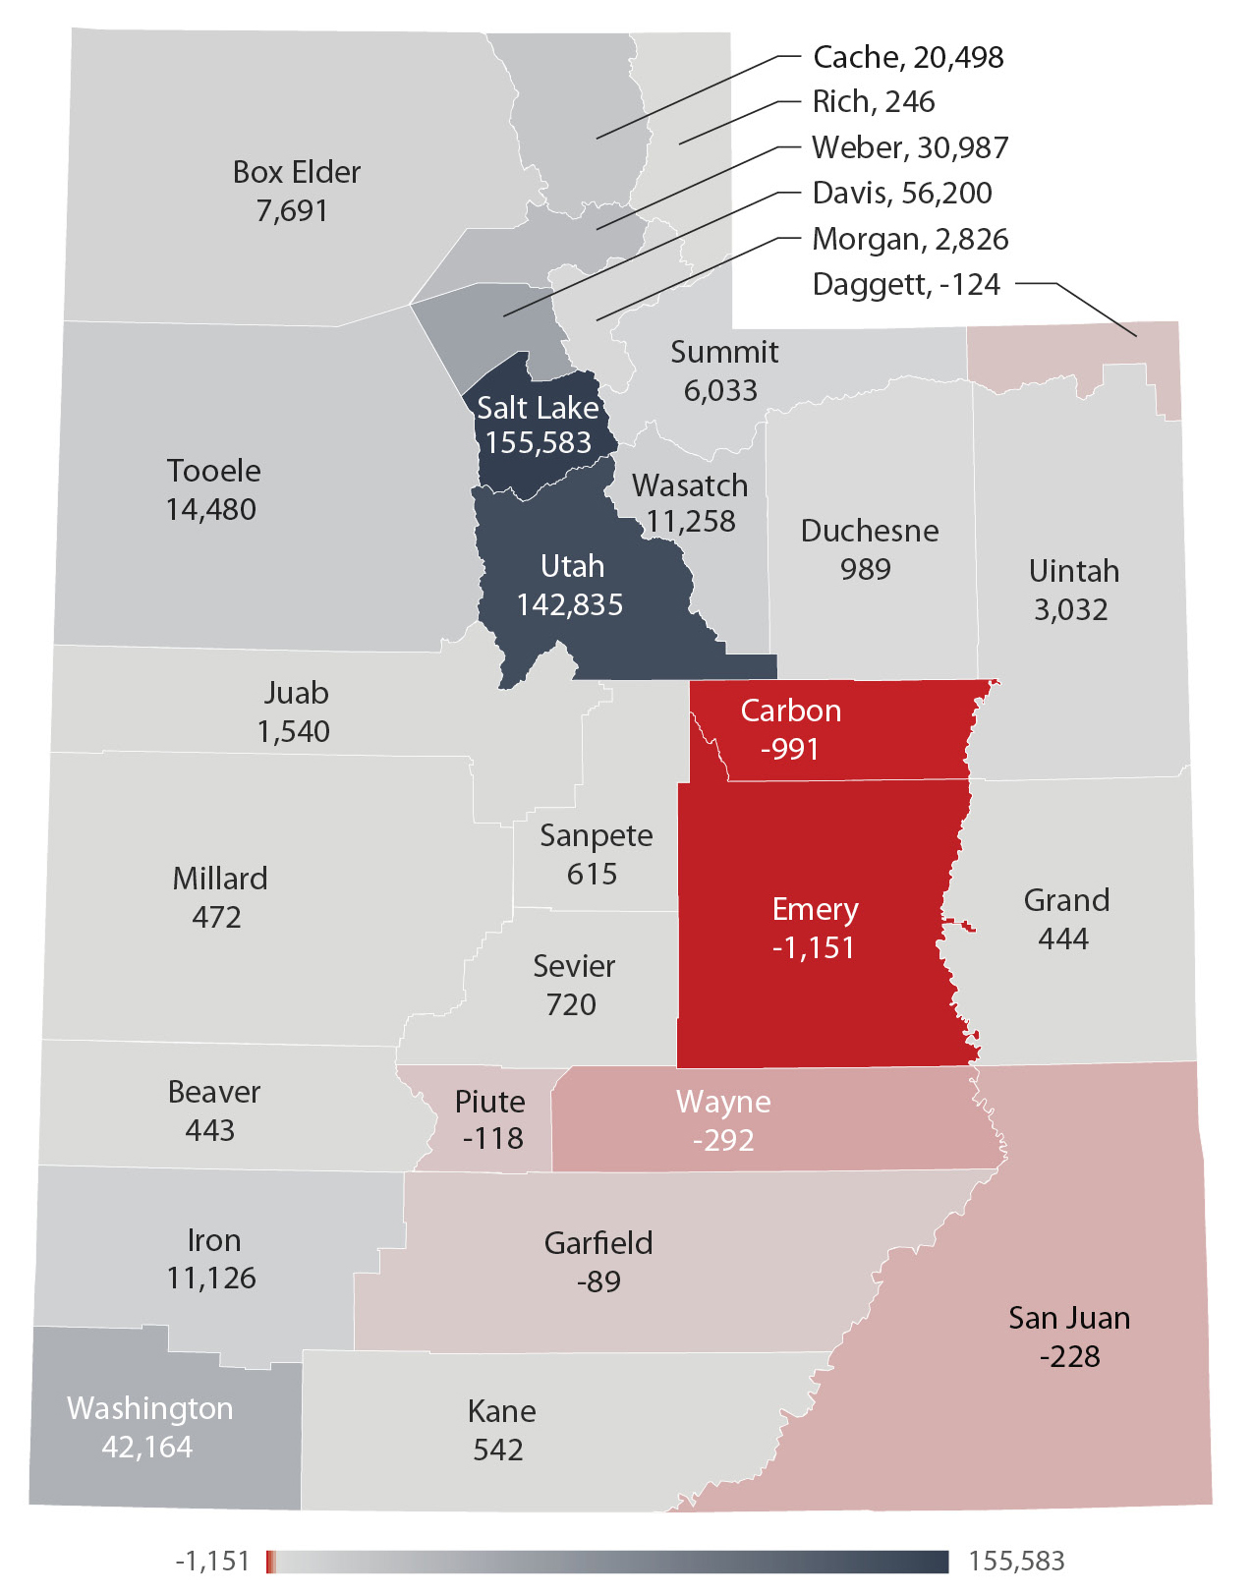
Utah’s Growth is Uneven
Percent Change, 2010-2020
Urbanization continues
  Wasatch Front
  Southwest Utah
Parts of Rural Utah lost population
Source: U.S. Census Bureau

Slide 7
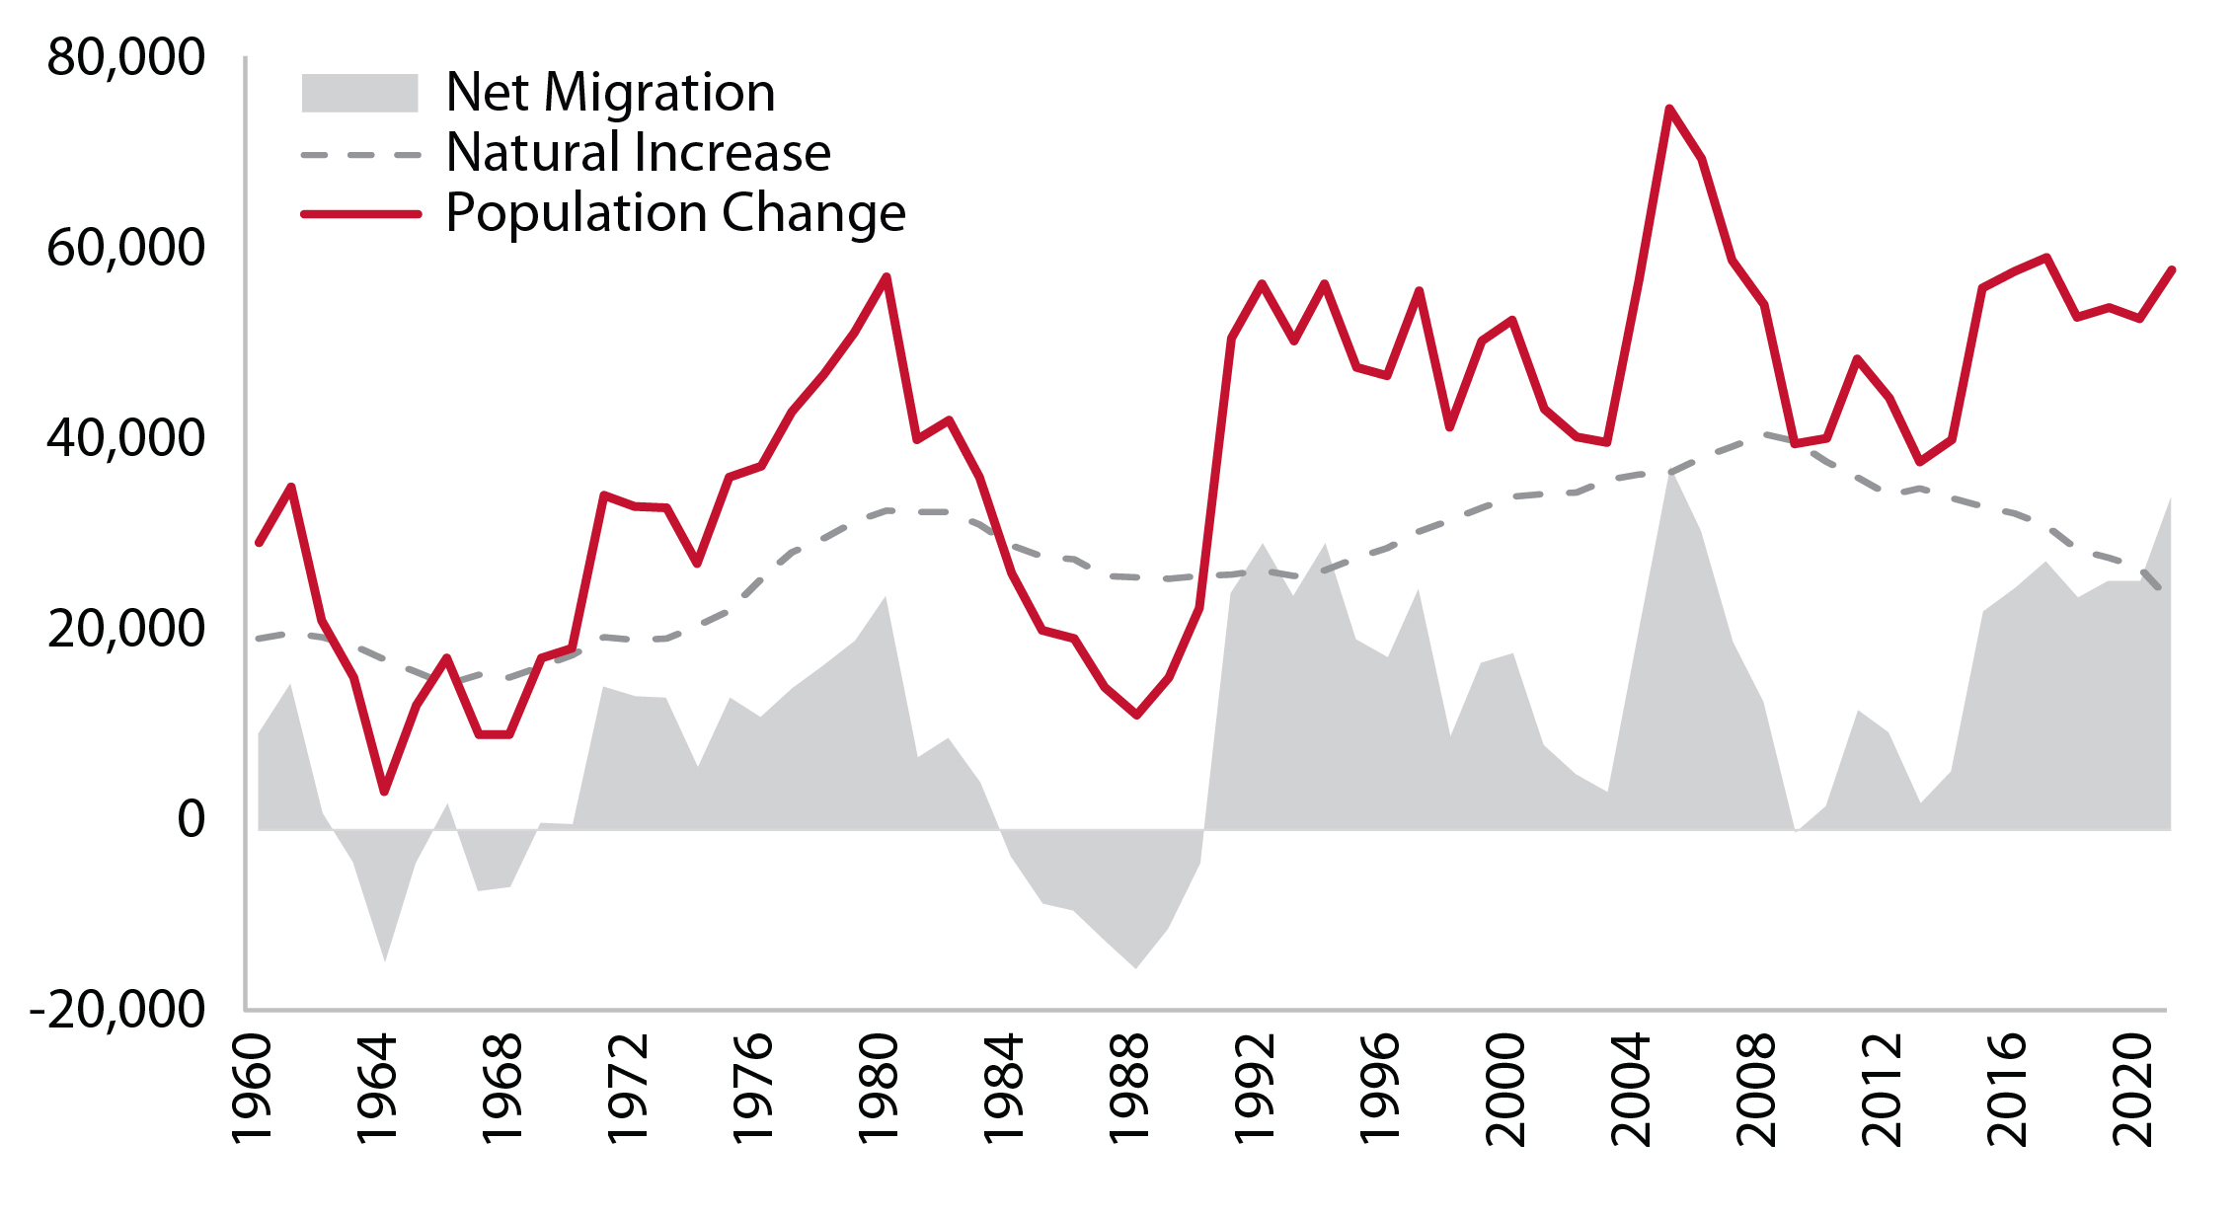
Lowest Natural Increase Since 1975
Source: Kem C. Gardner Policy Institute

Slide 8
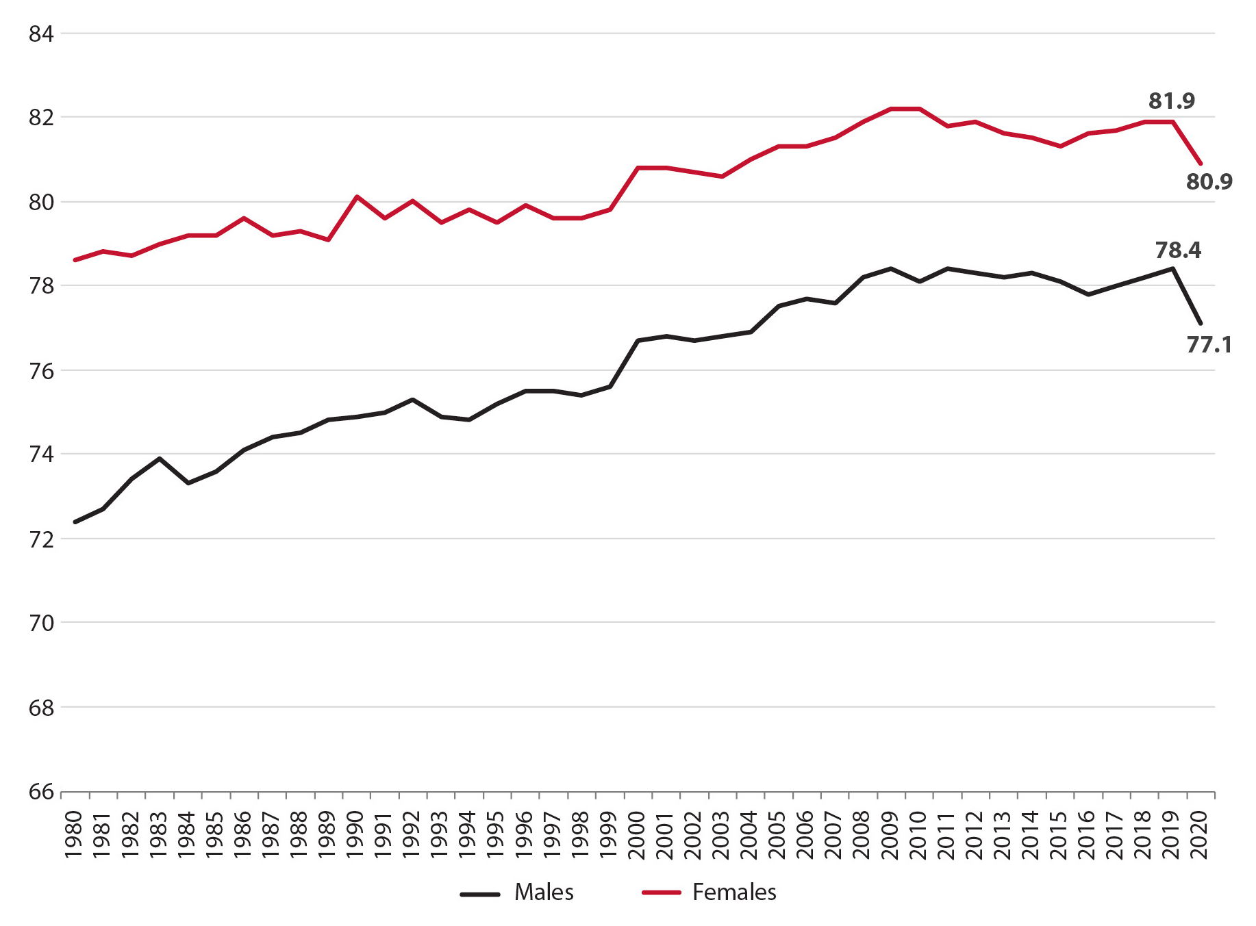
Pandemic Reducing Life Expectancy
Source: Kem C. Gardner Policy Institute
Kem C. Gardner Policy Institute
DAVID ECCLES SCHOOL OF BUSINESS UNIVERSITY OF UTAH

Slide 9
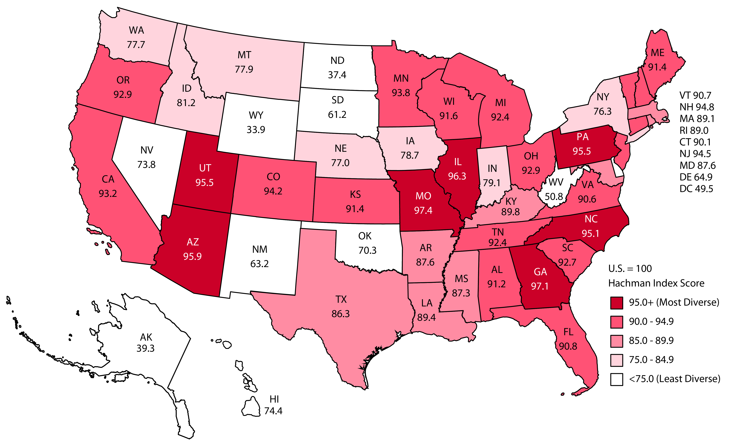
Utah’s Diverse Economy
Hachman Index 2020, 100=Most Diverse
Source: Kem C. Gardner Policy Institute
Kem C. Gardner Policy Institute
DAVID ECCLES SCHOOL OF BUSINESS UNIVERSITY OF UTAH

Slide 10
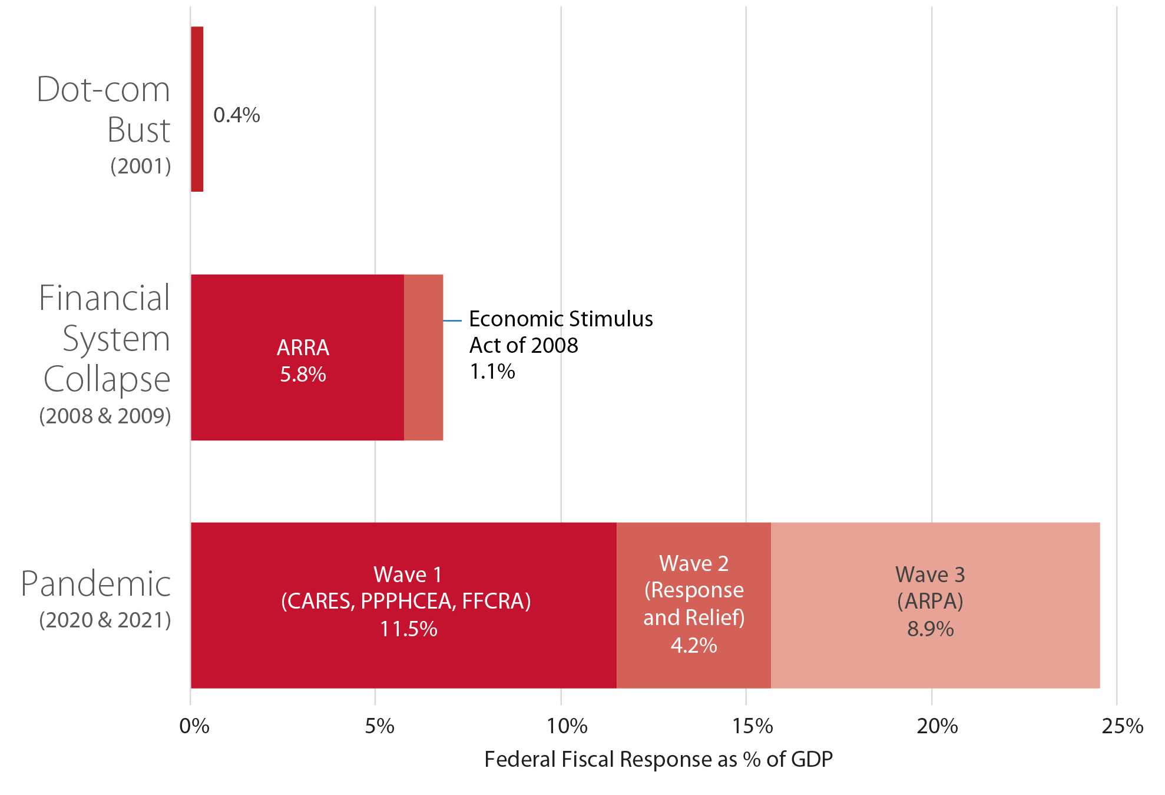
“Unprecedented” Federal Fiscal Support
Source: Congressional Budget Office and National Bureau of Economic Research

Slide 11
Lower Household Debt Service Payments
Lower monthly payments open up sizable spending capacity
Source: Federal Reserve
Kem C. Gardner Policy Institute
DAVID ECCLES SCHOOL OF BUSINESS UNIVERSITY OF UTAH

Slide 12
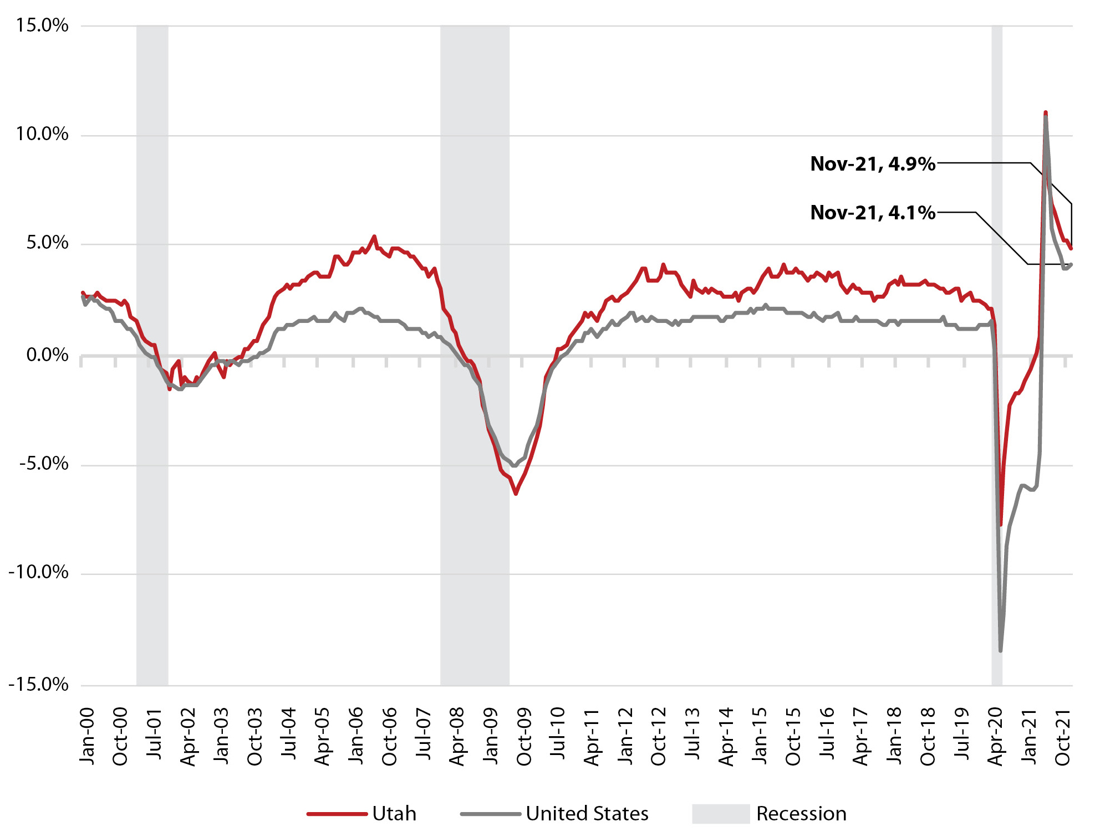
Job Growth - A Historical Comparison
Employment Change 2000 – 2021
Source: U.S. Bureau of Labor Statistics

Slide 13
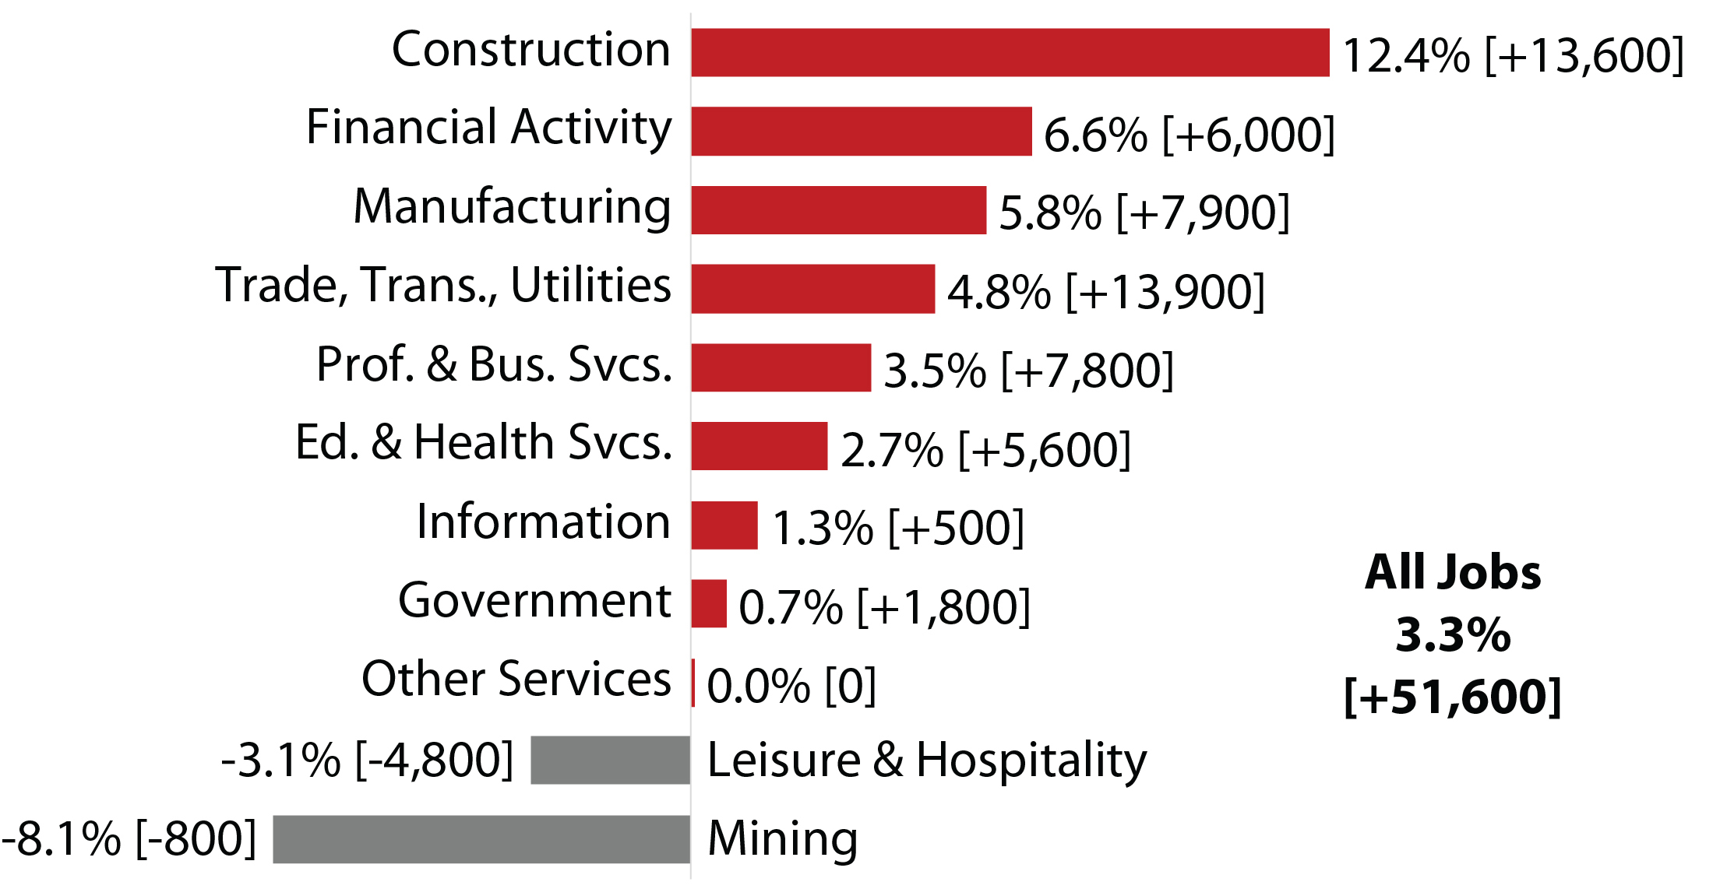
A Strong, Broad-Based Jobs Recovery in Utah
Employment Change 2019 – 2021e
Source: Utah Department of Workforce Services

Slide 14
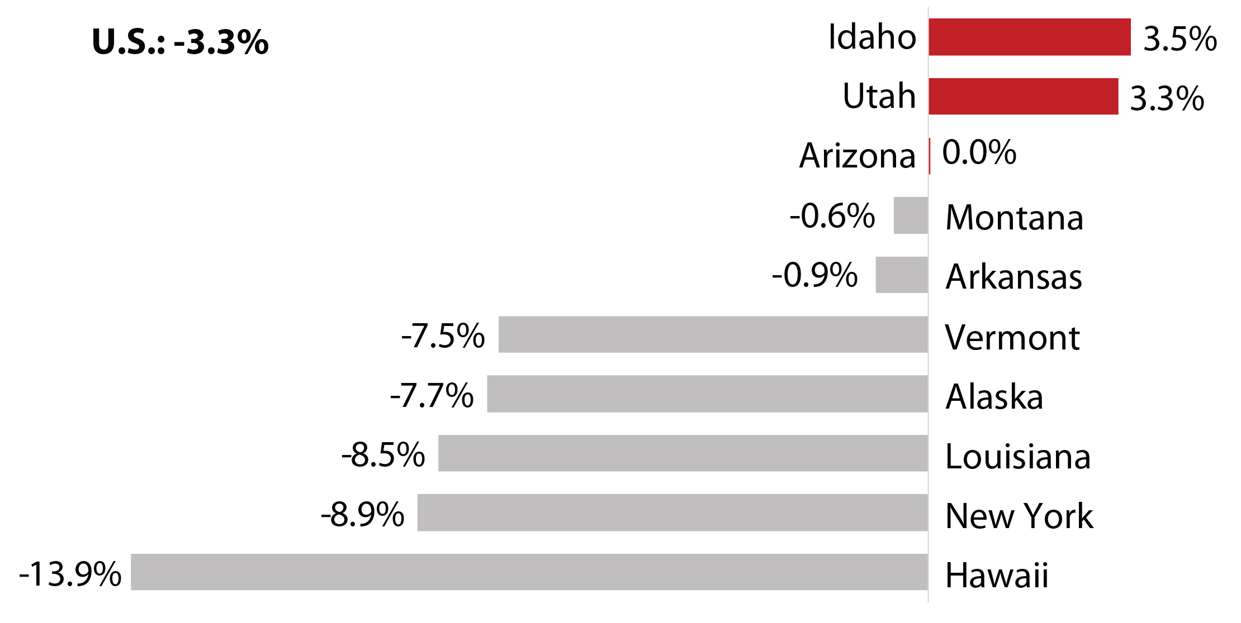
Utah and Idaho Lead the Nation’s Recovery
Employment Change 2019 – 2021e
Source: Utah Department of Workforce Services

Slide 15
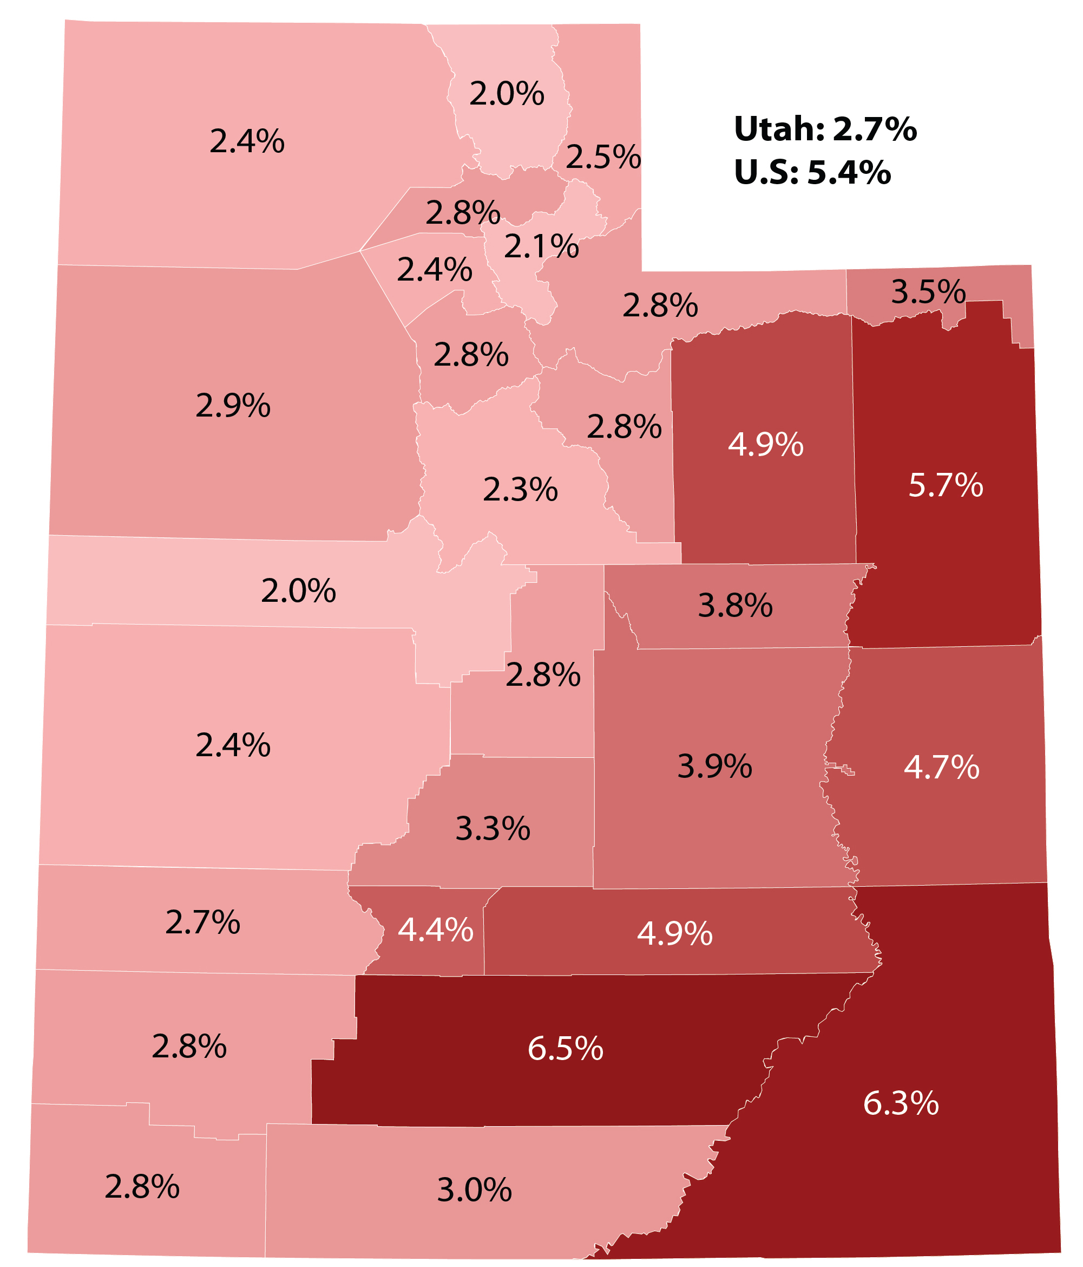
But 2021 Recovery Uneven
Unemployment Rate, 2021e
Source: Utah Department of Workforce Services

Slide 16
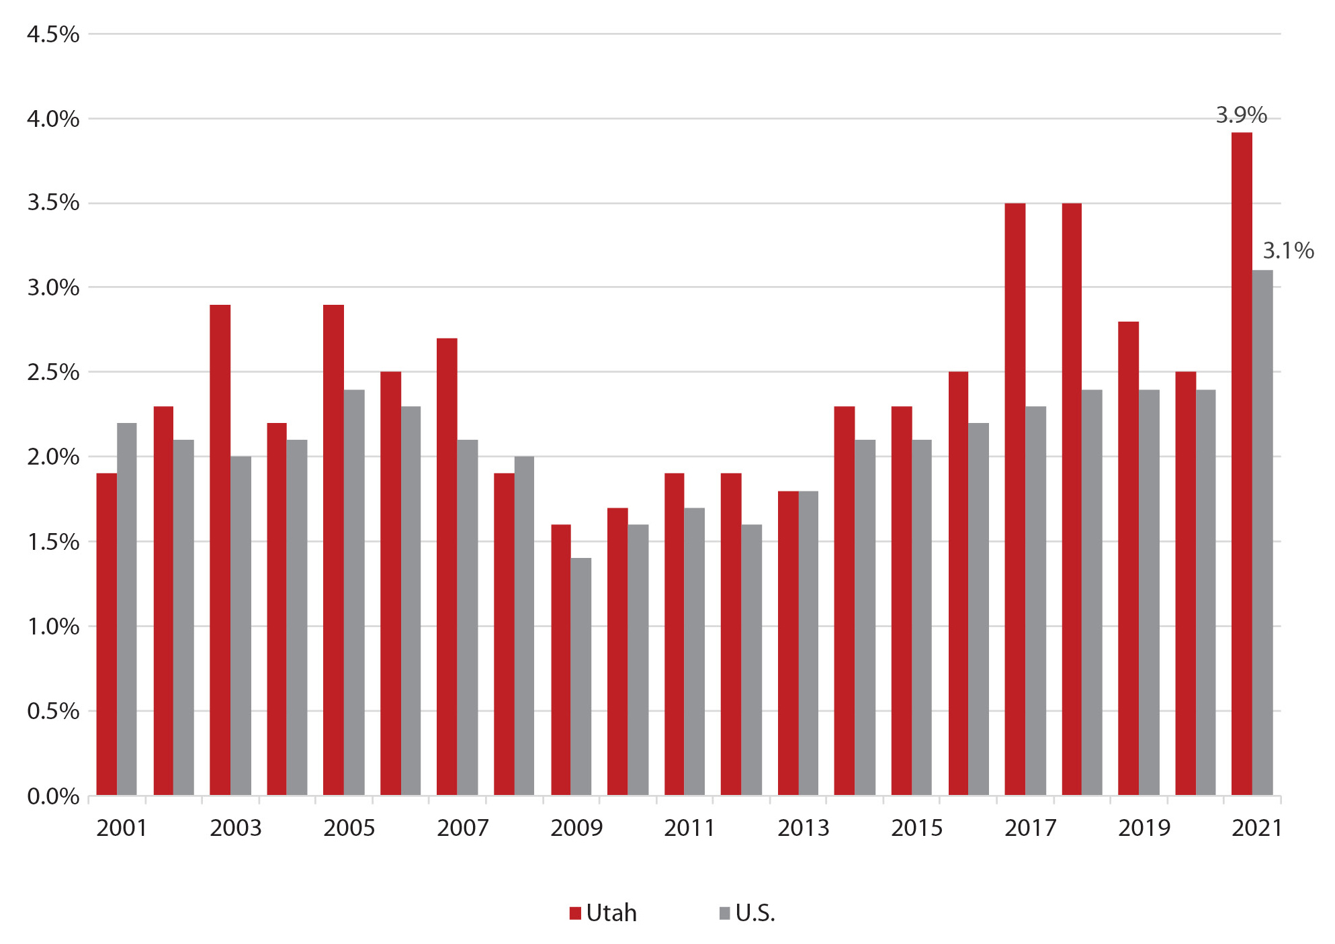
The Great Resignation and Labor Shortages
Quit Rate, Sept 2001-Sept 2021
Source: US. Bureau of Labor Statistics

Slide 17
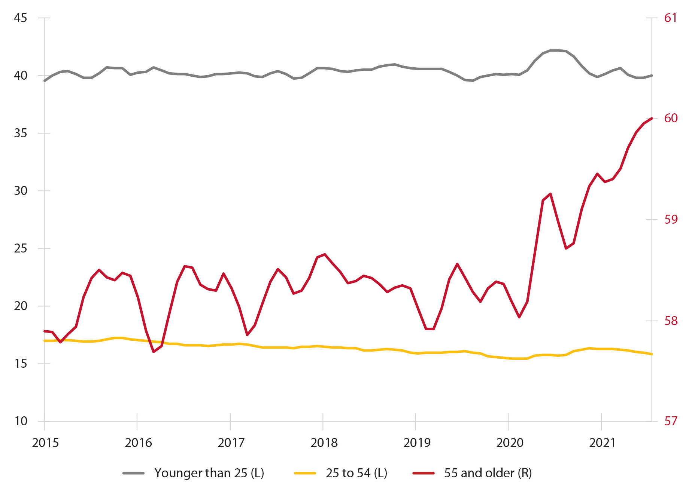
Retiring Boomers
Percent of U.S. Labor Force Not in Labor Force and Don’t Want Job (3 month average)
Source: Bureau of Labor Statistics, Moody’s Analytics

Slide 18
Supply and Demand
Supply
Prices below the market equilibrium create shortages
Equilibrium
Demand

Slide 19
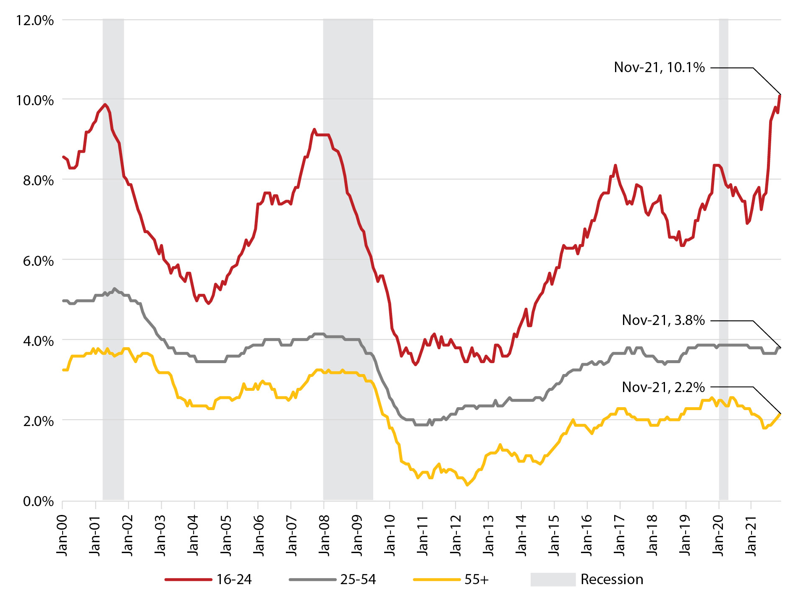
Increasing Gen Z Wages
Source: U.S. Bureau of Labor Statistics, Federal Reserve

Slide 20
The Sting of Accelerating Inflation
Consumer Price Index
Source: U.S. Bureau of Labor Statistics

Slide 21
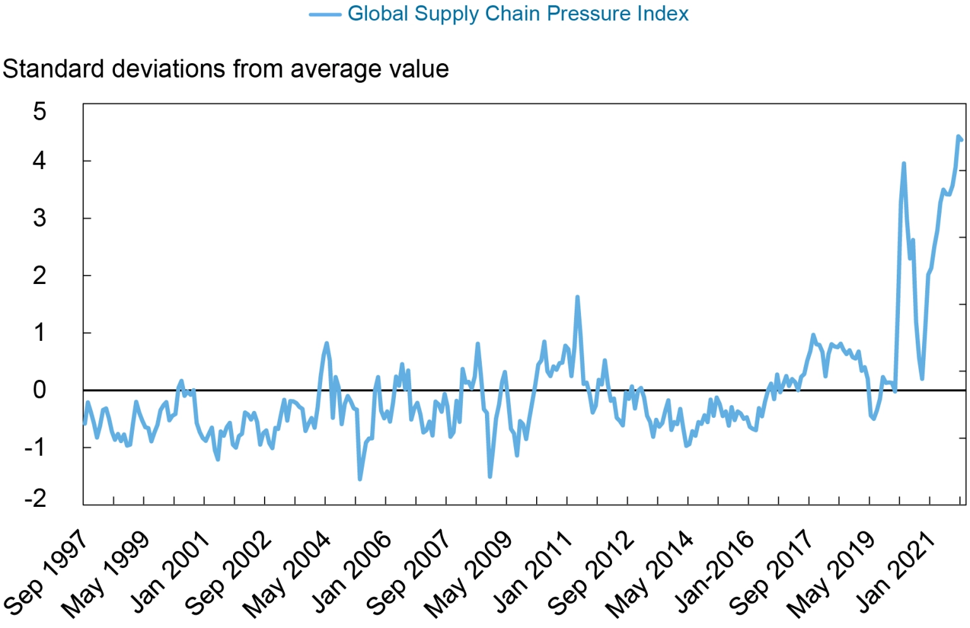
Global Supply Chain Disruptions
Source: Federal Reserve Bank of New York

Slide 22
Changing Inflation Expectations
Source: Federal Reserve Bank of New York

Slide 23
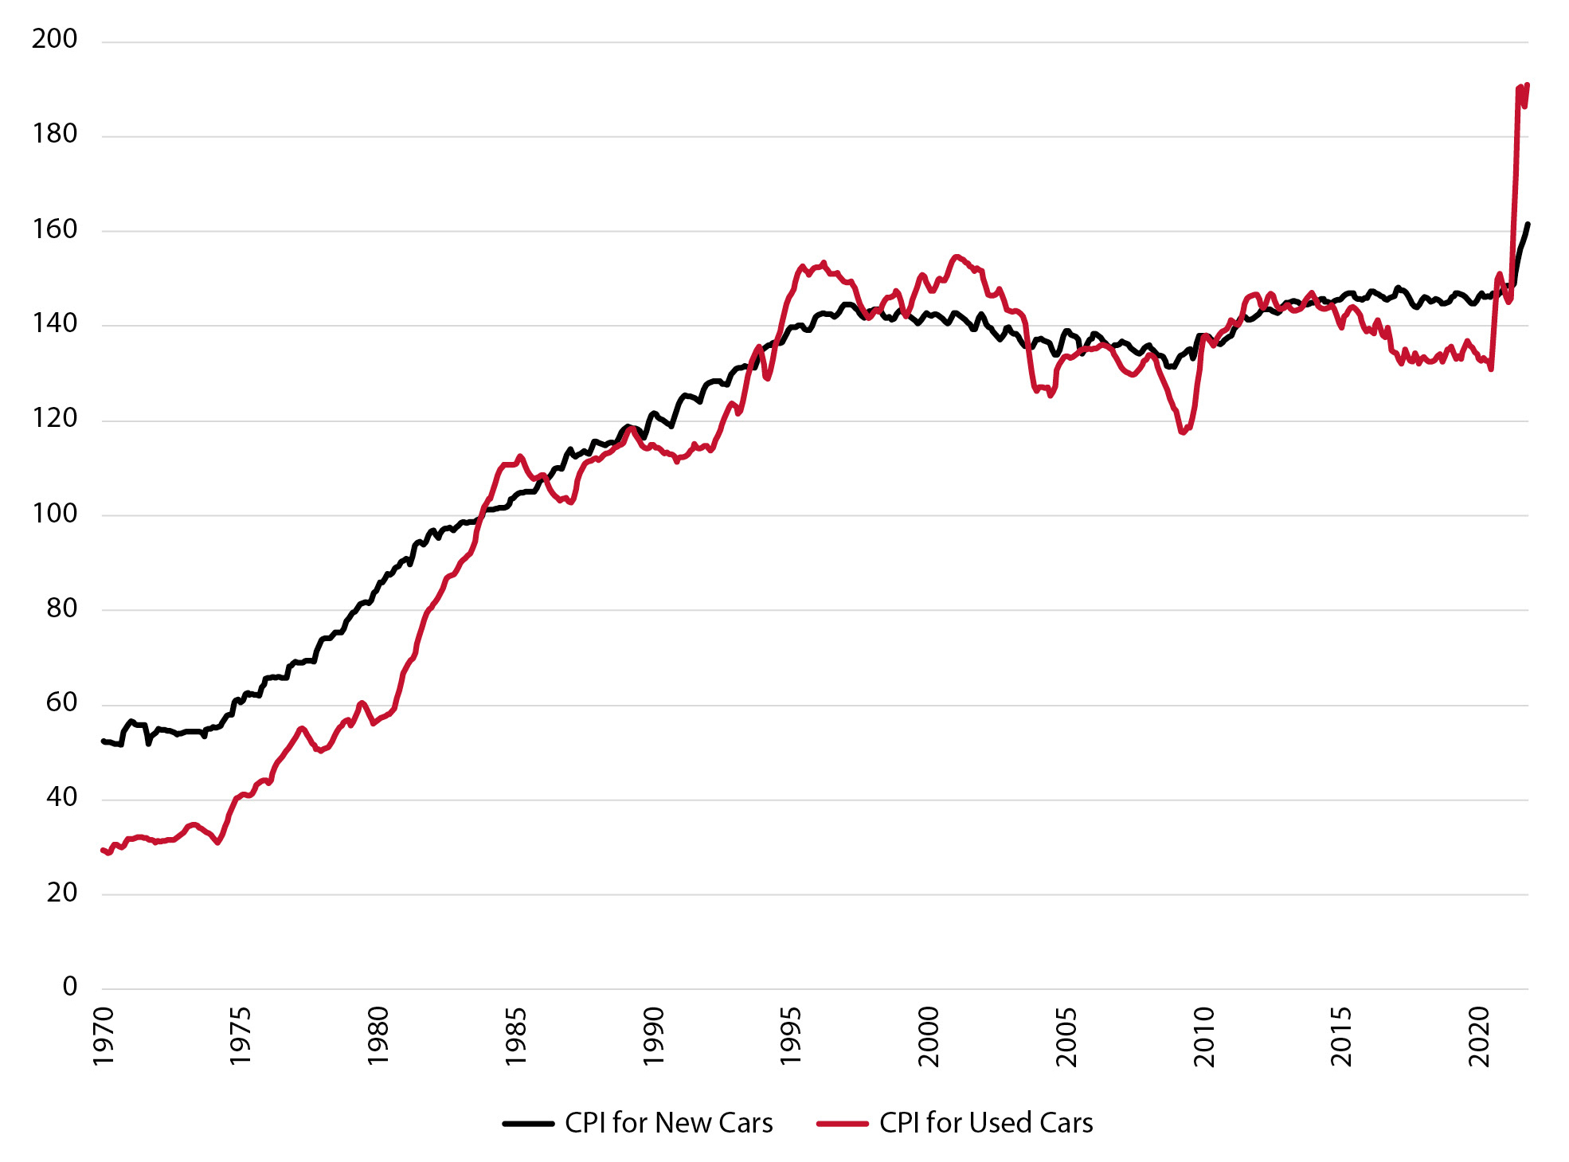
Skyrocketing Used Car Prices
Source: U.S. Bureau of Labor Statistics

Slide 24
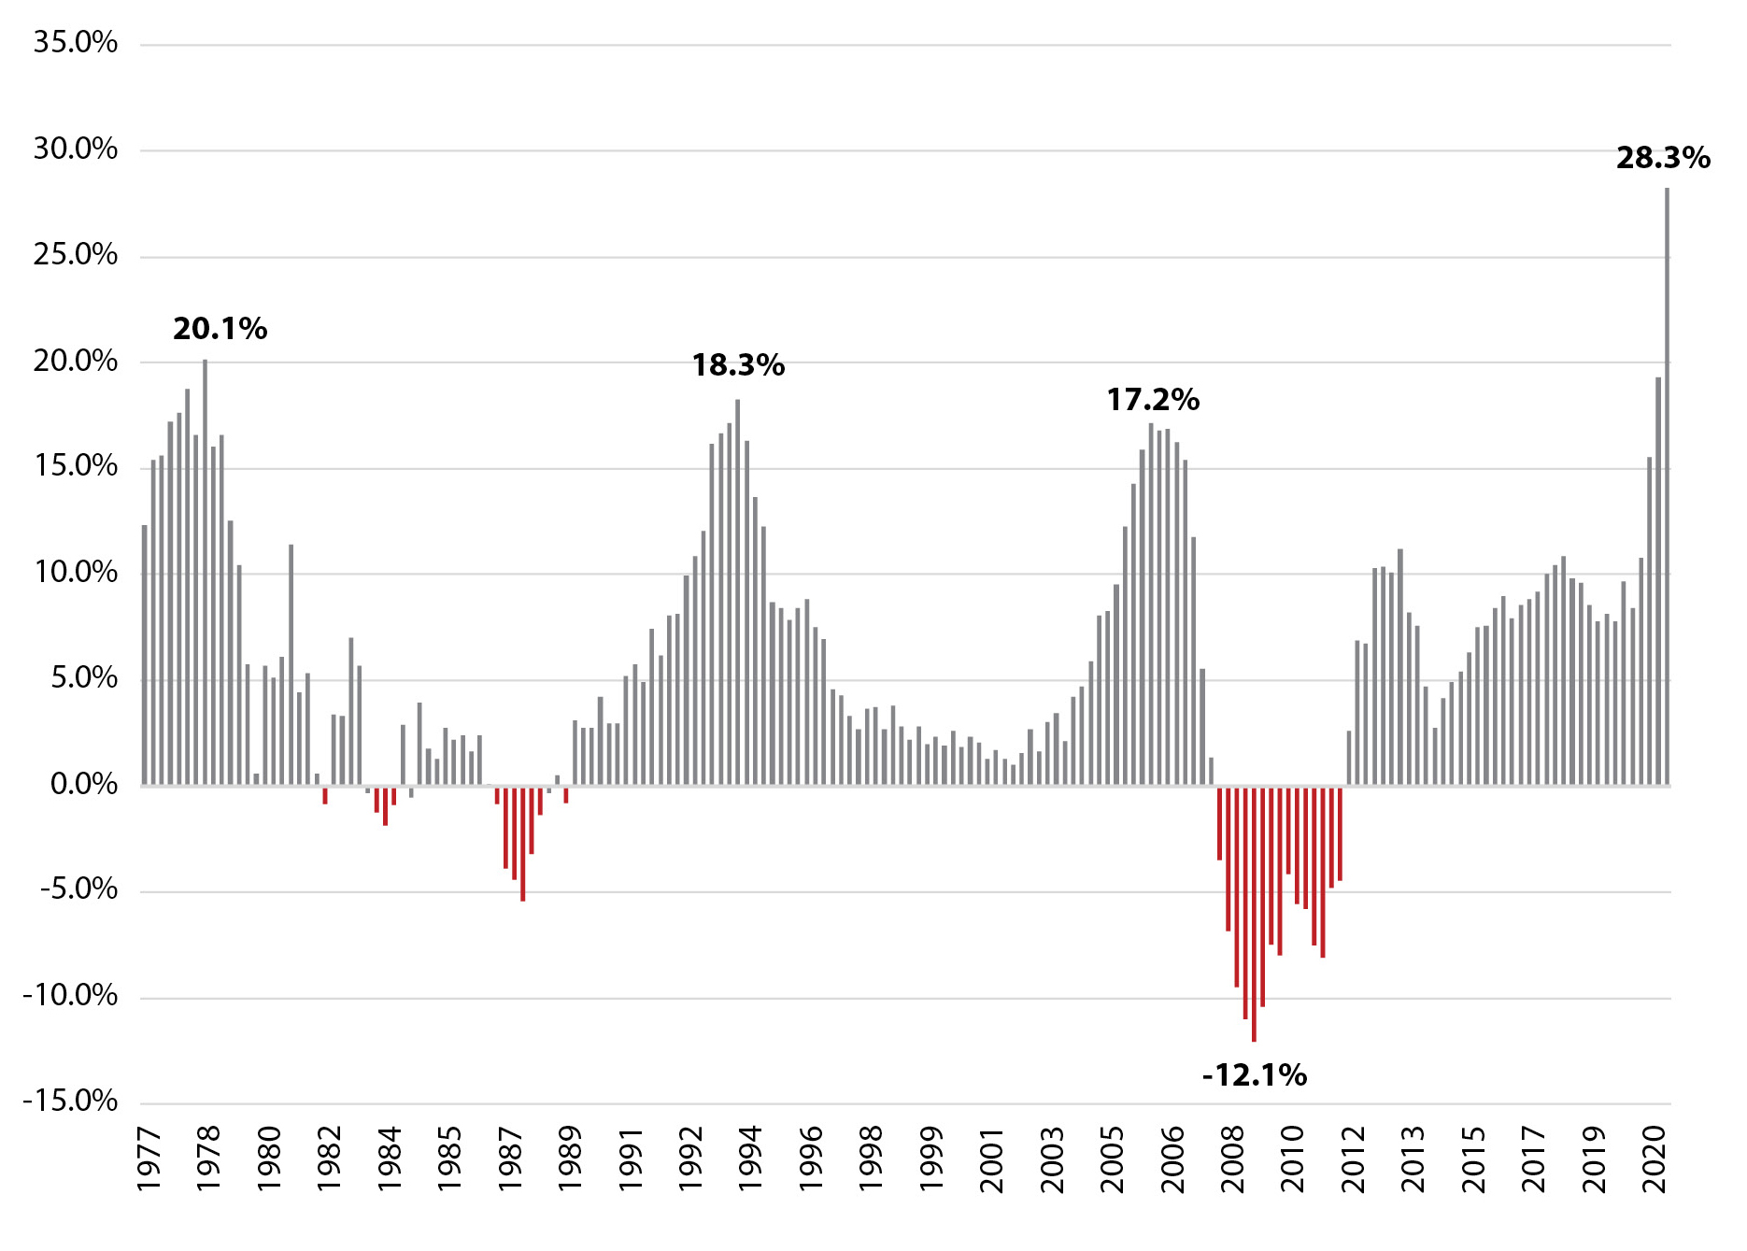
Skyrocketing Home Prices
Source: Federal Housing Finance Agency Housing Price Index

Slide 25
Historic Low Mortgage Interest Rates
30-year Fixed Mortgage Interest Rates
Source: Freddie Mac

Slide 26
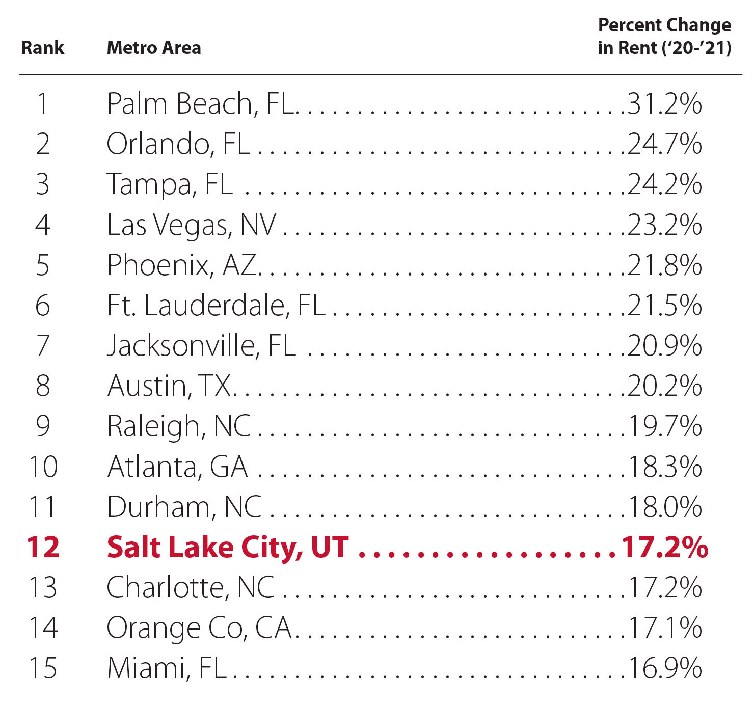
Skyrocketing Rents
Source: CoStar

Slide 27
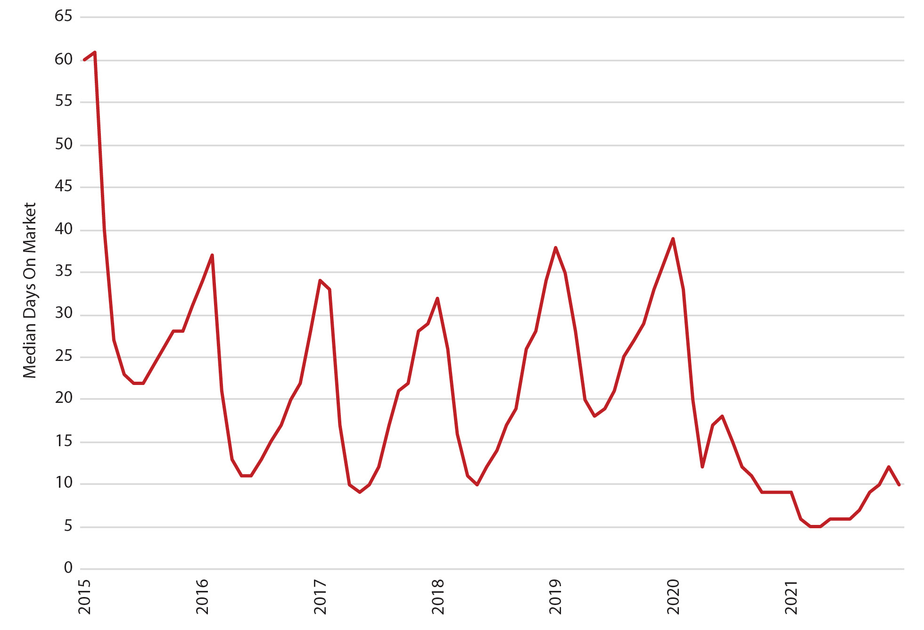
Quick Home Sales
Source: UtahRealEstate.com

Slide 28
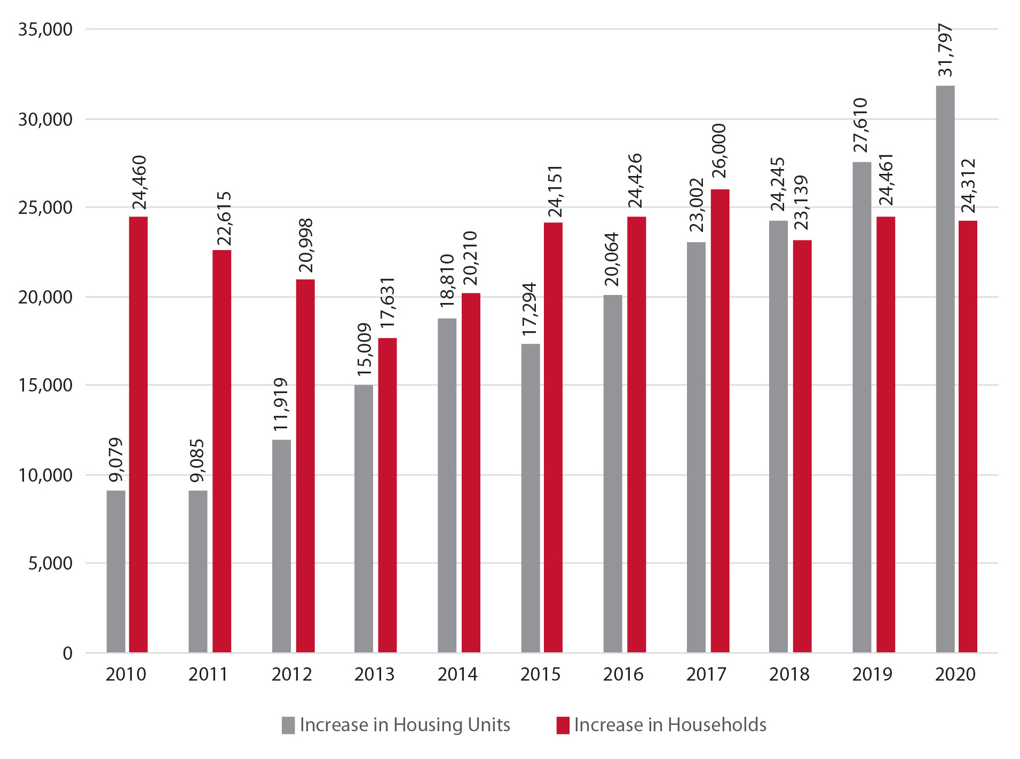
Housing Demand and Supply
Mismatch Since 2010
Source: Kem C. Gardner Policy Institute

Slide 29
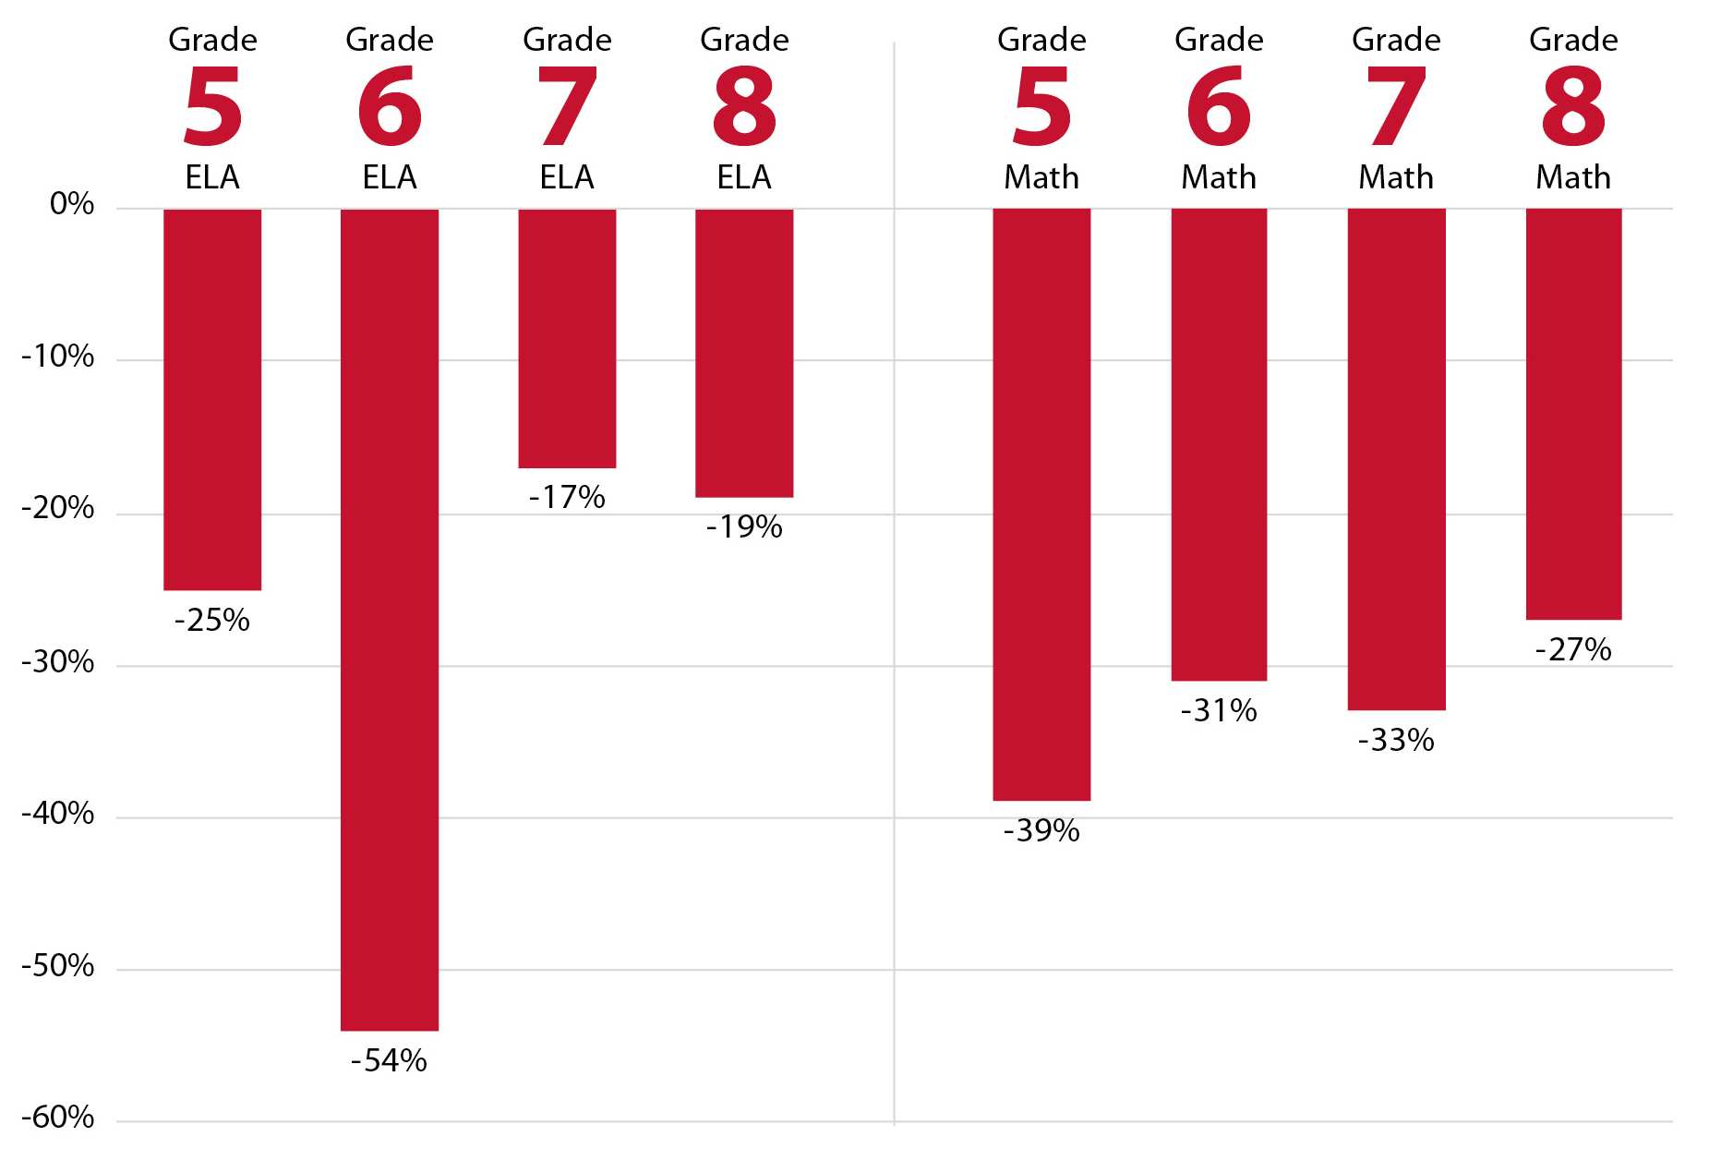
Learning Disruptions for Our Future Workforce
Source: Utah State Board of Education and National Center for Improvement of Education Assessment

Slide 30
Part Two:
Economic Forecast

Slide 31
Utah Forecast
Source: Kem C. Gardner Policy Institute
Kem C. Gardner Policy Institute
DAVID ECCLES SCHOOL OF BUSINESS UNIVERSITY OF UTAH
Notes:
Disclaimer about second federal stimulus

Slide 32
Forecast Risks
Tailwinds
  Quality of life
  Young, growing population
  Overall educational attainment
  Strong pandemic recovery
  Responsive and responsible government
  Outdoor recreation
  Infrastructure investments
  Social capital
  Savings
Headwinds
  Lingering pandemic
  Housing availability and affordability
  Overall inflation
  The Great Resignation
  Supply chain disruptions
  Reduced federal fiscal support
  Increasing interest rates

Slide 33
Looking to Utah’s Future
Instead of protesting at a healthcare leader’s personal residence, consider taking some time to volunteer at the local food bank. Instead of posting on Facebook, walk across the street to check on your neighbor. Instead of listening to another talking (screaming) head on cable news, try listening to a new friend who looks or
thinks a little differently than you.
Governor Spencer J. Cox
At the end of the day, we will be measured by our humanity, who we cared for and who we brought in, and not those we left behind.
President Taylor Randall

