Slide 1
ECONOMIC REPORT to the GOVERNOR
Utah Economic Council
Kem C. Gardner Policy Institute
Governor’s Office of Management and Budget
Utah Office of Tourism
Governor’s Office of Economic Development
Department of Natural Resources
Southern Utah University
University of Utah
Department of Workforce Services
Economic Development Corporation of Utah
Office of the Utah State Auditor
Silicon Slopes
Utah Defense Alliance
Utah Farm Bureau Federation
Utah Foundation
Utah Office of the Legislative Fiscal Analyst Utah Nonprofits Association
Utah State Board of Education
Utah State Tax Commission
Utah State University
Ivory Homes
CBRE
EconWest
Salt Lake Chamber
Utah System of Higher Education
World Trade Center Utah
Zions Bank
Juliette Tennert
Shannon Simonsen
Sophia Bagley
Mallory Bateman
DJ Benway, Jr.
Andrea Brandley
Sterling C. Brown
Elizabeth Converse
Eric Cropper
Phil Dean
John Downen
Dejan Eskic
Dale Frost
John Gilbert
Melanie Heath
Michael Hogue
Thomas Holst
Deborah Jacobson
Miranda Jones Cox
Leslee Katayama
Mark Knold
Jacoba Larsen
Jennifer Leaver
Kathryn Macdonald-Poelman
Joseph Mayans
Carrie Mayne
Kirin McInnis
Darin Mellott
Stephanie Mills
Collin Mosquito
McKinley Nicholas
Levi Pace
James Porter
Kate Rubalcava
Andrew Rupke
Robert Spendlove
Joshua Spolsdoff
Michael Stachitus
Jared Stahelo
David Stringfellow
Brandy Strand
Kevin Sullivan
Laura Summers
Nate Talley
Shawn Teigen
Michael Vanden Berg
Andrea Wilko
James Wood
Kem C. Gardner Policy Institute
DAVID ECCLES SCHOOL OF BUSINESS UNIVERSITY OF UTAH

Slide 2
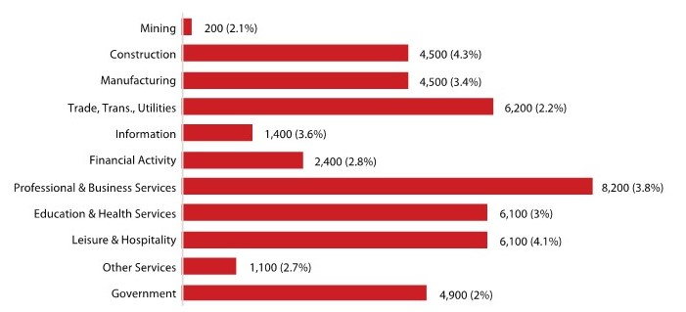
Utah Employment Growth, Level and Percent, 2018–2019
+45,600 jobs
Source: U.S. Bureau of Labor Statistics and Kem C. Gardner Policy Institute
Kem C. Gardner Policy Institute
DAVID ECCLES SCHOOL OF BUSINESS UNIVERSITY OF UTAH

Slide 3
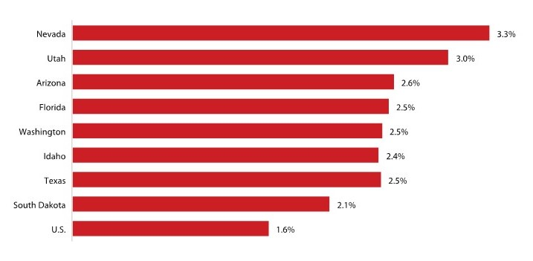
States with Strongest Job Growth, 2018–2019
Source: U.S. Bureau of Labor Statistics and Kem C. Gardner Policy Institute
Kem C. Gardner Policy Institute
DAVID ECCLES SCHOOL OF BUSINESS UNIVERSITY OF UTAH

Slide 4
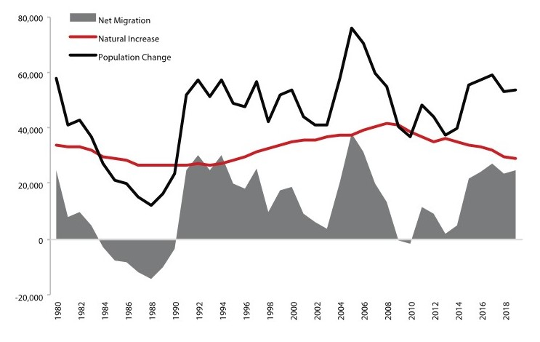
Utah Components of Population Change
Source: Utah Population Committee
Kem C. Gardner Policy Institute
DAVID ECCLES SCHOOL OF BUSINESS UNIVERSITY OF UTAH

Slide 5
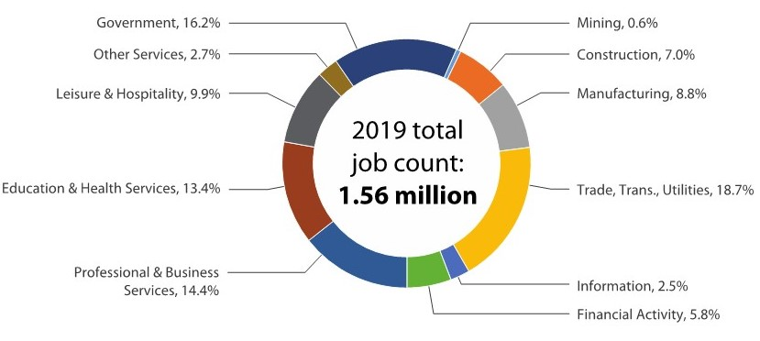
Total Share of Utah Jobs by Sector, 2019
Source: U.S. Bureau of Labor Statistics and Kem C. Gardner Policy Institute
Kem C. Gardner Policy Institute
DAVID ECCLES SCHOOL OF BUSINESS UNIVERSITY OF UTAH

Slide 6
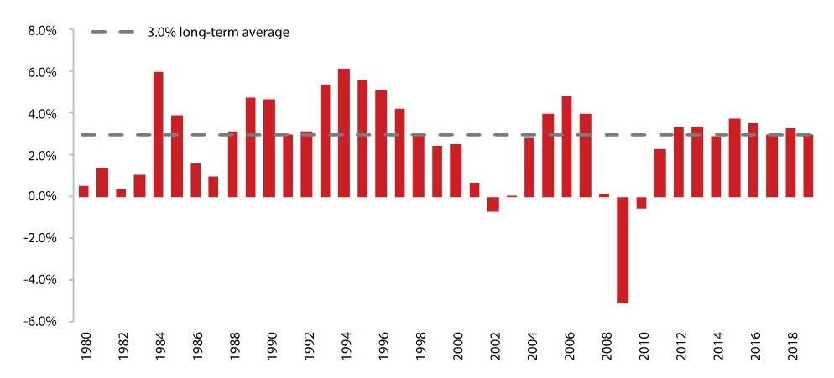
Utah Annual Job Growth History
Source: U.S. Bureau of Labor Statistics
Kem C. Gardner Policy Institute
DAVID ECCLES SCHOOL OF BUSINESS UNIVERSITY OF UTAH

Slide 7
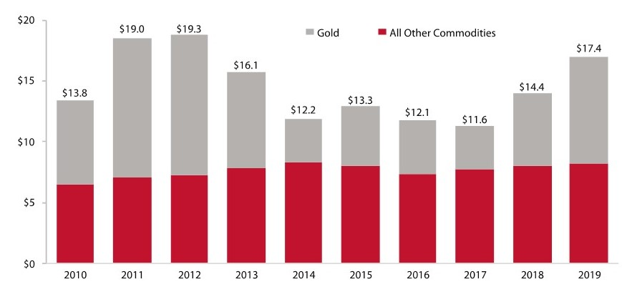
Utah International Exports, $ billions
Source: U.S. Census Bureau
Kem C. Gardner Policy Institute
DAVID ECCLES SCHOOL OF BUSINESS UNIVERSITY OF UTAH

Slide 8
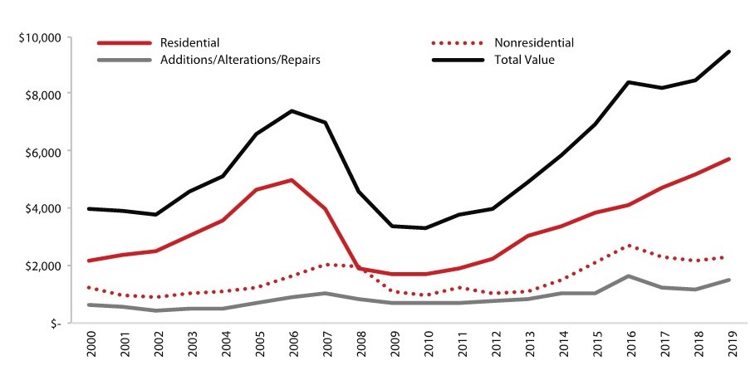
Utah Value of New Construction, $ millions
Sources: Kem C. Gardner Policy Institute
Kem C. Gardner Policy Institute
DAVID ECCLES SCHOOL OF BUSINESS UNIVERSITY OF UTAH

Slide 9
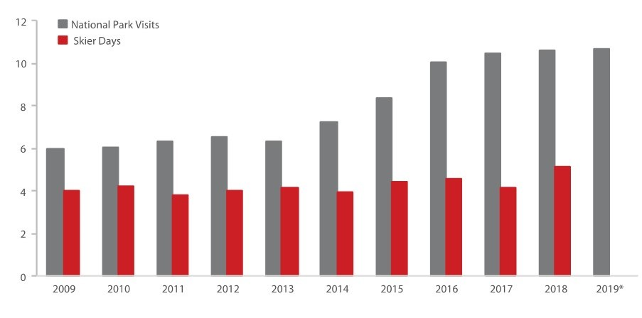
Utah National Park and Skier Visits, millions
*2019 skier days will be released in June 2020. Skier days include season that begins with year shown (e.g. 2018 = 2018-2019 ski season).
Source: U.S. National Park Service and Ski Utah
Kem C. Gardner Policy Institute
DAVID ECCLES SCHOOL OF BUSINESS UNIVERSITY OF UTAH

Slide 10
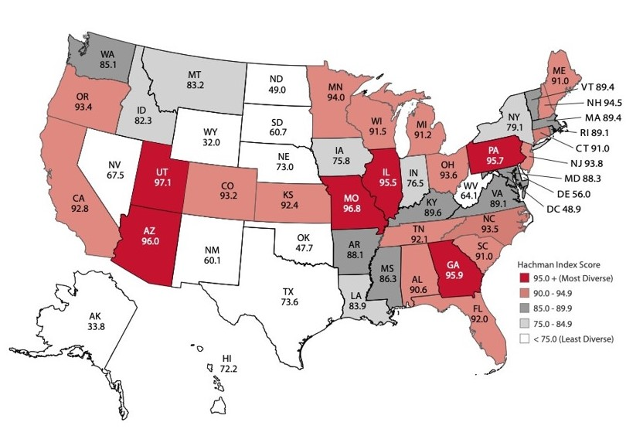
Hachman Index for States, 2018
Source: Kem C. Gardner Policy Institute
Kem C. Gardner Policy Institute
DAVID ECCLES SCHOOL OF BUSINESS UNIVERSITY OF UTAH

