Slide 1

Utah’s Demographic Transformation:
Washington County Growth & Change
February, 2019

Slide 2
GROWTH

Slide 3
Intermountain States Population: 1900-2010
Sources: U.S . Census Bureau, decennial censuses.

Slide 4
Utah’s Million Milestones
Sources: Utah Population Estimates Committee; Kem C. Gardner Policy Institute

Slide 5
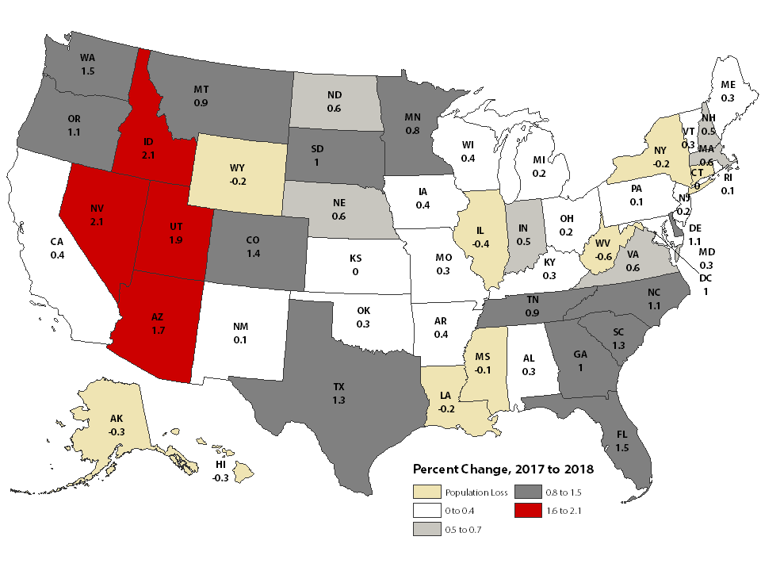
Population Change: 2017 to 2018
Source: U.S. Census Bureau Vintage 2018 Population Estimates

Slide 6
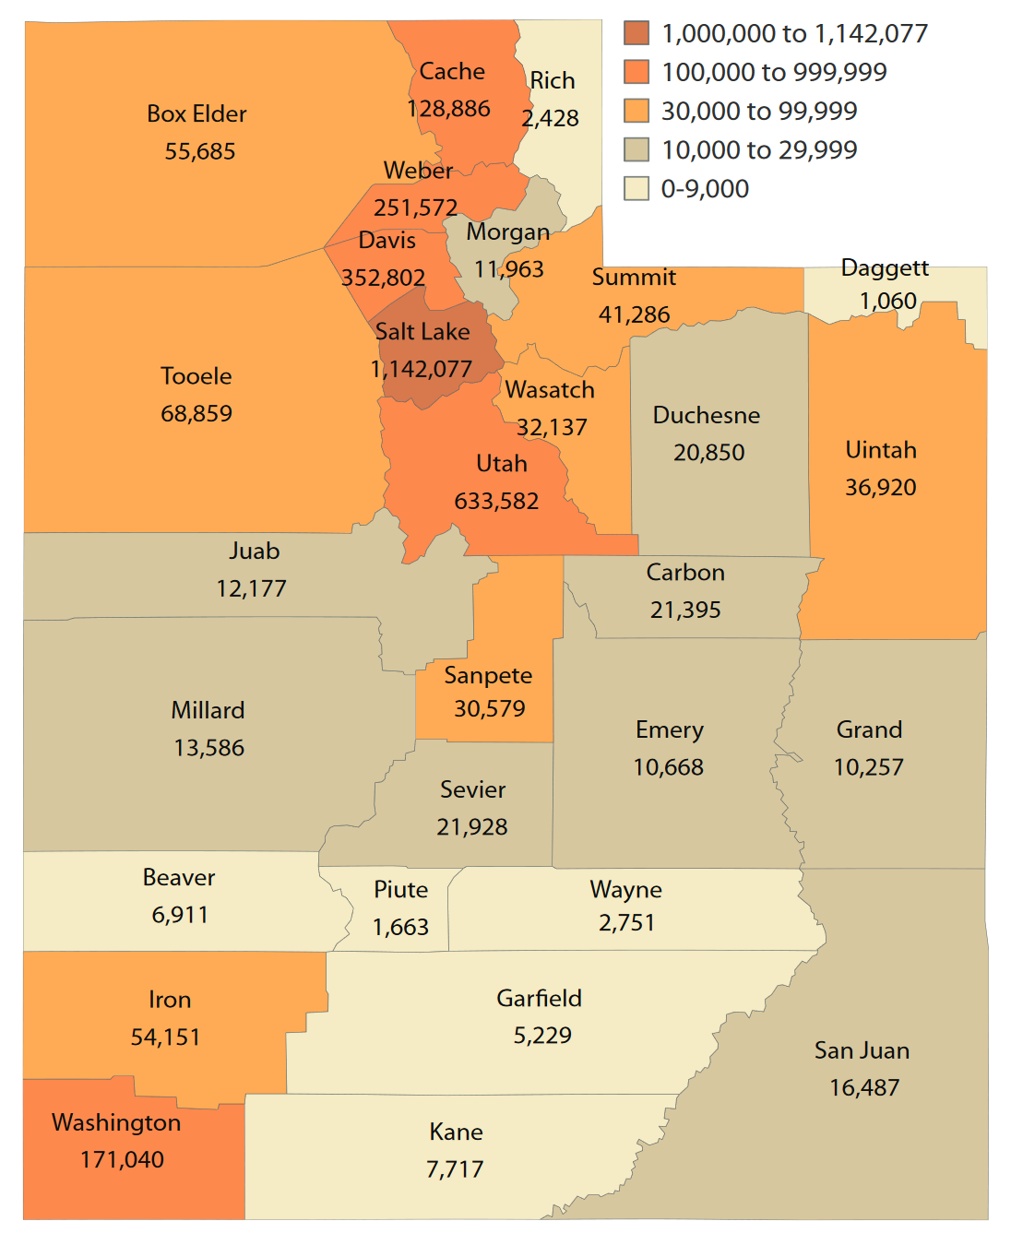
Utah Population by County: 2018
Source: Utah Population Committee

Slide 7
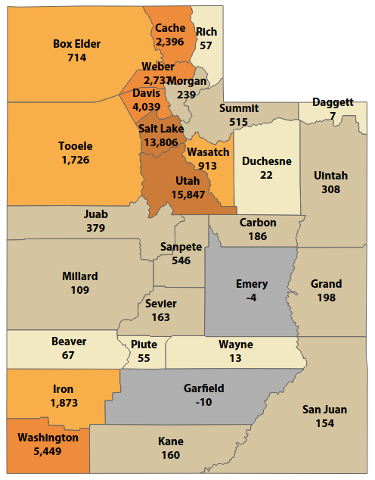
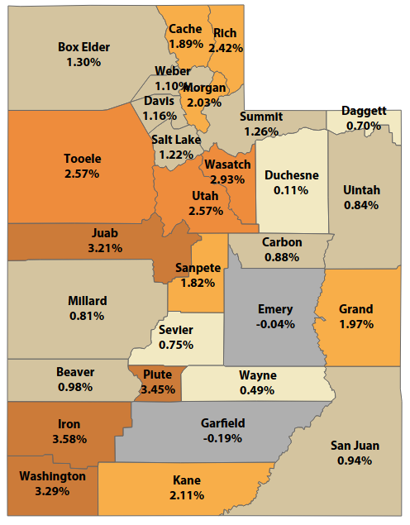
Utah Population Growth by County: 2017 to 2018
Absolute Growth
Percent Growth
Source: Utah Population Committee

Slide 8
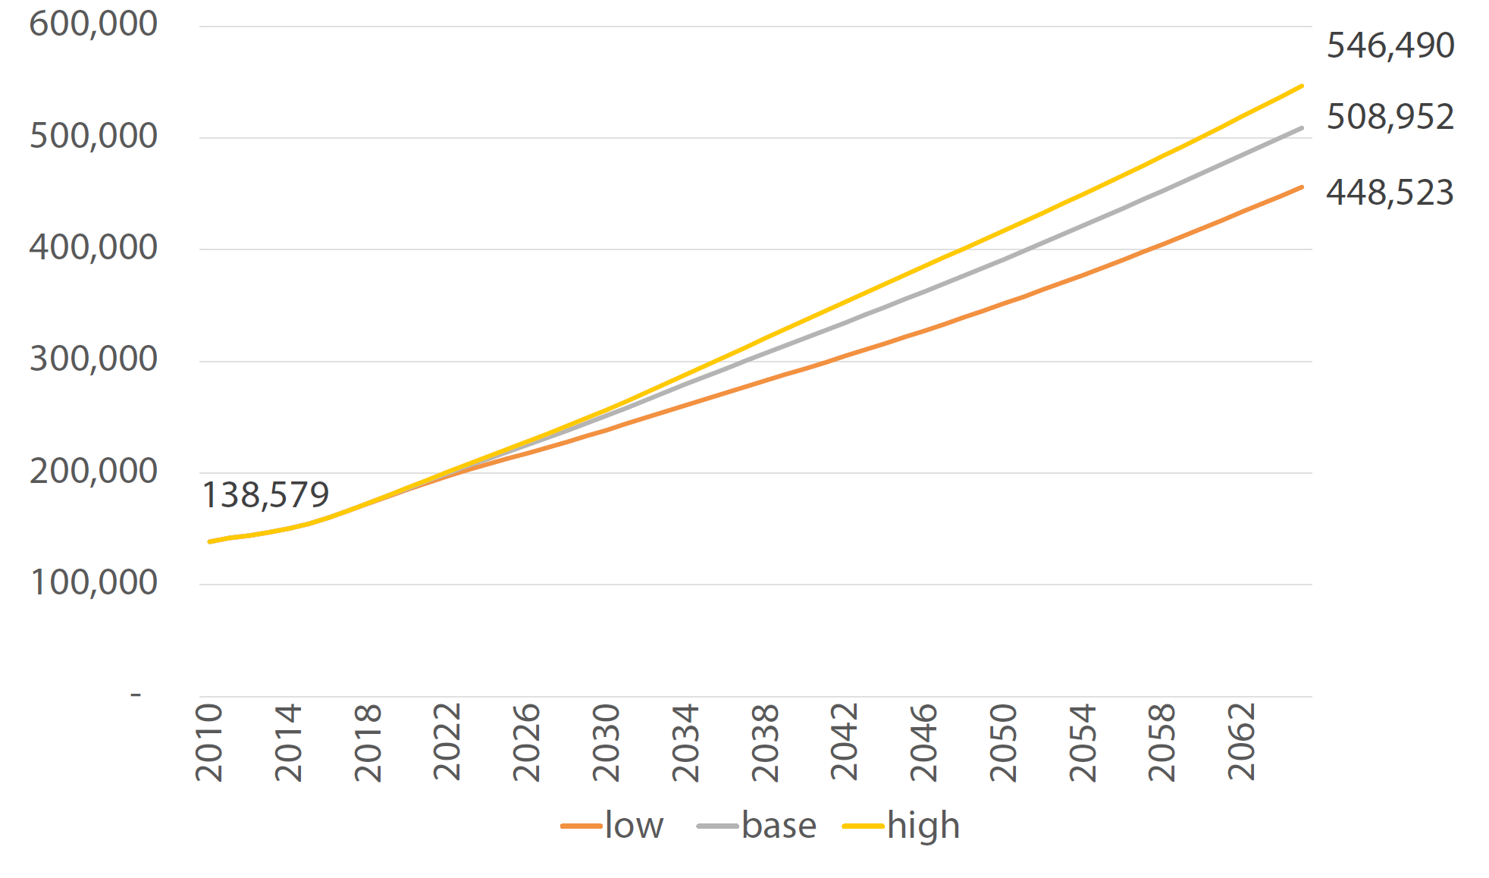
Washington County Population Scenarios
Source: Gardner Policy Institute

Slide 9
URBANIZATION

Slide 10
Urban Growth:
Utah is an Urban State with Urban Issues

Slide 11
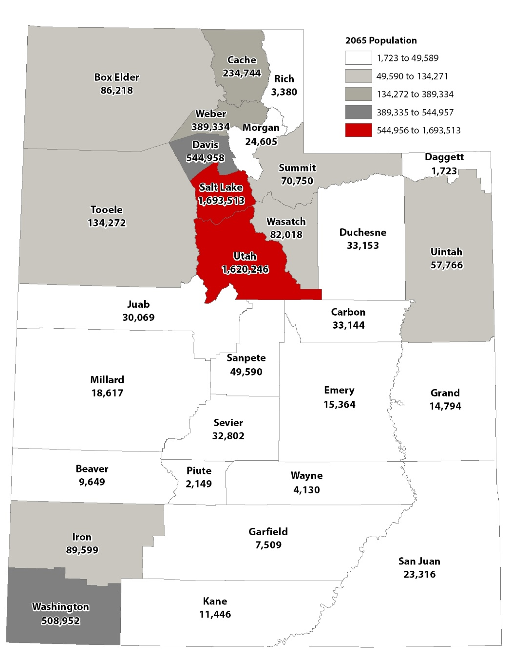
Total Population by County: 2065
Source: Kem C. Gardner Policy Institute 2015-2065 State and County Projections
Notes:
Not Updated

Slide 12
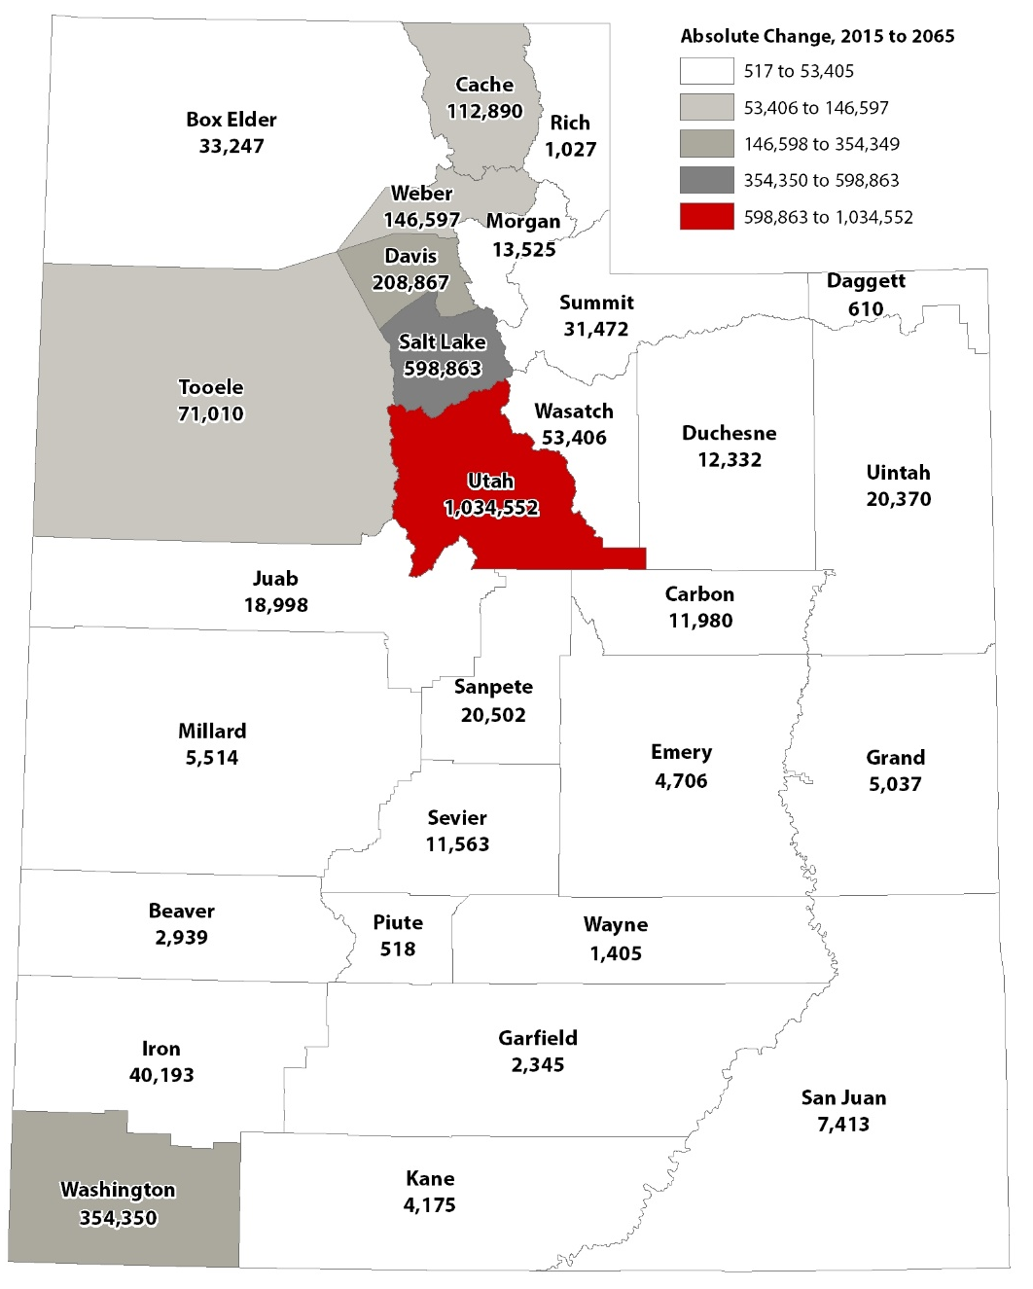
Absolute Population Change by County: 2015-2065
Source: Kem C. Gardner Policy Institute 2015-2065 State and County Projections
Notes:
Not Updated

Slide 13
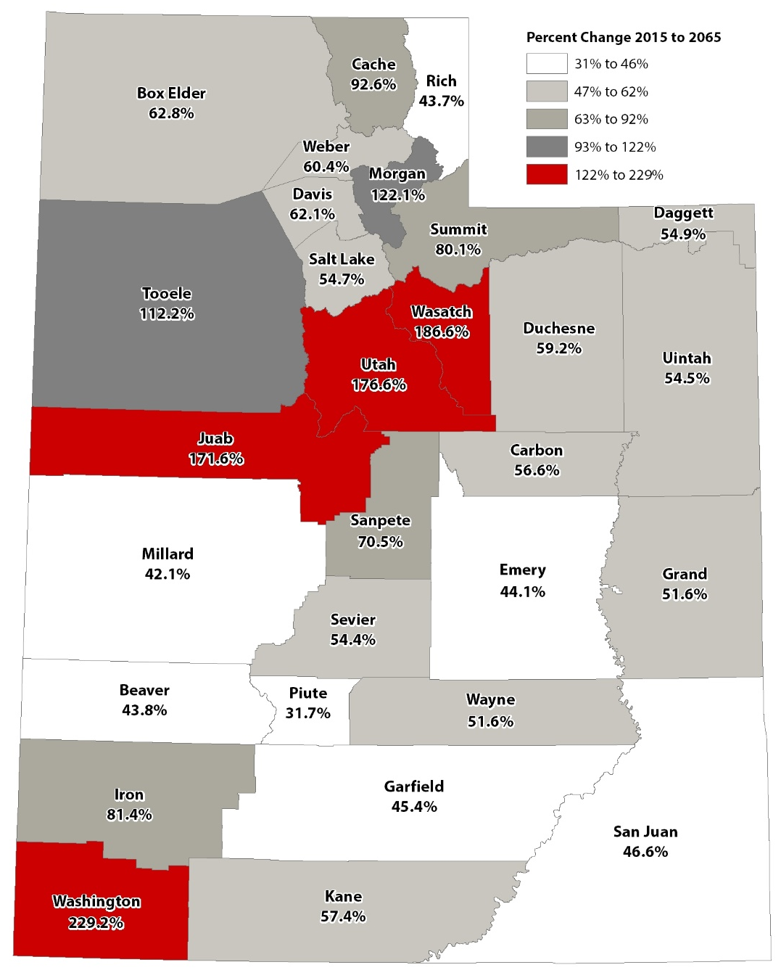
Percent Population Change by County: 2015-2065
Source: Kem C. Gardner Policy Institute 2015-2065 State and County Projections
Notes:
Not Updated

Slide 14
MIGRATION AS A DRIVER

Slide 15
Utah 10-Year Components of Population Change
Source: U.S. Census Bureau (1940-1950); Utah Population Estimates Committee (1960-2009); Utah Population Committee (2010-2017)

Slide 16
Utah Population Change 1990-2010
Sources: Kem C. Gardner Policy Institute analysis of U.S. Census Bureau data

Slide 17
Utah Foreign Born Population, Recent Arrivals by Region of Birth
.
Sources: U.S. Census Bureau (2000) and American Community Survey 5-Year Estimates; Kem C. Gardner Policy Institute Calculations.
Note: for 2000, entered 1990 to March 2000; for 2007-20122, entered 2000 or later; for 2012-2016, entered 2010 or later

Slide 18
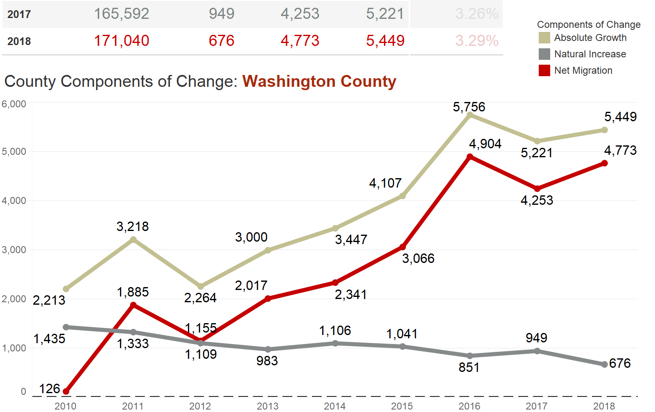
Source: Utah Population Committee 2018 Estimates

Slide 19
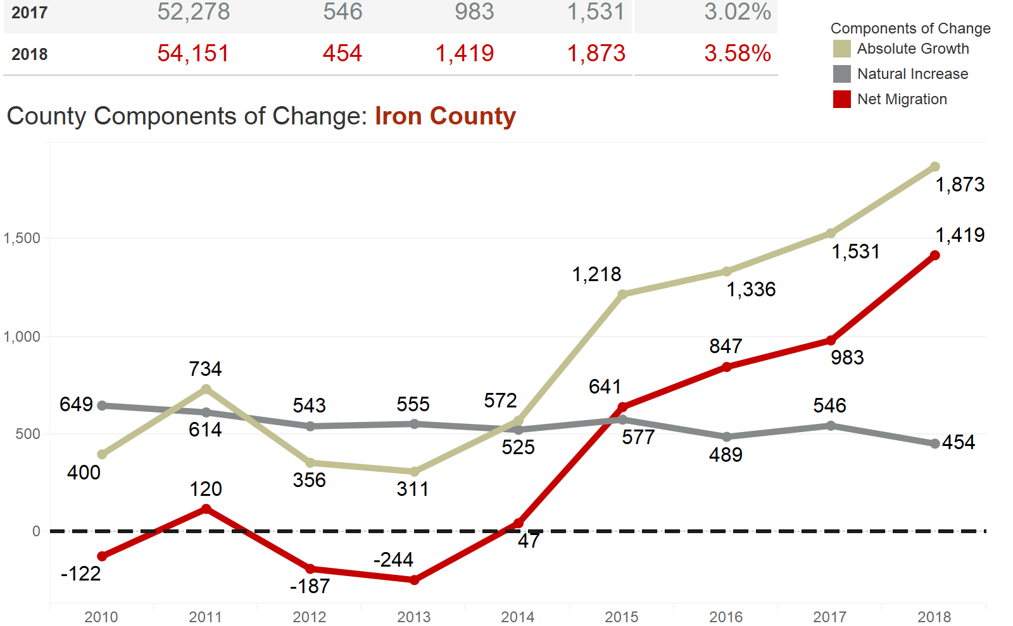
Source: Utah Population Committee 2018 Estimates

Slide 20
Sources: Kem C. Gardner Policy Institute 2017 Baseline State Projections, UPEC and UPC estimates.

Slide 21
Washington County:
Migration Over Time
Source: Winkler, R. 2013. County Specific Net Migration by five-year age groups, Hispanic Origin, Race, and Sex 2000-2010. CDE Working Paper NO. 2013-04
Notes:
Fix Graph

Slide 22
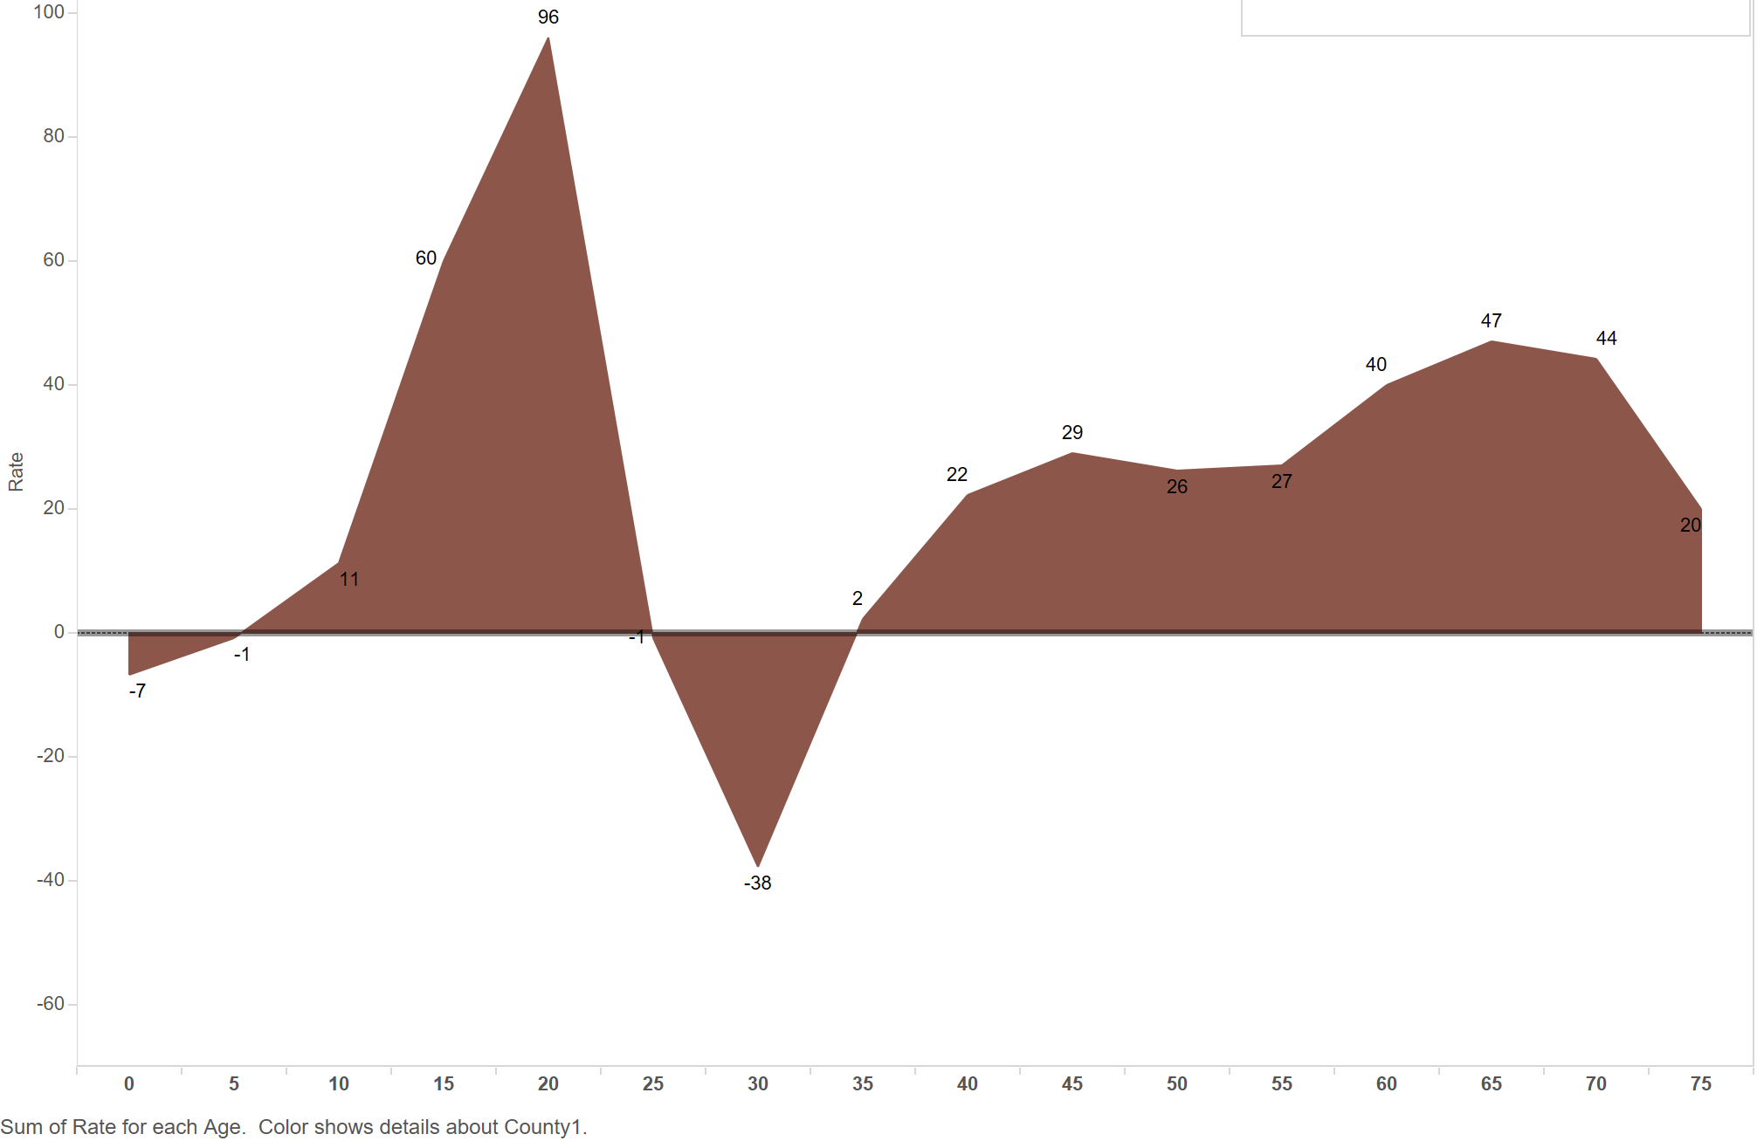
Iron County Migration by Age
Source: Winkler, R. 2013. County Specific Net Migration by five-year age groups, Hispanic Origin, Race, and Sex 2000-2010. CDE Working Paper NO. 2013-04

Slide 23
WASHINGTON COUNTY:
SINGLE FAMILY HOMES DOMINATE

Slide 24
Washington County Residential Permits, 2000 - 2018
Source: Ivory-Boyer Construction Database

Slide 25
City Residential Permits, 2000 - 2018
Source: Ivory-Boyer Construction Database

Slide 26
Washington County: Composition of Residential Permits by Type, 2018
Source: Ivory-Boyer Construction Database

Slide 27
Top 10 Cities Ranked by Detached Single-Family Permits, 2010 - 2018
Source: Ivory-Boyer Construction Database

Slide 28
AGING POPULATION

Slide 29
Utah Population Pyramid: 1960, 2015, & 2065
Note: The top age group for 1960 is 85+
Sources: U.S. Census Bureau, Utah Population Committee, Kem C. Gardner Policy Institute State Projections

Slide 30
Washington: 2000
Note: The top age group for 1960 is 85+
Sources: U.S. Census Bureau

Slide 31
Washington County: 2010 & 2065
Sources: U.S. Census Bureau, Kem C. Gardner Policy Institute State and County Projections

Slide 32
Note: The top age group for 1960 is 85+
Sources: U.S. Census Bureau

Slide 33
WASHINGTON COUNTY:
Growth and Change

Slide 34
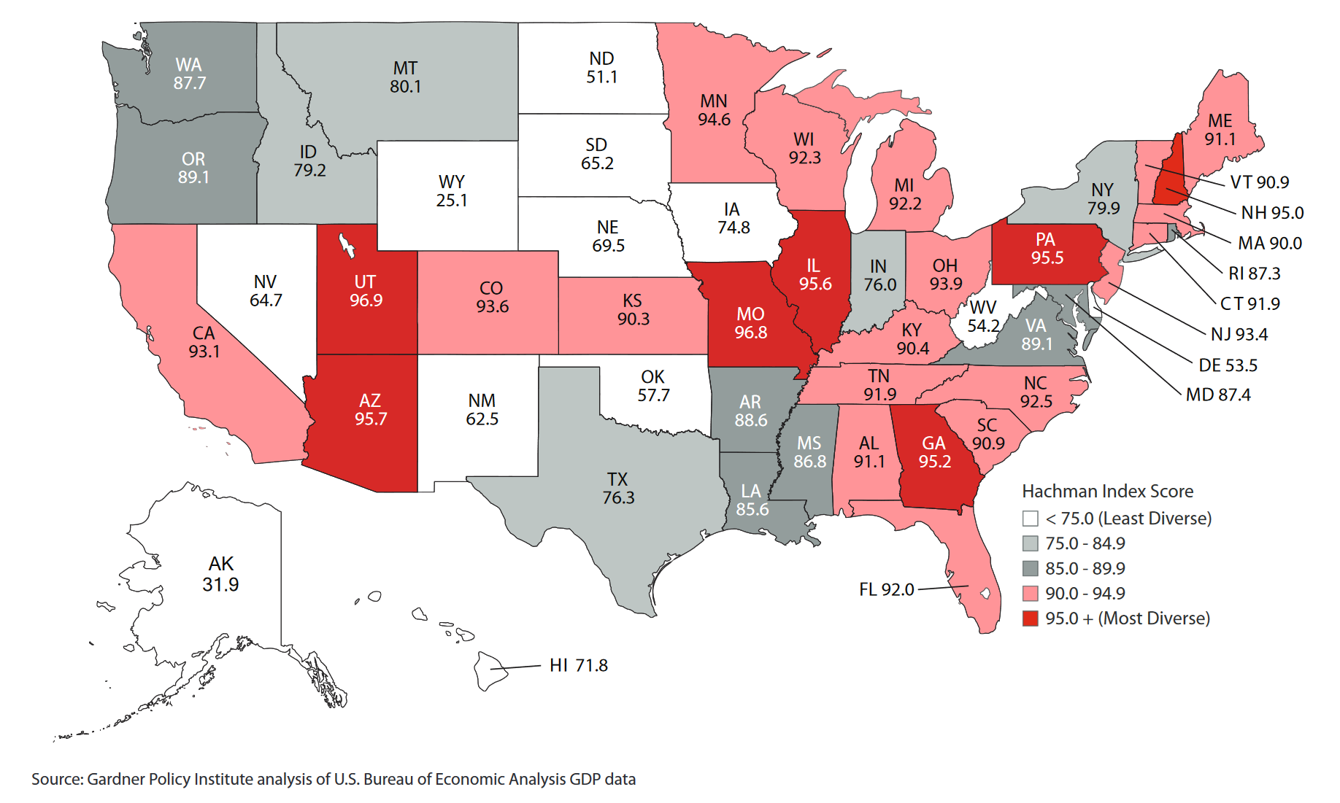
Hachman Index for States, 2017

Slide 35
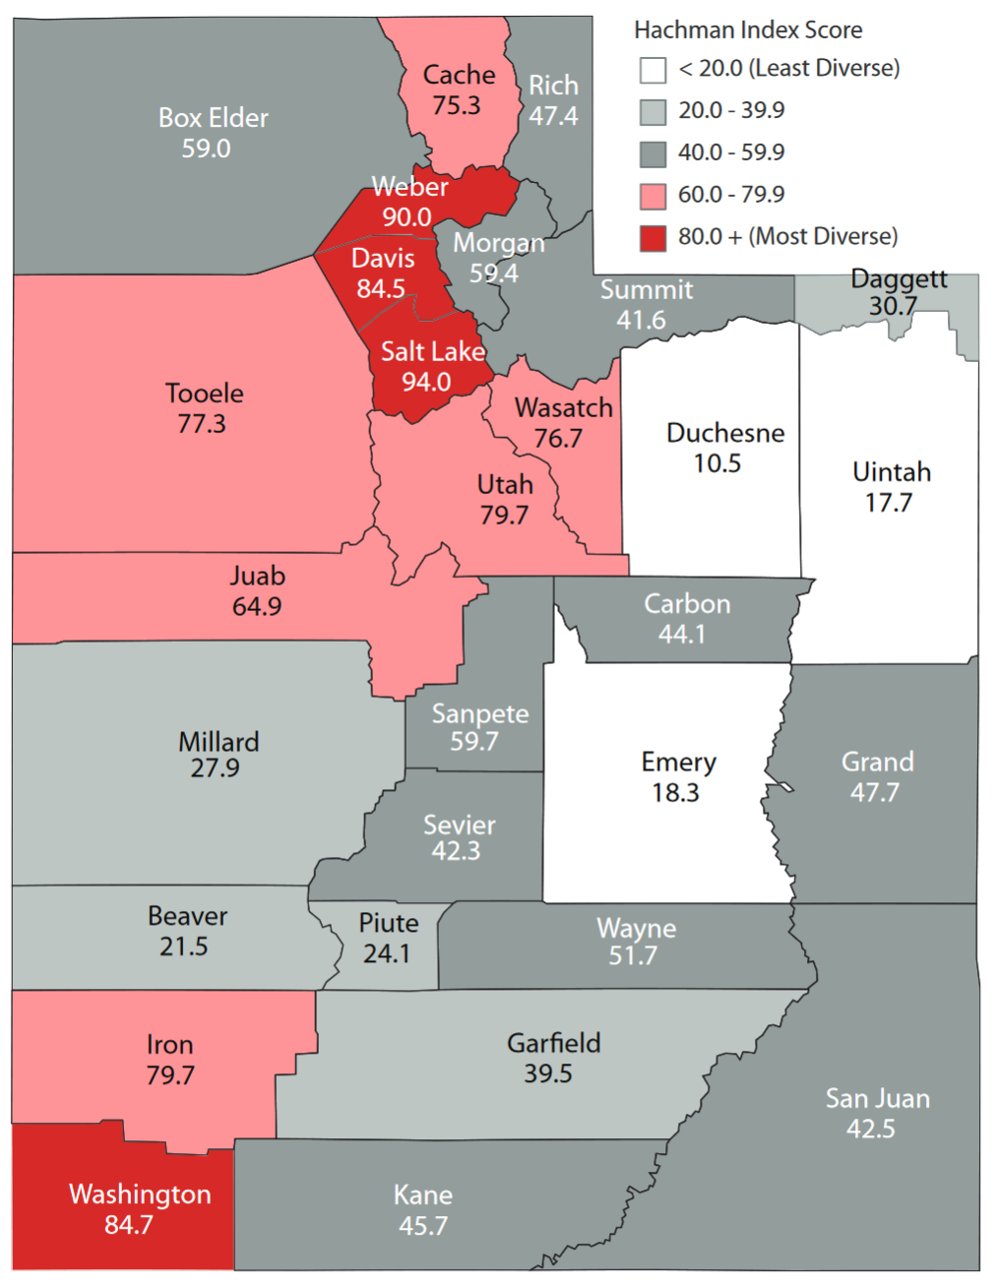
Hachman Index for Counties, 2017

Slide 36
Washington County Location Quotients
Source: Kem C. Gardner Policy Institute analysis of BEA data.

Slide 37
WASHINGTON COUNTY:
PLANNING & RESOURCE CHALLENGES

Slide 38
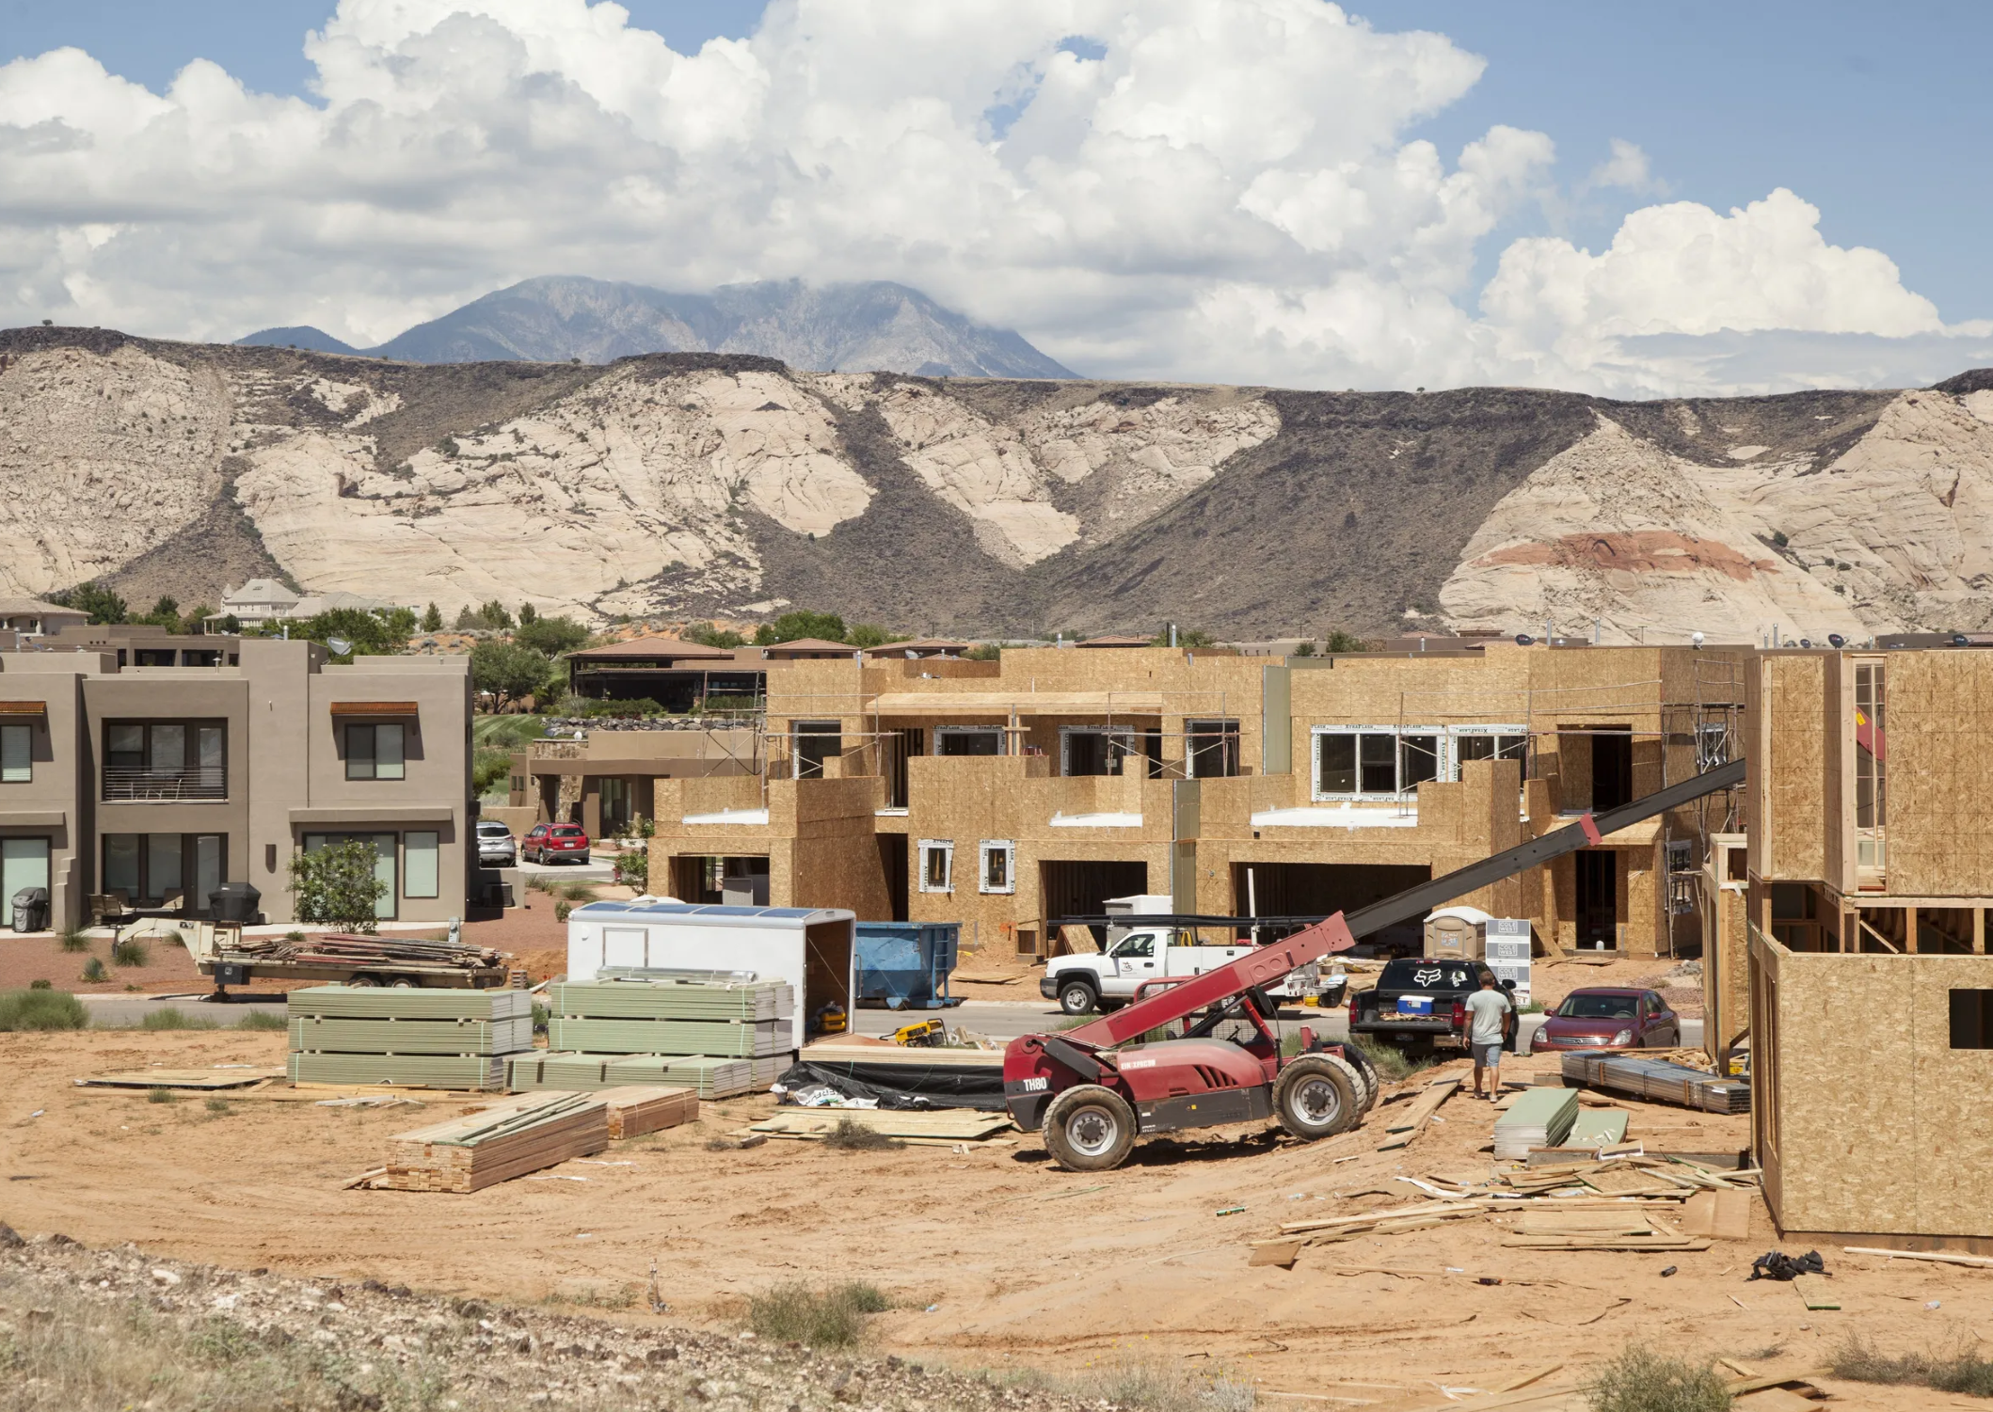
Source: The Spectrum

Slide 39

Source: https://www.wcwcd.org/

Slide 40

Notes:
Updated

