Slide 1


Utah’s Defense Sector:
Economic Impacts of the
Military and Veterans
June 7, 2017
Salt Lake Chamber Military Affairs Committee

Slide 2
Outline
Study Methods
Economic Impacts
Fiscal Impacts
Historical Trends
Hill AFB Forecast and Simulation
Economic Context

Slide 3

Measuring Economic Impacts
What would happen to Utah’s economy if an activity ceased to exist?
Notes:
FOCUS ON MONEY COMING IN FROM OUT OF THE REGION…

Slide 4
Measuring Economic Impacts
Economic indicators we measure:
JOBS
EARNINGS
STATE GDP

Slide 5

Measuring Economic Impacts
DIRECT
activity
+
INDIRECT activity
+
INDUCED
activity
=
TOTAL
ECONOMIC
IMPACT

Slide 6



Measuring Economic Impacts
DIRECT Employment
Input Industries
INDIRECT Employment
Consumer
Industries
INDUCED
Employment
Notes:
ATK, Lockhead Martin, Northrop Grunman

Slide 7
Data Collection and Analysis
Meetings at installations
Detailed jobs, payroll and spending
Federal defense contracts
REMI economic model
Fiscal impact models
Notes:
Meetings: Col. McCreary and Kathy Anderson, Mark McLeod, Col. Kirschner, Maj. Gen. Burton, John Edwards
Other contacts: Kari Tilton, Jill Atwood, LTC Steven Smith at USU
38 contacts

Slide 8
Economic Impact Results
Hill Air Force Base
Dugway Proving Ground
Tooele Army Depot
Utah National Guard
Reserves, Recruiting and ROTC
Veterans
Additional Contracts and Grants
Utah Defense Totals

Slide 9
Combined Economic Impact of Defense in Utah:
109,000 jobs and $9.2 billion in economic activity
Defense was responsible for
5.8% of Utah’s jobs,
7.1% of its earnings, and
6.2% of its GDP in 2015.
Table 1: Economic Impact of Utah's Defense Sector, 2015 (Millions of Dollars)
Category | Impact
Jobs | 109,021
Earnings | $6,384.3
Gross Domestic Product | $9,212.7
Source: Gardner Policy Institute analysis, REMI PI+
Notes:
2015 economic impact summary by installation or other item to support the totals above. Contracts column includes grants. Reserves and recruiting do not include HAFB or Guard amounts included elsewhere. Millions of dollars
Category Hill Dugway Tooele Guard Veterans Contracts Grants Reserves Recruiting ROTC Total
Employment 47,341 2,479 1,164 13,176 24,480 12,980 655 5,895 652 200 109,021
Earnings $3,202.3 $175.9 $75.0 $477.3 $1,437.8 $779.6 $37.2 $152.1 $36.2 $10.9 $6,384.3
GDP $4,569.8 $225.0 $113.8 $841.9 $1,891.9 $1,179.1 $51.4 $262.9 $58.6 $18.3 $9,212.7

Slide 10
Hill Air Force Base supported over 47,000 jobs and about $4.6 billion in GDP for Utah in 2015.
Table 2: Statewide Impacts of Hill Air Force Base, 2015 (Millions of Dollars)
Category | Direct Federal* | Indirect & Induced | Total
Jobs | 16,732 | 30,609 | 47,341
Earnings | $1,825.2 | $1,377.1 | $3,202.3
Gross Domestic Product |  |  | $4,569.8
* Does not include jobs of contract civilian or private businesses on base. These are included in the indirect and induced jobs.
Source: Kem C. Gardner Policy Institute analysis using the REMI PI+ model (see Table 2.3 on p. 11 of the report)
Hill AFB employed 16,732 military personnel and DoD civilians.
Including contractors, nearly 20,000 people worked on base.
Hill AFB spent $2.1 billion in Utah during 2015, including
employee earnings, DoD contracts, and other expenses.
Notes:
19,970 worked on base: 16,732 military and DoD civilian + 3,238 contractors etc.
This includes 18 off-site recruiters in the 368th Squadron.
Sources: response to information request, meetings and follow-up conversations and emails; HAFB Economic Impact Statement; FPDS/USAspending for DoD prime and sub contracts from Hill

Slide 11
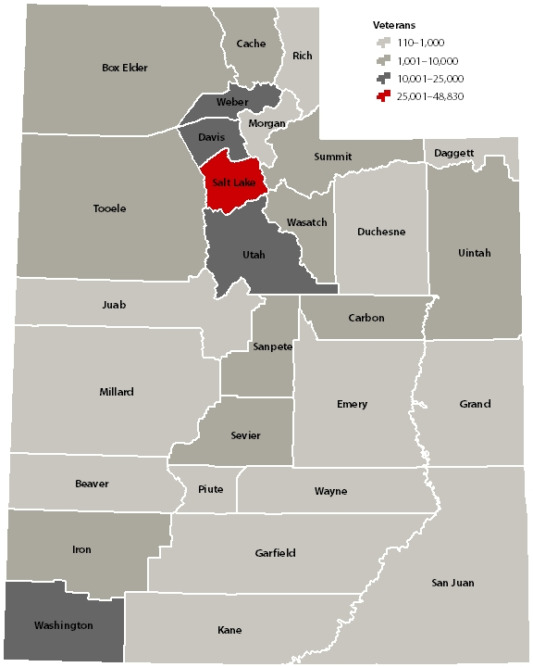
Utah Veterans
Items included:
Veteran compensation
Veteran benefits
Military pensions
VA employment
VA contracts & grants
Source: U.S. Department of Veterans Affairs,
U.S. Department of Defense, U.S. Census Bureau
(see Figure 7.1 on p. 22 of the report).
Notes:
Map is Figure 7.1 on p. 22 of report, and Table 7.2 on the following page, showing that every county had at least one 100 veterans and at least 1 military retiree.

Slide 12
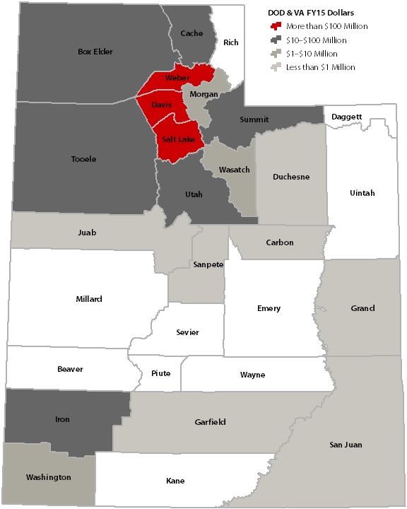
Defense Contracts and Grants in Utah
Amounts in 19 Counties
Top Three Counties:
Salt Lake – $831.4 million
Davis – $387.5 million
Weber – $111.5 million
Three Others Selected:
Summit – $15.3 million
Washington – $6.5m
San Juan – $259,000
Source: Gardner Policy Institute analysis, USASpending.gov (see Figure 8.2 on p. 28 of the report).
Notes:
Map is Figure 8.2 on p. 28 of report, and Table 8.3 on the following page, showing that 19 counties had at least one DOD or VA contract.

Slide 13
Top 10 Defense Contractors
Table 3: Ten Largest DoD and VA Contractors in Utah, FY 2015 (Millions of Dollars)
Company | Amount | Share
L-3 Communications | $334.6 | 22.1%
Orbital ATK | $240.7 | 15.9%
Northrop Grumman | $82.5 | 5.5%
Boeing | $36.8 | 2.4%
Utah State University | $32.7 | 2.2%
Rio Vista Management | $29.6 | 2.0%
Unisys Corp. | $29.6 | 2.0%
BioFire | $28.9 | 1.9%
ImSAR | $24.1 | 1.6%
Sverdrup Technology | $21.9 | 1.4%
Total | $861.5 | 56.9%
Note: Shares are of total FY15 DOD and VA contracts of $1.5 billion.
Source: Gardner Policy Institute analysis of data from USASpending.gov. (see Table 8.5 on p. 29 of the report)

Slide 14
Fiscal Impact Results

Slide 15
Fiscal Impacts: The defense sector directly and indirectly generated $146.3 million in net state revenue.
Table 4: State Fiscal Impacts of Utah's Defense Sector, 2015 (Millions of Dollars)
Category | Impact
Revenue | $387.7
Operating Expenditures | $232.4
Net State Revenue | $146.3
Source: Kem C. Gardner Policy Institute analysis. (see Table 2, p. 3 in report)

Slide 16
Components of $146.3 Million in Net State Revenue from the Defense Sector in 2015
Source: Figure 3 on p. 4 of the report.

Slide 17
Historical Trends in
Federal Defense Employment

Slide 18
Defense employment has been fairly stable in Utah for 15 years, with a slight decline in military personnel and a somewhat larger increase in civilian defense jobs.
Source: Bureau of Economic Analysis, Bureau of Labor Statistics
(see Figure 4 on p. 4 of the report or Figure 9.1 on p. 33).

Slide 19
Utah’s non-defense employment has grown faster than its defense employment.
Source: Bureau of Economic Analysis, Bureau of Labor Statistics
(see Figure 5 on p. 4 of the report or Figure 9.2 on p. 33).

Slide 20
Economic Impact of Hill Air Force Base through 2040:
Forecast and Simulation

Slide 21
Statewide Losses Without Hill AFB
Table 5: Statewide Economic, Demographic and Fiscal Impacts from Hill AFB Closure Scenario (Millions of Constant 2015 Dollars, Percent of State Total)
Category | 2023 |  | 2040
Employment | -35,678 | -1.7% | -28,712 | -1.1%
Earnings | -$2,926.5 | -2.6% | -$2,644.3 | -1.8%
GDP | -$3,899.5 | -2.1% | -$3,770.5 | -1.5%
Population | -30,616 | -0.9% | -53,830 | -1.2%
State Tax Revenue | -$155.5 | NA | -$172.8 | NA
State Expenditures | -$122.8 | NA | -$230.4 | NA
Source: Kem C. Gardner Policy Institute analysis (see report Table 10.1, p. 37).

Slide 22
Statewide employment without Hill AFB: more than 35,000 jobs in 2023 and 28,000 jobs in 2040.
Source: Gardner Policy Institute analysis using REMI PI+ model and Utah GOMB 2012
baseline employment projections (see Figure 10.1 on p. 37 of the report).

Slide 23
Losses in Davis County Without Hill AFB
Table 6: Davis County Economic, Demographic and Fiscal Impacts of Hill AFB Closure Scenario (Millions of Constant 2015 Dollars, Percent of County Total)
Category | 2023 |  | 2040
Employment by Place of Residence | -20,004 | -9.4% | -19,077 | -7.9%
Earnings by Place of Residence | -$1,670.6 | -13.5% | -$1,799.9 | -11.3%
GDP | -$2,877.3 | -17.7% | -$2,899.7 | -13.4%
Population | -20,604 | -5.6% | -40,594 | -9.5%
State Tax Revenue | -$39.1 | NA | -$47.9 | NA
State Expenditures | -$13.4 | NA | -$34.7 | NA
Source: Kem C. Gardner Policy Institute analysis (see report Table 10.7, p. 41).

Slide 24
Davis County employment without Hill AFB:
20,000 jobs in 2023, 19,000 jobs in 2040
Source: Gardner Policy Institute analysis using REMI PI+ model (see Figure 10.8 on p. 41 of the report).

Slide 25
For the report PDF and to contact researchers…
  “Utah’s Defense Sector: Economic Impacts of the Military and Veterans” by John Downen and Levi Pace, Kem C. Gardner Policy Institute,
  March 2017, 45 pages
  http://gardner.utah.edu/wp-content/uploads/DefenseReportFinal.pdf
  Research team contact information:
  Juliette Tennert, Director, 801-581-3362, juliette.tennert@utah.edu
  John Downen, Author, 801-581-3366, john.downen@utah.edu
  Levi Pace, Author, 801-587-9890, levi.pace@utah.edu

Slide 26

Utah Defense Alliance
450 Simmons Way, Suite 400 | Kaysville, UT 84037-0967
801-593-2113 | www. utahdefensealliance.com
Kem C. Gardner Policy Institute
David Eccles School of Business | 411 E. South Temple Street
Salt Lake City, UT 84111 | 801-585-5618 | gardner.utah.edu
Facebook.com/gardnerpolicyinstitute | Twitter.com/KemGardnerInst | LinkedIn

Slide 27
Additional Slides
Details on direct, indirect and induced economic impacts for each defense component, similar to the slide for Hill AFB with Table 2.

Slide 28
Dugway Proving Ground supported nearly
2,500 jobs and $225 million in GDP for Utah.
Table 7: Statewide Impacts of Dugway Proving Ground, 2015 (Millions of Dollars)
Category | Direct Federal* | Indirect & Induced | Total
Jobs | 689 | 1,790 | 2,479
Earnings | $78.9 | $96.9 | $175.9
Gross Domestic Product |  |  | $225.0
* Does not include jobs of contract civilians or private businesses on base. These are included in the indirect and induced jobs. Source: Kem C. Gardner Policy Institute analysis using the REMI PI+ model (see Table 3.3 on p. 14 of the report)
Dugway Proving Ground employed 689 people and
spent an estimated $135.1 million in Utah during 2015.
Including contractors, over 1,500 people worked on base.
Notes:
At Dugway Proving Ground…
1,545 worked on base = 689 military and DoD civilian + 856 permanent contractors
Sources: response to information request, on-site meetings and follow-up communication; RIAC fact sheet; FPDS/USAspending for prime and sub contracts from Dugway

Slide 29
Tooele Army Depot supported 1,100 jobs and
$114 million in GDP for Utah in 2015.
Table 8: Statewide Impacts of Tooele Army Depot, 2015 (Millions of Dollars)
Category | Direct Federal | Indirect & Induced | Total
Jobs | 550 | 614 | 1,164
Earnings | $41.0 | $34.0 | $75.0
Gross Domestic Product |  |  | $113.8
Source: Kem C. Gardner Policy Institute analysis using the REMI PI+ model (see Table 4.3 on p. 15 of the report)
Tooele Army Depot employed 550 people and
spent $56.8 million in Utah during 2015.
Notes:
TEAD’s budget was $63.8 million, but not all of that was spending in Utah. Our estimate of Utah payroll and non-payroll spending is $56.8 million.
Sources: response to information request, including contracts; on-site meeting and follow-up communication; TEAD Fast Facts

Slide 30
The Utah National Guard supported over 13,000 jobs and $840 million in GDP for Utah in 2015.
Table 9: Statewide Impacts of the Utah National Guard, 2015 (Millions of Dollars)
Category | Direct Federal | Indirect & Induced | Total
Jobs | 9,280 | 3,896 | 13,176
Earnings | $245.7 | $231.6 | $477.3
Gross Domestic Product |  |  | $841.9
Source: Kem C. Gardner Policy Institute analysis using the REMI PI+ model (see Table 5.3 on p. 18 of the report)
The Utah National Guard employed 2,383 people
full-time, as well as 6,897 Guard members, in 2015.
The Guard spent an estimated $251.3 million in-state.
Notes:
The UTNG Annual Report for 2015 gives $279 million in payroll, somewhat higher than our $257 million earnings figure based on detailed payroll information provided by the Guard for this study. Our LTC contact there advised us to proceed with $257 million as an input to the economic model.
Sources: detailed response from the Guard to our information request, on-site meeting, follow-up conversations; UTNG annual report; FPDS/USAspending.gov for DoD and VA contracts from UTNG

Slide 31
Reserves, recruiting, and ROTC supported over 6,700 jobs and $340 million in GDP for Utah in 2015.
Table 10: Economic Impacts of Reserves, Recruiting and ROTC, 2015 (Millions of Dollars)
Category | Direct Federal | Indirect & Induced | Total
Jobs | 4,462 | 2,284 | 6,746
Earnings | $73.7 | $125.5 | $199.2
Gross Domestic Product |  |  | $339.8
Note: This slide does not include 1,128 military and 214 civilian reserve employees at Hill AFB or 106 military and 6 civilian recruiters at Hill AFB and the Utah National Guard. They are all included in Hill and Guard impacts, respectively. Source: Kem C. Gardner Policy Institute analysis using the REMI PI+ model (see report, Table 6.2, p. 11 for reserves; Table 6.5, p. 20 for recruiting, Table 6.9, p. 21 for ROTC)
Reserves: 3,978 reservists and active-duty, 185 civilians
Recruiting: 183 military and 47 civilians
ROTC: 54 military and 15 civilians
Notes:
Sources: detailed response from the Guard to our information request, on-site meeting, follow-up conversations; UTNG annual report; FPDS/USAspending.gov for DoD and VA contracts from UTNG

Slide 32
Federal spending for veterans in Utah supported
24,000 jobs and $1.9 billion in GDP for Utah in 2015.
Table 11: Economic Impacts of Federal Spending for Veterans in Utah, 2015 (Millions of Dollars)
Category | Impact
Jobs | 24,480
Earnings | $1,437.8
Gross Domestic Product | $1,891.9
Source: Gardner Policy Institute analysis using REMI PI+ model (see Table 7.6 on p. 25 of the report)
During 2015, the VA employed 3,010 people in Utah. VA and DoD spending for Utah veterans was $1.8 billion, including employee earnings, health care, pensions for veterans and military retirees, federal contracts & grants, and other expenditures.
Notes:
Below are details of the direct effects (the 3,010 VA employees and $1.8 billion in transfers and other spending
Impact Amount (millions of dollars)
Direct Employment (jobs) 3,010 (total of the next two rows)
VA SLC Health Care System 2,365
VA Regional Benefit Office 645
Total Compensation $284.3
Total VA Transfer Payments $579.8
DoD military pensions $430.4
Construction Expenditures $3.5
Medical Care Expenditures $475.8
VA Grants to UT Recipients $24.2
Sources: employment and payroll from VA regional benefits office and Salt Lake City Health Care System, federal contracts and grants from USAspending.gov; military pension amounts including survivor pensions from the DoD Actuary
File for table: “impacts” tab of “VA Expenditure Impacts.xlsx”

Slide 33
Additional contracts and grants supported 13,600 jobs and $1.2 billion in GDP for Utah in 2015.
Table 12: Economic Impacts of Other Contracts and Grants to Utah Recipients, 2015 (Millions of Dollars)
Category | Impact
Jobs | 13,635
Earnings | $816.8
Gross Domestic Product | $1,230.4
Only includes DoD and VA contracts and grants that were not included in the analysis for veterans, Utah National Guard, or any military installation. Source: Kem C. Gardner Policy Institute analysis using the REMI PI+ model (see report, Table 8.9, p. 30 for grants; Table 8.13, p. 32 for contracts)
The DoD and VA provided $891.4 million in contracts and grants to Utah recipients in 2015, in addition to those included in economic impacts for veterans, the Guard or any Utah military installation.
Notes:
In 2015 the DoD and VA issued $860.8 million in “non-installation contracts” to Utah recipients, apart from contracts from those already counted on the previous slides.
Also, the DoD provided $30.6 million in grants to Utah recipients; this figure excludes over $30 million in grants to the Utah National Guard, which are included in its economic impacts.
The Department of Veterans Affairs (VA) awarded grants in Utah as well, $24.2 million; that amount is included on veterans page, not here.
Source: USAspending.gov for federal contracts and grants from DoD and VA

