Slide 1

What would a Marshall Plan for rural Utah look like?

Slide 3
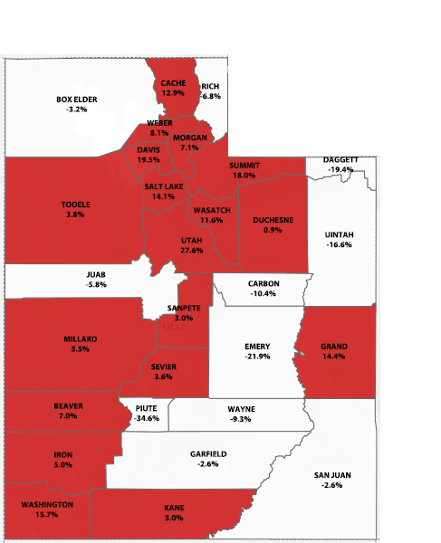
A Tale of Two Utahs
Employment change, Q4 2007 – Q4 2016
Increase
Decrease
Source: Utah Dept. of Workforce Services

Slide 4
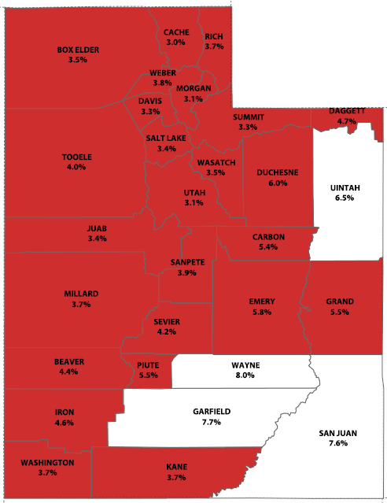
Unemployment Rates by County
June 2017
Below 6.5%
6.5% or higher
Source: Utah Dept. of Workforce Services

Slide 5
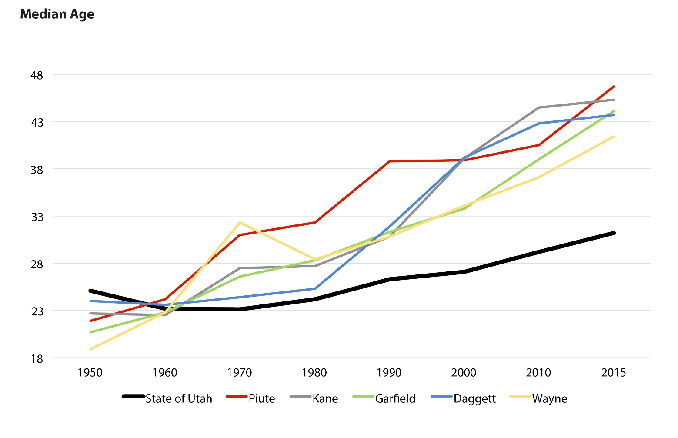
The Aging of Rural Utah
Source: U.S. Census Bureau

Slide 6
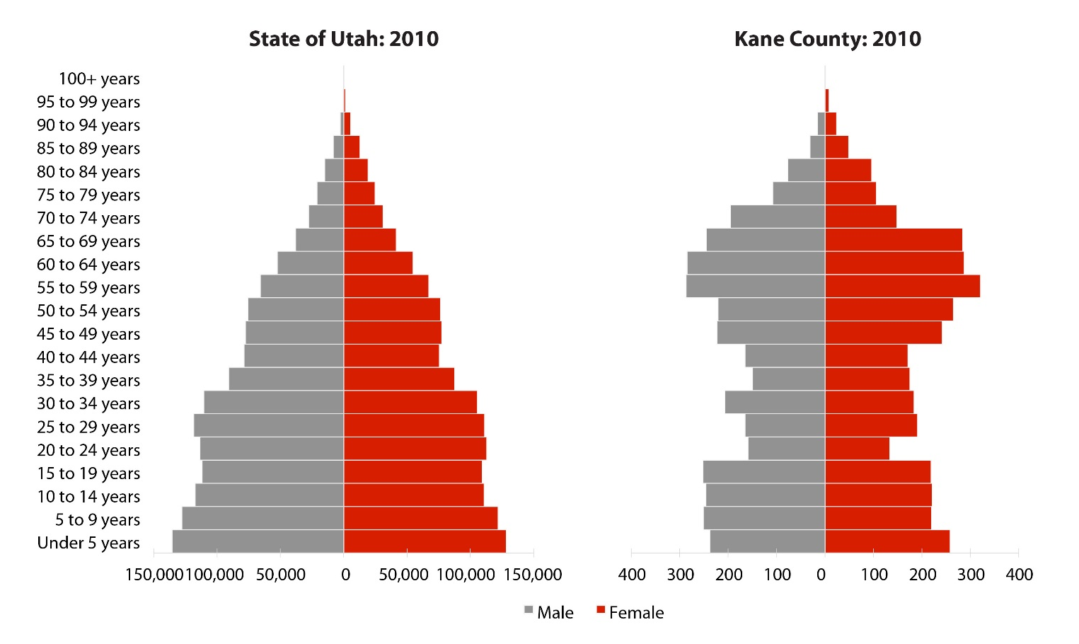
Demography is Destiny
Source: U.S. Census Bureau

Slide 7
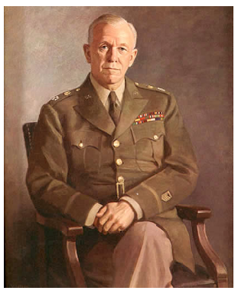
General George Marshall

Slide 8
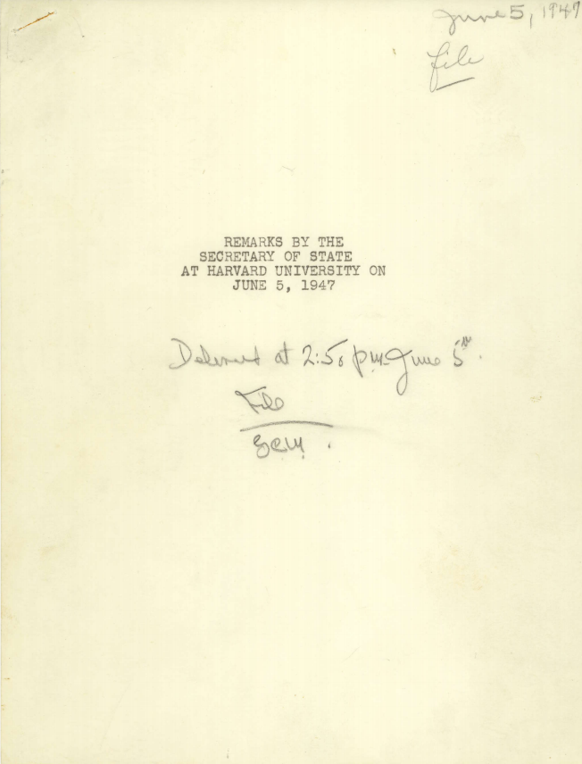
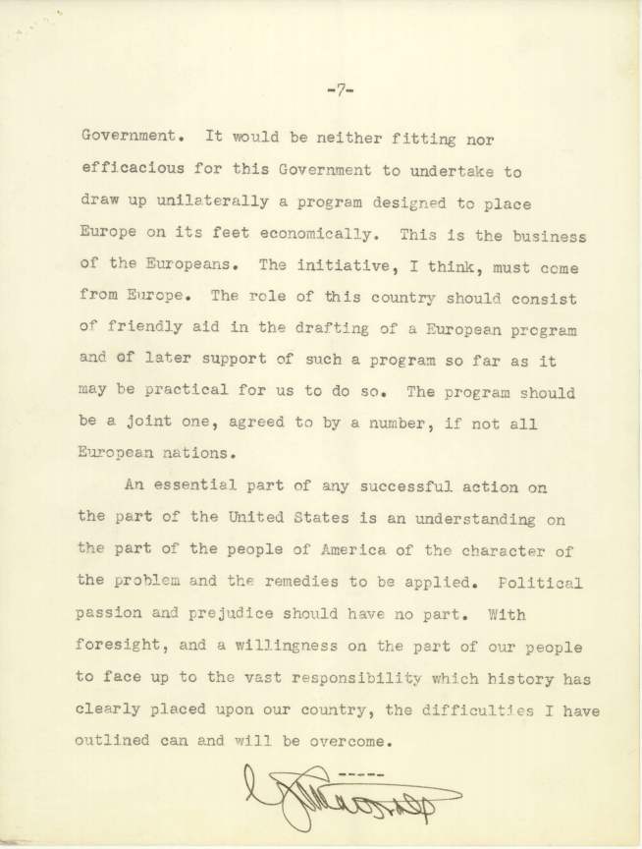
Harvard Speech Announcing the Marshall Plan

Slide 9
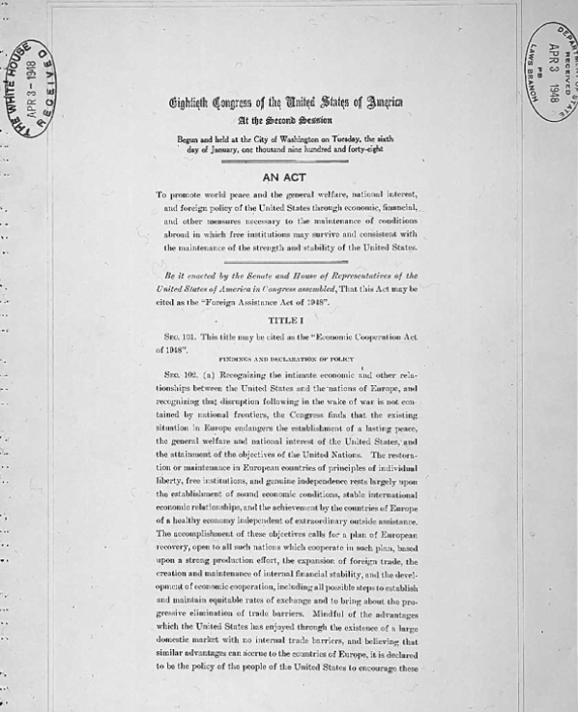
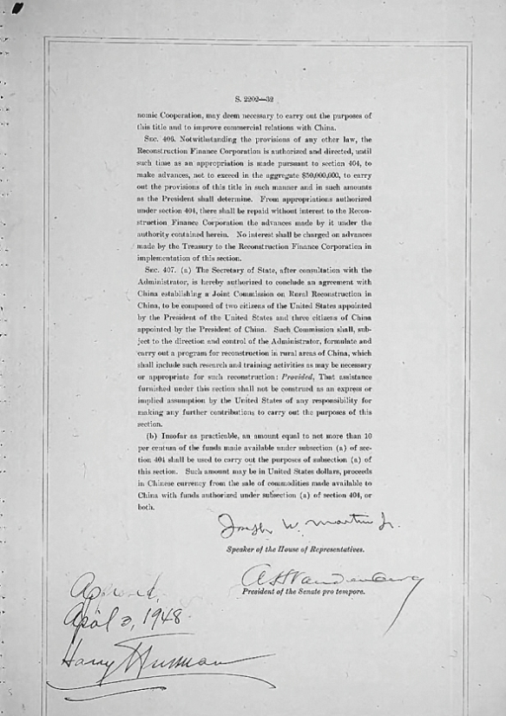
Marshall Plan Made Into Law

Slide 10
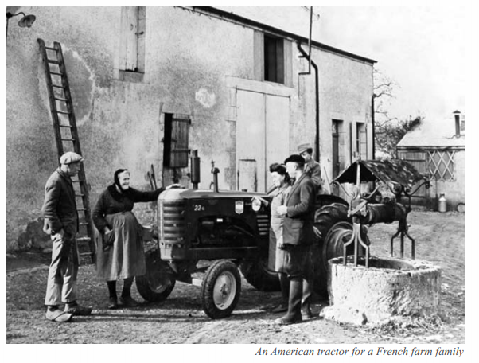
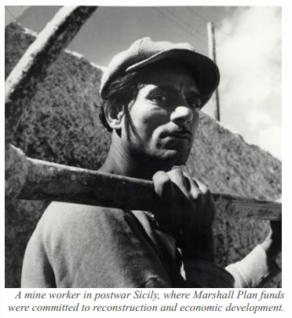

Slide 11
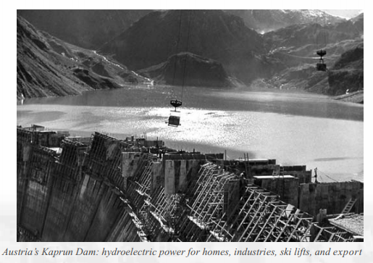
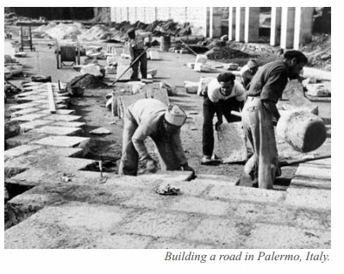
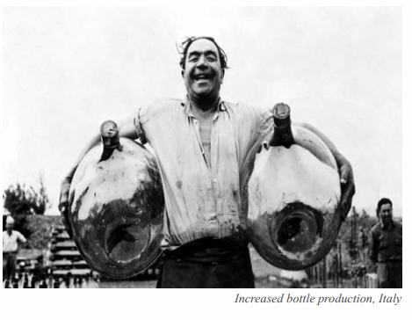
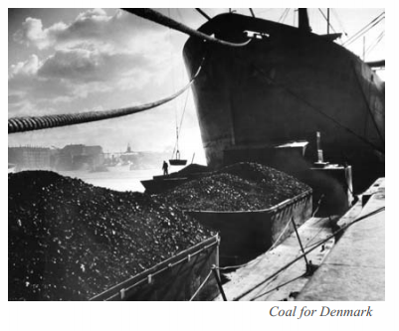

Slide 12
What would an investment plan for rural Utah that is inspired by the Marshall Plan look like?

Slide 24
Key Components
Vision
Unity
Smart investment
Public communications

