Slide 1
Utah’s Long-Term
Demographic and Economic Projections, 2015-2065
Notes:
Updated

Slide 2
State-Level Results
Notes:
Updated

Slide 3
Utah Population Pyramid: 2015 & 2065
Source: Kem C. Gardner Policy Institute 2015-2065 State and County Projections
Notes:
Updated

Slide 4
Total Population with Million Markers
2050
2032
Notes:
Updated

Slide 5
Utah Population Growth Projections:
2015-2065
Notes:
Updated

Slide 6
Utah Population & Growth Projections by Decade: 2015-2065
Notes:
Updated

Slide 7
Projected Percent Growth by Decade:
Utah and the United States
Notes:
Updated

Slide 8
Historical & Projected Total Fertility Rates: Utah vs United States
Notes:
Updated

Slide 9
Historical & Projected Utah Life Expectancy: Males and Females
Notes:
Updated

Slide 10
State of Utah Components of Change: Historical and Projected
Notes:
Updated

Slide 11
Selected Age Groups as a Percent of Total Population: 2015-2065
Source: Kem C. Gardner Policy Institute 2015-2065 State and County Projections
Notes:
Updated

Slide 12
Utah Projected Dependency Ratios: 2015-2065
Notes:
Updated

Slide 13
Aging Baby Boomer Drive Increase in Total
U.S. Dependency Ratios:
1970-2060
Source: Kem C. Gardner Policy Institute analysis of U.S. Census Bureau Decennial Census and Population Division data and Kem C. Gardner Policy Institute
Note: Dependency Ratios are computed as the number of nonworking age persons per 100 working age (18-64 year old) persons in the population. Youth are less than 18 years old and retirement age is 65 years and older.
Notes:
Updated

Slide 14
Youth Dependency Ratios Decline and Stabilize
Utah Dependency Ratios:
1970-2060
Source: Kem C. Gardner Policy Institute analysis of U.S. Census Bureau Decennial Census data and Kem C. Gardner Policy Institute
Note: Dependency Ratios are computed as the number of nonworking age persons per 100 working age (18-64 year old) persons in the population. Youth are less than 18 years old and retirement age is 65 years and older.
Notes:
Updated

Slide 15
Historical and Projected Total Employment Growth (%): Utah & U.S.
Sources: Kem C. Gardner Policy Institute 2015-2065 State and County Projections; U.S. Bureau of Economic Analysis (BEA) & U.S. Bureau of Labor Statistics (BLS) historical employment data
Notes:
Updated

Slide 16
County-Level Results
Notes:
Updated

Slide 17
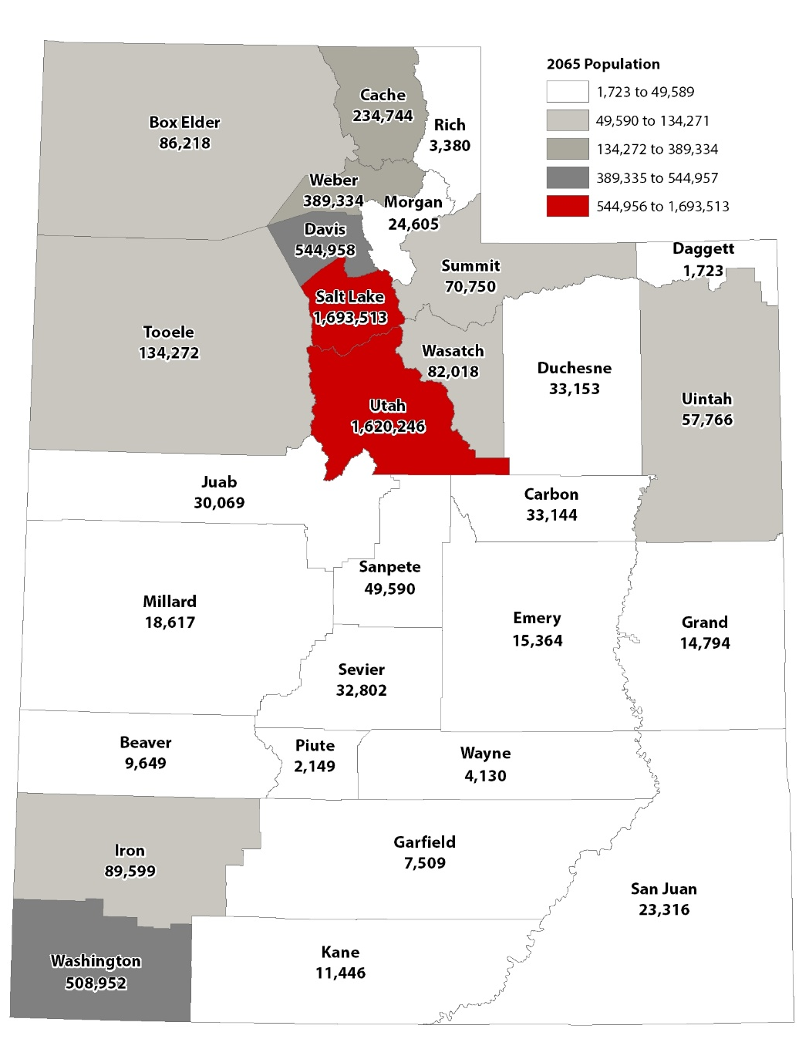
Total Population by County: 2065
Source: Kem C. Gardner Policy Institute 2015-2065 State and County Projections
Notes:
Not Updated

Slide 18
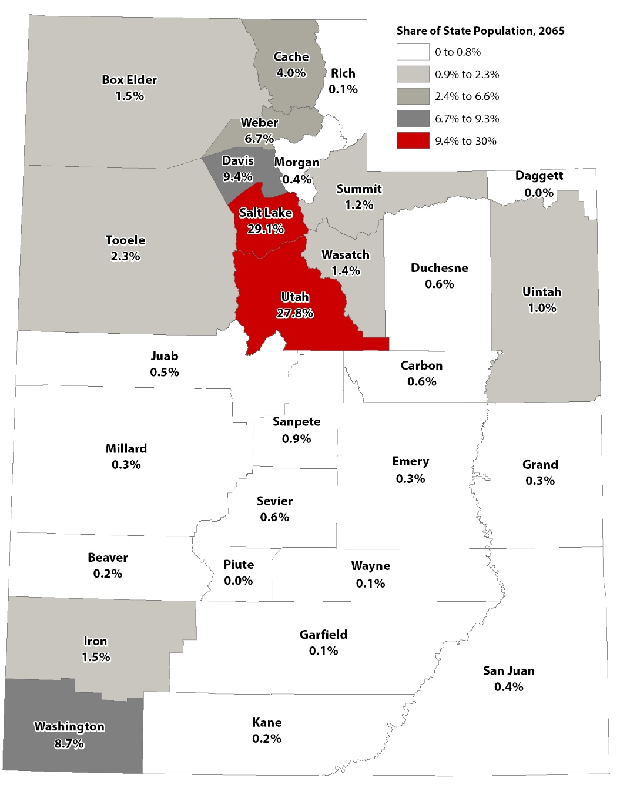
County’s Share of State Population: 2065
Source: Kem C. Gardner Policy Institute 2015-2065 State and County Projections
Notes:
Not Updated

Slide 19
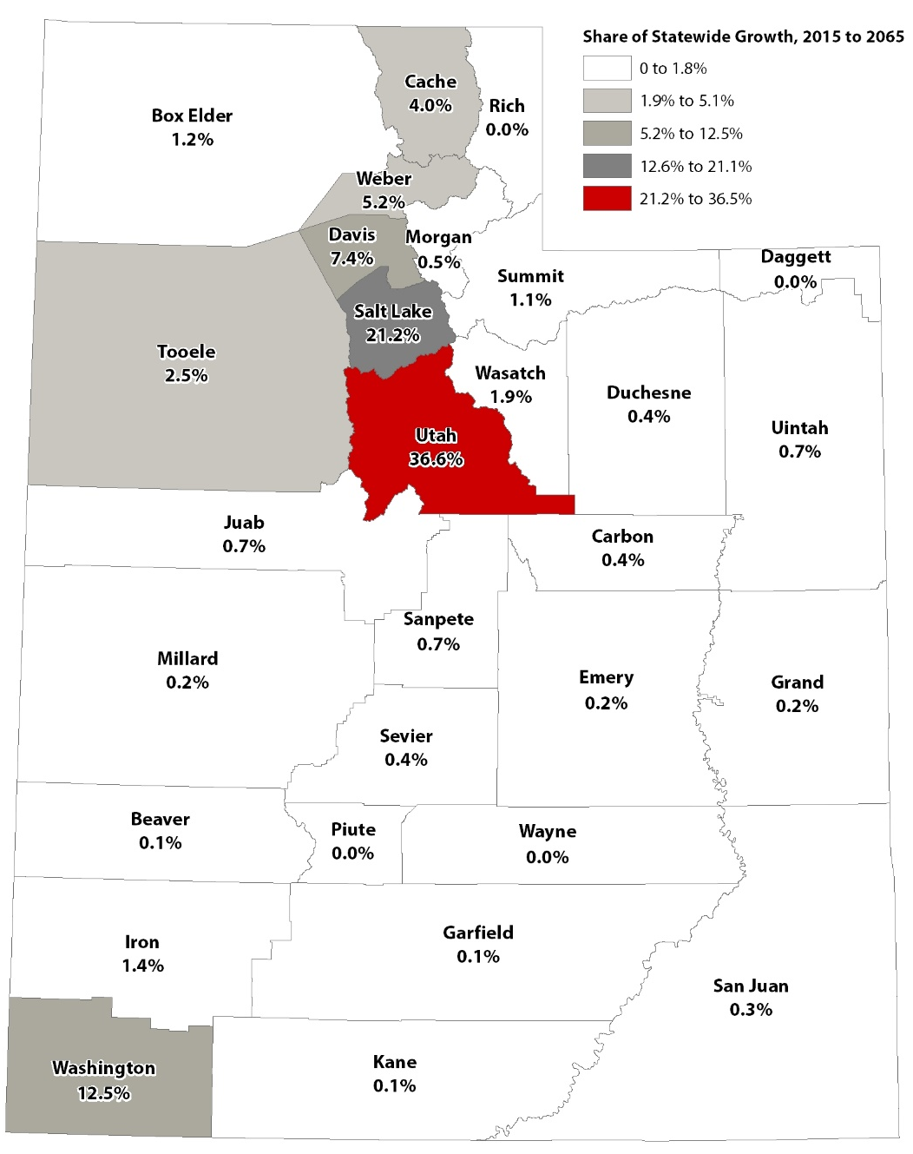
County’s Share of Total State Growth: 2015-2065
Source: Kem C. Gardner Policy Institute 2015-2065 State and County Projections
Notes:
Not Updated

Slide 20
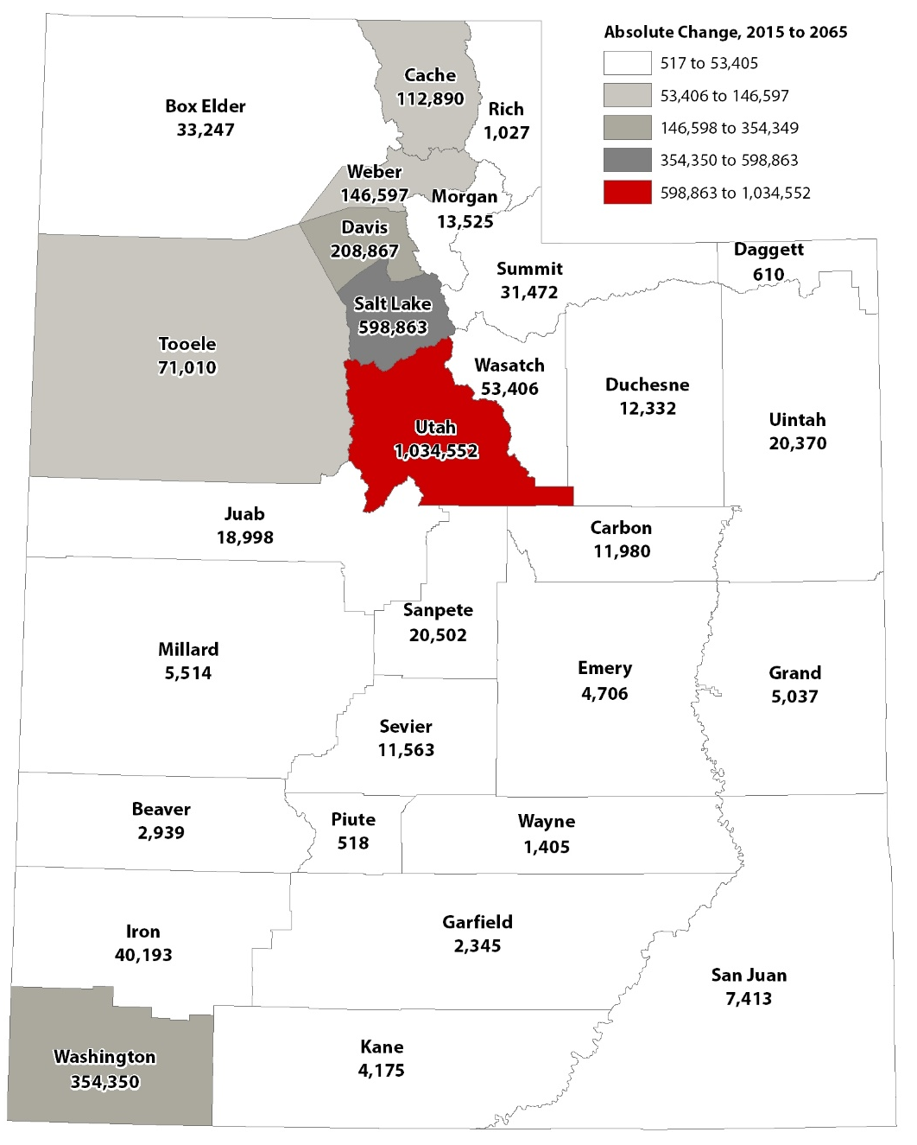
Absolute Population Change by County: 2015-2065
Source: Kem C. Gardner Policy Institute 2015-2065 State and County Projections
Notes:
Not Updated

Slide 21
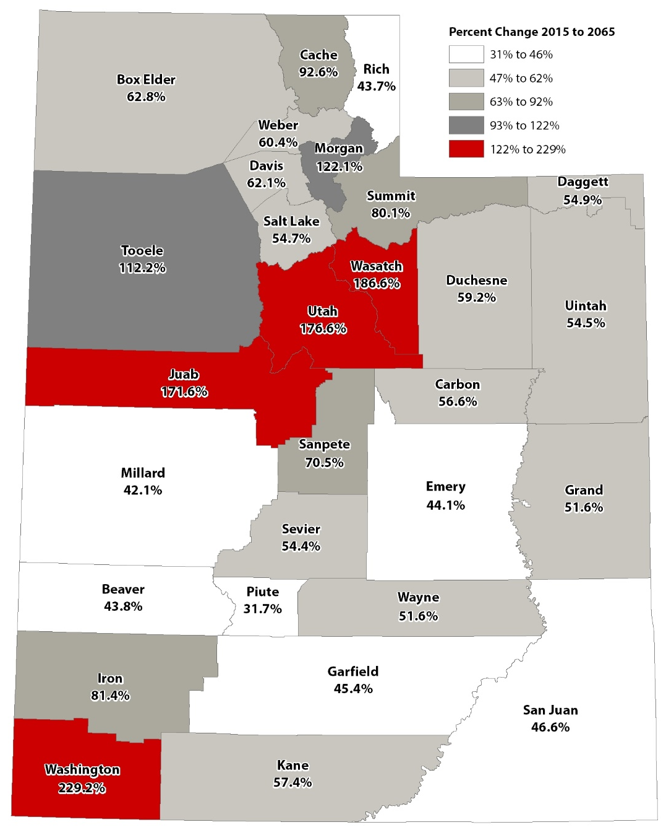
Percent Population Change by County: 2015-2065
Source: Kem C. Gardner Policy Institute 2015-2065 State and County Projections
Notes:
Not Updated

Slide 22
Kem C. Gardner Policy Institute
David Eccles School of Business | 411 E. South Temple Street Salt Lake City, UT 84111 | 801-585-5618 | gardner.utah.edu
Facebook.com/gardnerpolicyinstitute
Twitter.com/KemGardnerInst
Notes:
Updated

