Slide 1
2019 Economic Report to the Governor

Slide 2
Chapter 1: National and Utah Overview

Slide 3
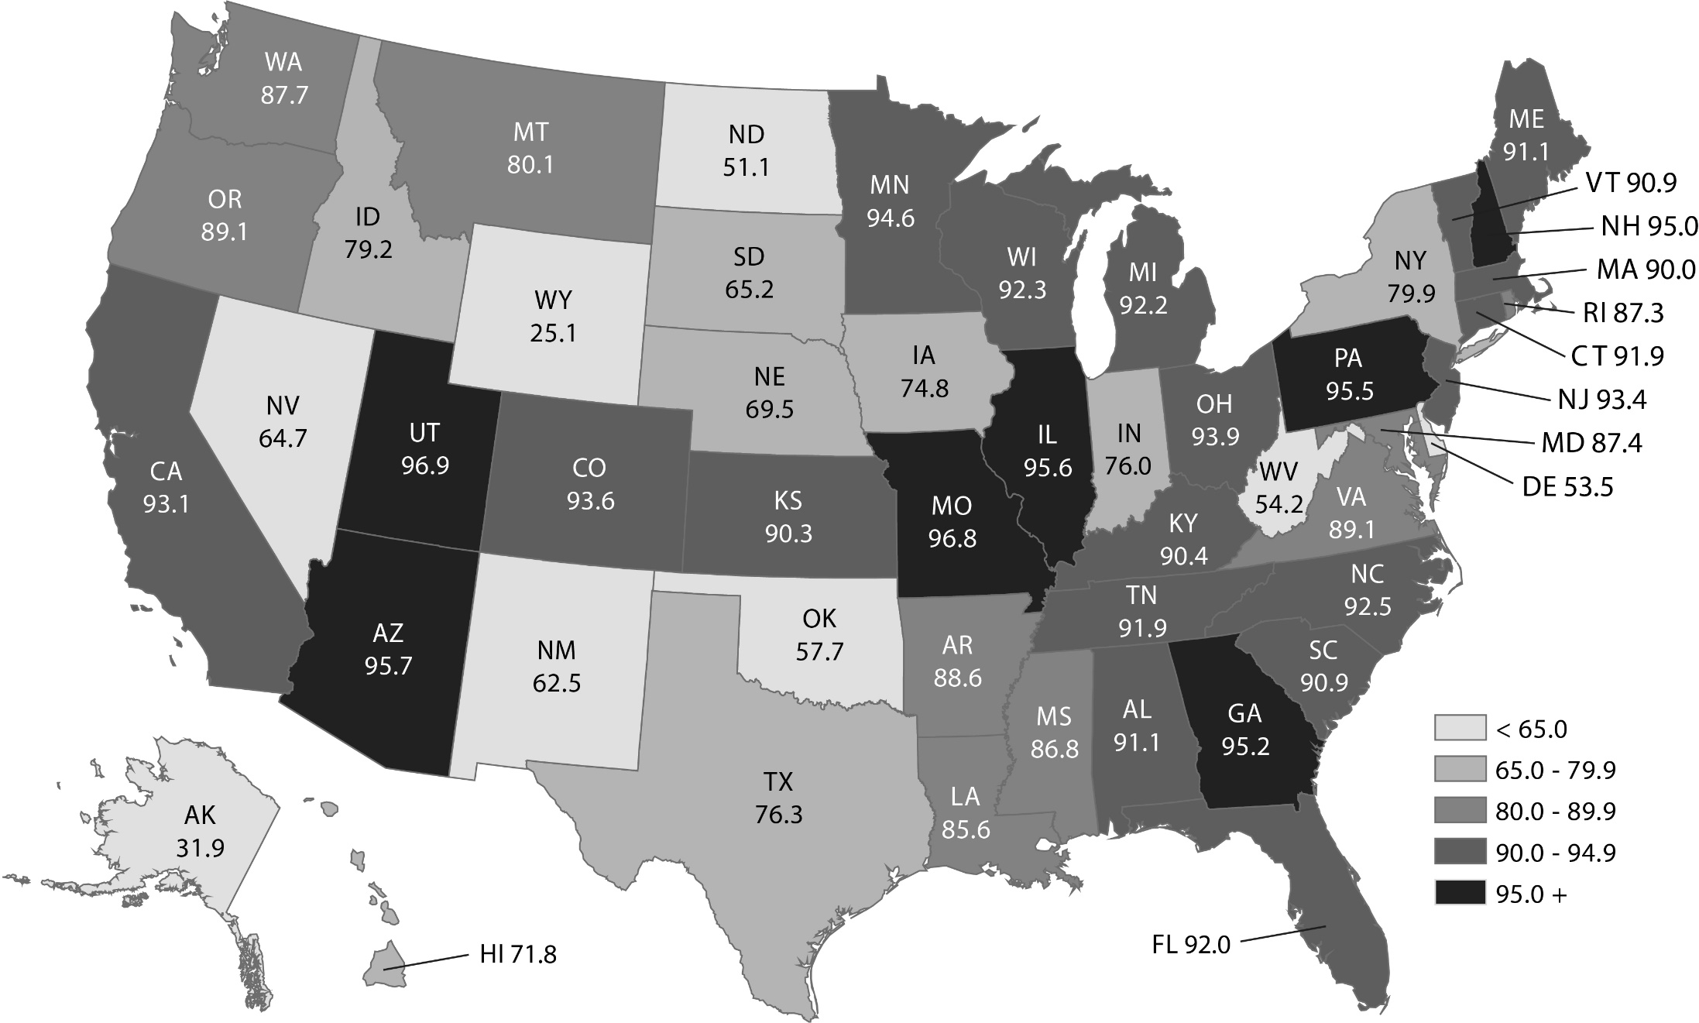
Figure 1.1 Hachman Index of Economic Diversity, 2017
Note: Value of 100 would mean that state’s economic activity is distributed exactly like the nation’s; more diverse economies have a higher index score.
Source: Kem C. Gardner Policy Institute Analysis of U.S. Bureau of Economic Analysis data

Slide 4
Figure 1.2 Annual Average Job Growth Rate for Utah and the United States
Note: e=estimate
Source: Utah Department of Workforce Services

Slide 5
Chapter 2: Demographics

Slide 6
Figure 2.1 State of Utah Components of Population Change
Source: Utah Population Estimates Committee and Utah Population Committee
Notes:
Start with black line (natural increase)
Next, explain migration (blue)
Green line= total
Utah’s echo boom occurred from around the late 1970s to the early 1980s
Utah is unique demographically in that the echo boom was larger than the original baby boom

Slide 7
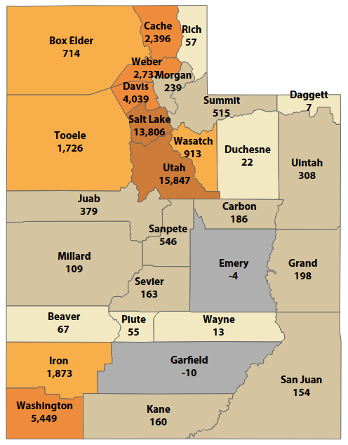
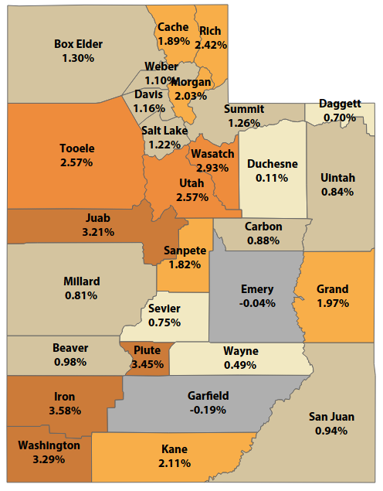
Figure 2.2
Utah Population Growth by County: 2017 to 2018
Absolute Growth
Percent Growth
Source: Utah Population Committee

Slide 8
Figure 2.3
Utah Population & Growth Projections by Decade:
2015-2065
Source: Kem C. Gardner Policy Institute 2015-2065 State and County Projections

Slide 9
Figure 2.4
U.S. Dependency Ratios: 1970-2060
Note: Dependency Ratios are computed as the number of nonworking age persons per 100 working age (18-64 year old) persons in the population. Youth are less than 18 years old and retirement age is 65 years and older.
Source: Kem C. Gardner Policy Institute analysis of U.S. Census Bureau Decennial Census and Population Division data

Slide 10
Figure 2.5
Utah Dependency Ratios: 1970-2060
Note: Dependency Ratios are computed as the number of nonworking age persons per 100 working age (18-64 year old) persons in the population. Youth are less than 18 years old and retirement age is 65 years and older.
Source: Kem C. Gardner Policy Institute analysis of U.S. Census Bureau Decennial Census data and Kem C. Gardner Policy Institute State Projections

Slide 11
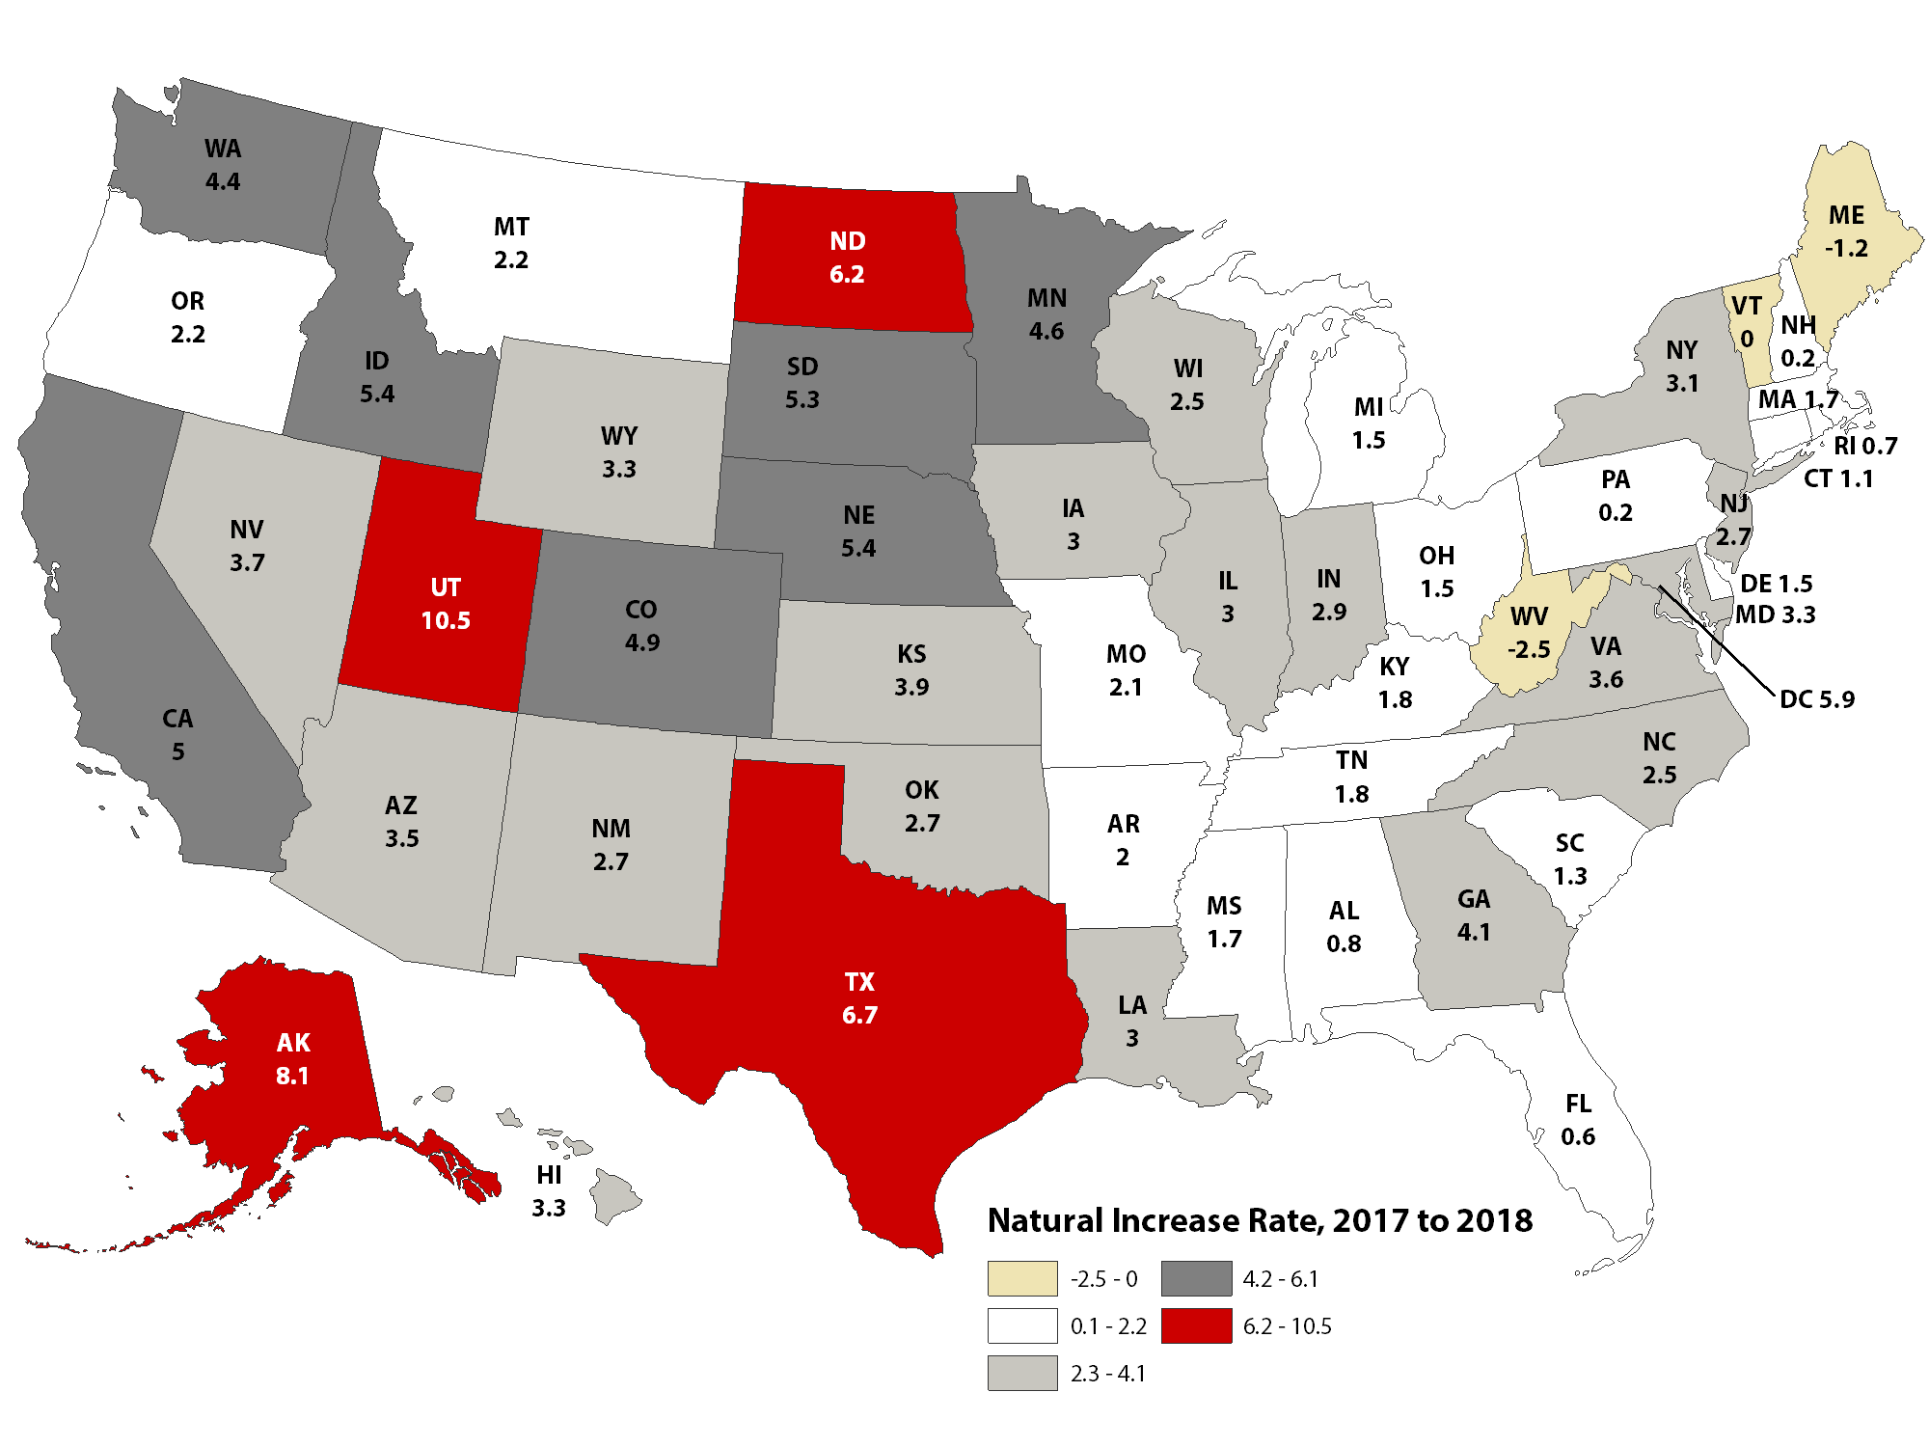
Figure 2.6 Natural Increase Annual Rate of Change: July 1, 2017 to July 1, 2018
Note: Natural increase equals births minus deaths
Source: U.S. Census Bureau, Population Division

Slide 12
Figure 2.7
Total Fertility for Utah and the United States
Note: The Replacement Level is the fertility level at which the current population is replaced
Source: National Center for Health Statistics

Slide 13
Chapter 3: Employment, Wages, and Labor Force

Slide 14
Figure 3.1 Annual Average Job Growth Rate for Utah and the United States
Note: e=estimate
Source: Utah Department of Workforce Services

Slide 15
Figure 3.2 Annual Unemployment Rate for Utah and the United States
Note: e=estimate
Source: Utah Department of Workforce Services

Slide 16
Figure 3.3 Annual Average Unemployment Rate and Wage Growth for Utah
Note: e=estimate
Source: Utah Department of Workforce Services

Slide 17
Figure 3.4 Unemployment Rates by Educational Attainment for Utah
Note: e=estimate
Source: Utah Department of Workforce Services

Slide 18
Chapter 4: Personal Income

Slide 19
Figure 4.1
Utah Per Capita Income as Percent of U.S. Per Capita Income
Note: e = estimate, f = forecast
Source: U.S. Bureau of Economic Analysis and Utah Revenue Assumptions Working Group

Slide 20
Figure 4.2
Utah vs. U.S. Total Personal Income Growth
Note: e = estimate, f = forecast
Source: U.S. Bureau of Economic Analysis and Utah Revenue Assumptions Working Group

Slide 21
Chapter 5: Gross Domestic Product by State

Slide 22
Figure 5.1
Percent of Gross Domestic Product by Industry: 2017
Source: Bureau of Economic Analysis

Slide 23
Figure 5.2
Utah vs. United States Real Gross Domestic Product Growth
Source: Bureau of Economic Analysis

Slide 24
Chapter 6: Utah Taxable Sales

Slide 25
Figure 6.1 Percent Change in Utah Taxable Sales by Component
Note: e = estimate, f = forecast
Source: Utah State Tax Commission

Slide 26
Chapter 7: State Tax Collections

Slide 27
Figure 7.1
Unrestricted General and Education Fund Revenues
Inflation-Adjusted Percentage Change
Note: f = forecast
Source: Utah State Tax Commission

Slide 28
Figure 7.2
Surplus/Deficit for the General and Education Funds
Actual and Inflation-Adjusted Unrestricted Revenues
Note: Inflation-adjusted amounts are in 2014 dollars, adjusted from nominal amounts using the GDP implicit price deflator.
Source: Governor’s Office of Management and Budget

Slide 29
Figure 7.3
Income Tax, Sales and Use Taxes, and All Other Unrestricted Revenues Percent of Total State Unrestricted Revenues
Note: Total State Unrestricted Revenues includes General Fund, Education Fund, and Transportation Fund revenues. Mineral lease revenues are not included. "Other" category includes all other revenue sources in those funds except for Sales and Use and Income tax.
f = forecast
Source: Utah State Tax Commission and Governor’s Office of Management and Budget

Slide 30
Chapter 8: Exports

Slide 31
Figure 8.1 Utah Merchandise Exports
Source: U.S. Census Bureau, USA Trade Online

Slide 32
Figure 8.2 Utah Merchandise Exports of Top Ten Export Industries
Source: U.S. Census Bureau, USA Trade Online

Slide 33
Figure 8.3 Utah Merchandise Exports to Top Ten Purchasing Countries
Source: U.S. Census Bureau, USA Trade Online

Slide 34
Figure 8.4 Utah Monthly Exports: With and Without Gold
Source: U.S. Census Bureau, USA Trade Online

Slide 35
Chapter 9: Price Inflation and Cost of Living

Slide 36
Figure 9.1 Cumulative Percent Change in Consumer Price Index this Decade
Source: Office of the State Auditor calculations from CPI data

Slide 37
Figure 9.2 Consumer Price Index Year-over-Year Price Change and Relative Value of a Dollar
The same groceries (i.e., a general good) that one paid $15 for in the 1960s, or the $45 spent in the 1980s
would cost about $100 to buy today.
Source: Office of the State Auditor calculations from CPI data

Slide 38
Chapter 10: Regional/National Comparison

Slide 39
Figure 10.1
Annualized Population Growth: 2014-2017
Source: U.S. Census Bureau

Slide 40
Figure 10.2
Annualized Gross Domestic Product Growth: 2014-2017
Source: U.S. Bureau of Economic Analysis

Slide 41
Figure 10.3
Unemployment Rate: October 2016, 2017 and 2018
Source: U.S. Bureau of Labor Statistics

Slide 42
Figure 10.4
Annualized Employment Growth: December 2014 – December 2017
Source: U.S. Bureau of Labor Statistics

Slide 43
Chapter 12: Economic Development

Slide 44
Figure 12.1 Economic Development Project Summary
Source: Economic Development Corporation of Utah

Slide 45
Chapter 13: Public Education

Slide 46
Figure 13.1
Utah Public Education Enrollment
FY 1985 ‒ FY 2020
Note: f = forecast
Source: Utah State Board of Education, School Finance & Data and Statistics

Slide 47
Figure 13.2 Percent Change in Public Education Enrollment FY 1985 – FY 2020
Fiscal Year
Note: f = forecast
Source: Utah State Board of Education, School Finance & Data and Statistics

Slide 48
Figure 13.3 Largest Enrollment FY 2019
Source: Utah State Board of Education, School Finance & Data and Statistics

Slide 49
Figure 13.4 Largest Enrollment Growth FY 2018 to FY 2019
Source: Utah State Board of Education, School Finance & Data and Statistics

Slide 50
Figure 13.5 Kindergarten Enrollment and Five Years Prior Births 2000 ‒ 2019
Birth year, Kindergarten start year
Note: f = forecast
Source: Utah State Board of Education - School Finance & Data and Statistics, Interagency Common Data Committee, and Utah Department of Health

Slide 51
Figure 13.6 U.S. FY 2018 Projection and Utah Current Expenditures per Pupil in Enrollment FY 2002 – FY 2018
Note: U.S. expenditures are in constant 2017-18 dollars based on the Consumer Price Index adjusted to a school-year basis.
* For Fiscal Years 2016-2018 U.S. data is projected.
Source: USBE, School Finance, and U.S. Department of Education, National Center for Education Statistics

Slide 52
Figure 13.7 Current Expenditures per Pupil FY 2015
Source: USBE, School Finance, and U.S. Department of Education, National Center for Education Statistics

Slide 53
Figure 13.8 Current Expenditures as a Percentage of Personal Income FY 2015
Source: USBE, School Finance, U.S. Department of Education, National Center for Education Statistics, and the Bureau of Economic Analysis

Slide 54
Figure 13.9 Utah Total Enrollment and Current Expenditures per Pupil FY 2018
Source: USBE, School Finance

Slide 55
Chapter 14: Higher Education

Slide 56
Figure 14.1 Utah System of Higher Education Enrollment Fall Third Week Headcount
Source: USHE Annual Data Books for Fall Third Week Enrollment

Slide 57
Figure 14.2 USHE Education and General Revenue Trends
Source: USHE Annual Data Book Tab G- Financial , Table 1 Revenue Trends

Slide 58
Figure 14.3 Median Wages, Poverty, and Unemployment by Education Level
Source: U.S. Census Bureau, 2017 American Community Survey

Slide 59
Figure 14.4 Percentage of Individuals Ages 25 and Older Living in Households Participating in Public Assistance by Education Level: 2015
Source: The College Board, Education Pays 2016, pg. 35. - Figure 2.17; https://trends.collegeboard.org/sites/default/files/education-pays-2016-full-report.pdf

Slide 60
Figure 14.5 Percentage Volunteering by Educational Attainment (Age 25 and Older)
Source: Bureau of Labor Statistics, 2015, Table 1.

Slide 61
Figure 14.6
Education Appropriations Per FTE Student, FY 2017
Source: SHEOO Finance Survey 2017 - Constant Dollars

Slide 62
Figure 14.7
Percent of Population Age 25 and Older with an Associates Degree or Higher
Source: U.S. Census Bureau, 2017 American Community Survey

Slide 63
Chapter 15: Agriculture

Slide 64
Figure 15.1 Average Annual Price Received in Major Utah Agricultural Sectors
Source: U.S. Department of Agriculture

Slide 65
Figure 15.2 Farmers’ Share of Retail Food Sales
Source: U.S. Department of Agriculture

Slide 66
Chapter 16: Real Estate and Construction

Slide 67
Figure 16.1 Utah Residential Construction Activity
Note: e=estimate
Source: Ivory-Boyer Construction Database. Kem C. Gardner Policy Institute, University of Utah.

Slide 68
Figure 16.2 Value of Permit Authorized Construction in Utah
Note: e=estimate
Source: Ivory-Boyer Construction Database. Kem C. Gardner Policy Institute, University of Utah.

Slide 69
Chapter 17: Energy

Slide 70
Figure 17.1 Utah's Crude Oil Production, Pipeline Imports, and Refinery Receipts Plotted with Wellhead Price, 1980-2018
Source: Utah Geological Survey; Utah Division of Oil, Gas and Mining; U.S. Energy Information Administration

Slide 71
Figure 17.2 Utah's Petroleum Product Production and Consumption Plotted with Motor Gasoline and Diesel Prices, 1980-2018
Source: Utah Geological Survey; U.S. Energy Information Administration

Slide 72
Figure 17.3 Utah's Natural Gas Production and Consumption Plotted with Wellhead and Residential Prices, 1980-2018
Source: Utah Geological Survey; Utah Division of Oil, Gas and Mining; Utah State Tax Commission; U.S. Energy Information Administration

Slide 73
Figure 17.4 Utah's Coal Production, Consumption, and Exports Plotted with Mine Mouth Price, 1980-2018
Source: Utah Geological Survey; U.S. Energy Information Administration

Slide 74
Figure 17.5 Utah's Electricity Net Generation and Consumption Plotted with End-Use Residential Price, 1980-2018
Source: Utah Geological Survey; U.S. Energy Information Administration

Slide 75
Chapter 18: Minerals

Slide 76
Figure 18.1 Value of Utah's Annual Nonfuel Production
Note: The value presented for 2018 is an estimate.
Source: Utah Geological Survey

Slide 77
Figure 18.2 Value of Utah's Annual Base Metal Production
Note: The value presented for 2018 is an estimate.
Source: Utah Geological Survey

Slide 78
Figure 18.3 Value of Utah's Annual Precious Metal Production
Note: The value presented for 2018 is an estimate.
Source: Utah Geological Survey

Slide 79
Figure 18.4 Value of Utah's Annual Industrial Mineral Production
Note: The value presented for 2018 is an estimate.
Source: Utah Geological Survey

Slide 80
Chapter 19: Tourism and Travel

Slide 81
Figure 19.1 Accommodations Taxable Sales, 2008‒2017 (In Constant 2017 Dollars)
Source: Kem C. Gardner Policy Institute Analysis of Utah State Tax Commission data

Slide 82
Figure 19.2 Utah National Park and Skier Visits, 1983‒2017
Source: U.S. National Park Service and Ski Utah

Slide 83
Chapter 20: Nonprofit Sector

Slide 84
Figure 20.1
Private Foundations Versus 501(c)(3) Charities
Source: Internal Revenue Service, October 2018, Exempt Organizations Business Master File

Slide 85
Figure 20.2
Nonprofits by County
Source: Internal Revenue Service, October 2018, Exempt Organizations Business Master File

Slide 86
Figure 20.3
Total Utah Nonprofit Sector Reporting
Note: “Non-Reporting” means less than $25,000 in annual income.
Source: Internal Revenue Service, Exempt Organizations Business Master File List, September 2017
Source: Internal Revenue Service, Exempt Organizations Business Master File List, October 2018

Slide 87
Figure 20.4
Utah Tax-exempt Nonprofit Organization Assets
(Billions of Dollars)
Sources: Internal Revenue Service, October 2018, July 2017, November 2016, December 2015, December 2014, Exempt Organizations Business Master File

Slide 88
Figure 20.5
Utah Tax-exempt Nonprofit Organizations
Sources: Internal Revenue Service, (October 2018, July 2017, November 2016, December 2015, December 2014) Exempt Organizations Business Master File

Slide 89
Figure 20.6
Utah Nonprofit Projected Salary Increases by Budget Size, FY 2018
Note: Salaries are not projected to decrease.
Source: Columbia Books and Association TRENDS (2018) The Compensation Report: An Analysis of Utah Nonprofits

