Slide 1
Utilizing County Typologies to Explore Utah’s Age Specific Migration Patterns
Emily Harris, Demographic Analyst
Kem C. Gardner Policy Institute, University of Utah

Slide 2
Introductions
Demographic Analyst
State and County Population Estimates
Demographic Research (Migration)
Our Institute
The Kem C. Gardner Policy Institute at the University of Utah prepares economic, demographic and public policy research that helps Utah prosper. We are Utah’s demographic experts, leaders on the Utah economy, and specialists on public policy and survey research.

Slide 3
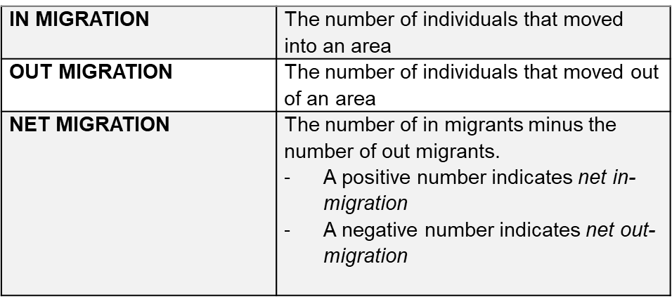
Migration Defined
Migration
The residential movement of people from one place to another
This study:
The residential movement of people from one county to another
Notes:
People migrate for so many different reasons: Affordable housing, retirement, employment opportunities being filled by a national labor market, modern technology makes moving easier

Slide 4
Migration Life Stages
Johnson, Winkler, & Rogers (2013)
Emerging Adults
(ages 15-24)
Young Adults
(ages 25-29)
Family Age (ages 30-49, and 5-14)
Older Adults
(ages 50-74)
Notes:
People move for many different reasons, and those reasons and priorities for living change as we go through different stages in our lives

Slide 5
Data and Interpretation of Rates
Source: County-Specific Net Migration by Five-Year Age Groups, Hispanic Origin, Race and Sex 2000-2010 (University of Wisconsin-Madison)
Rates prepared using a vital statistics version of the forward cohort residual method
NM= (P1 − P0 ) − (B − D)
Ages 10-14
(2000)
Deaths
Actual 2010
Age
20-24
Expected 2010
Age
20-24
2010
Net Migration
Ages 20-24
Expected 2010
Ages
20-24
Notes:
Rates should be interpreted as the number of net-migrants per 100 total residents of a given age group
For example:
Utah’s net-migration rate for the entire decade for ages 15 to 19 is 11.75 per 100.
For every 100 people in Utah ages 15-19 at the beginning of the decade, 11.75 people aged 15-19 migrated into Utah by the end of the decade.

Slide 6
Objective
Life Stage Migration Patterns
Demographic and Economic Profiles
Meaningful County Typologies

Slide 7
County Typologies
College
Tourism
Energy
Ring
Coal
Rural
Urban Metro

Slide 8
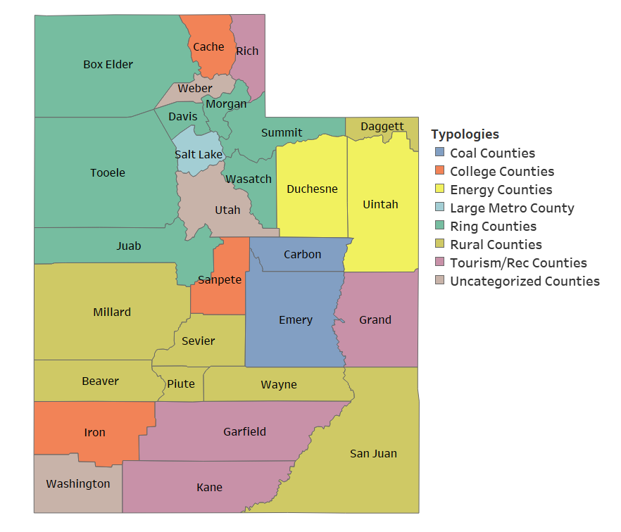
Map with County Typologies

Slide 9
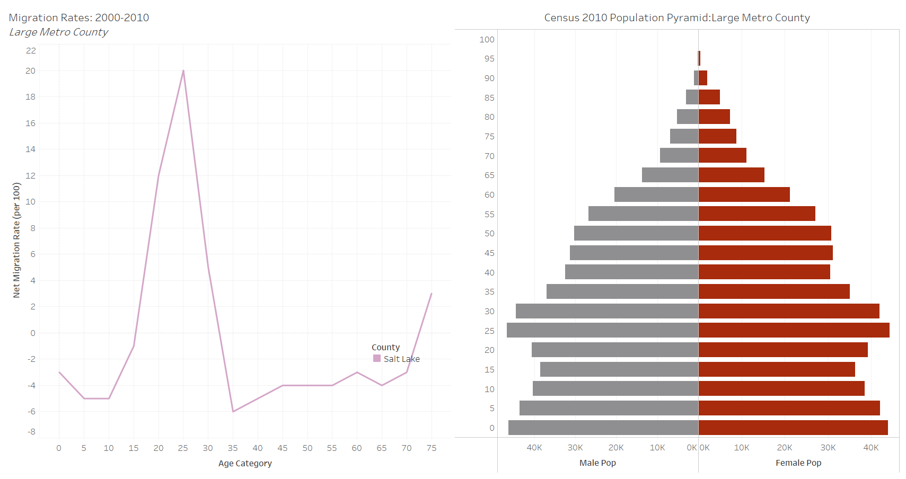
Results: County Typologies and Migration Patterns
Large Metro
Young Adult Migration

Slide 10
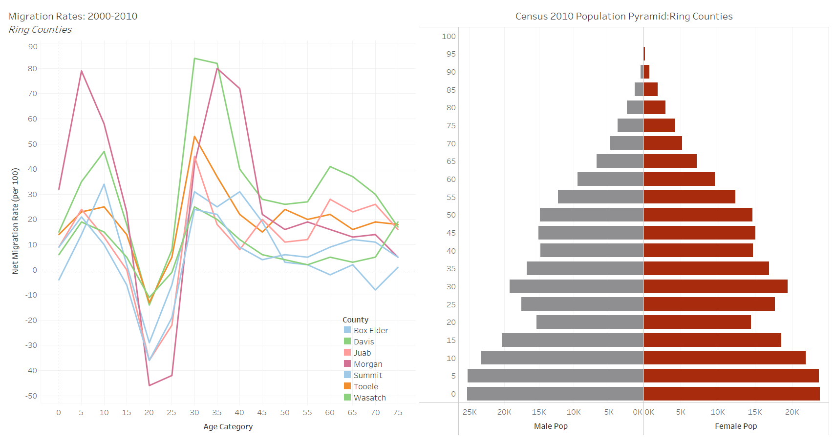
Results: County Typologies and Migration Patterns
Ring Counties
Family Age Migration

Slide 11
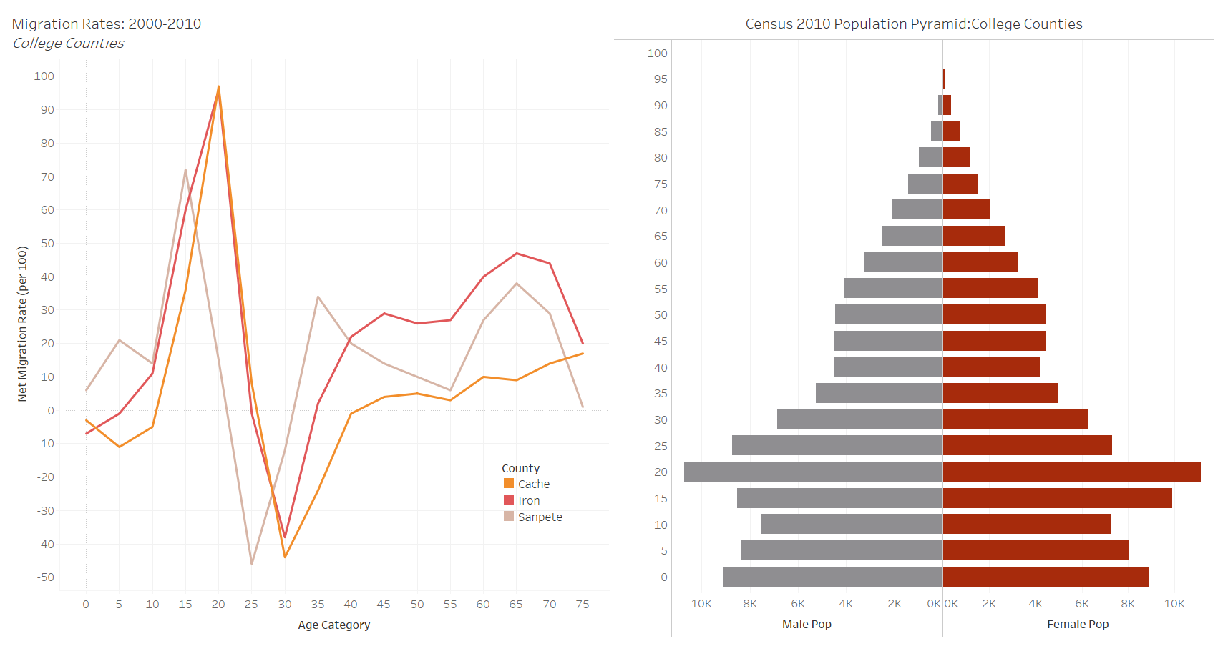
Results: County Typologies and Migration Patterns
College Counties
Emerging Adult Migration

Slide 12
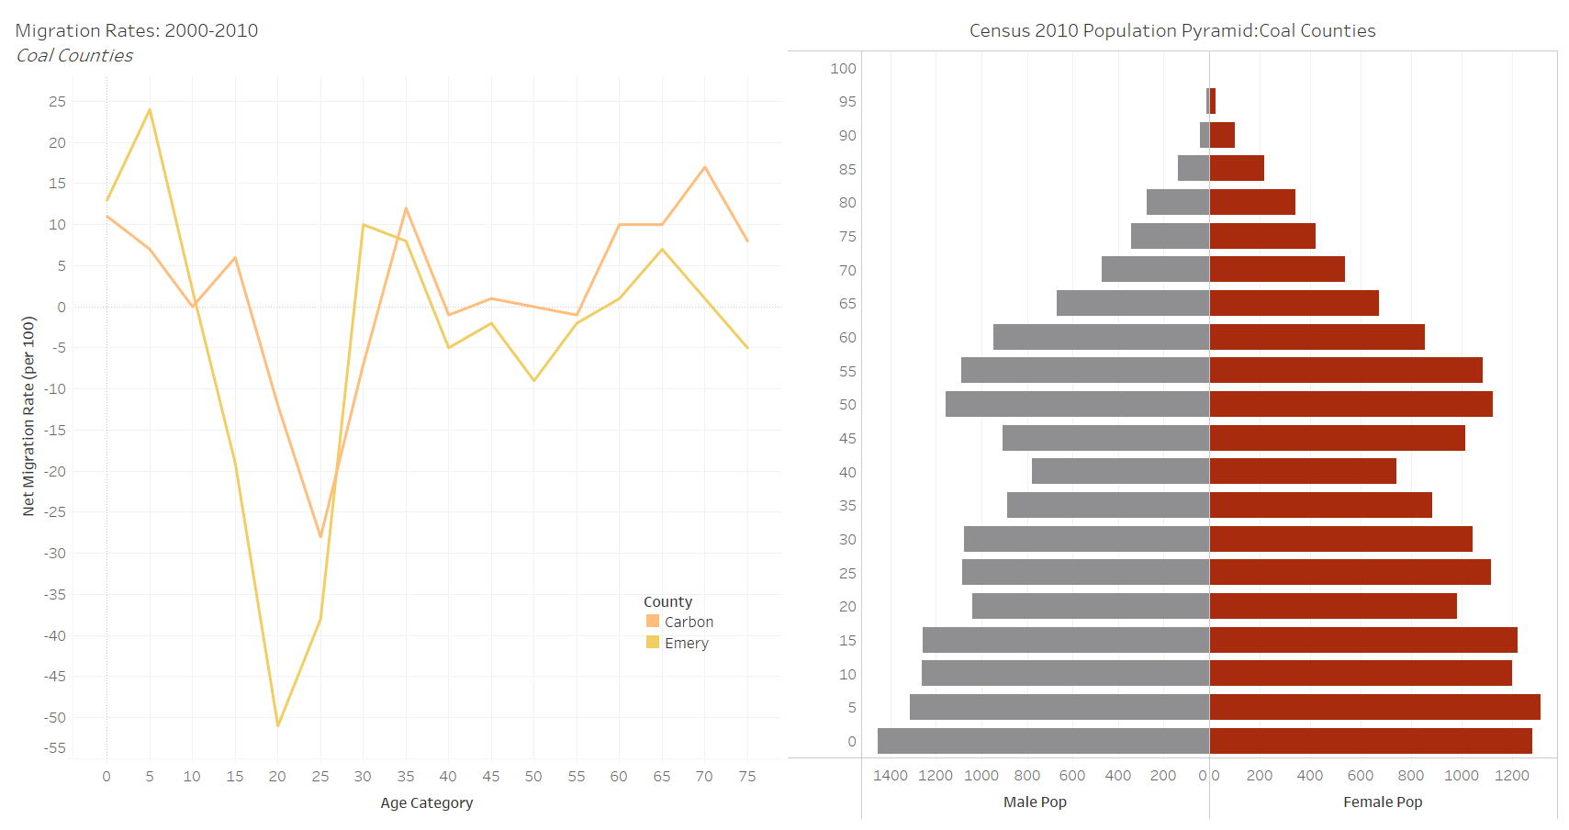
Results: County Typologies and Migration Patterns
Coal Counties
Some Family Migration
Significant Young Adult Out-Migration

Slide 13
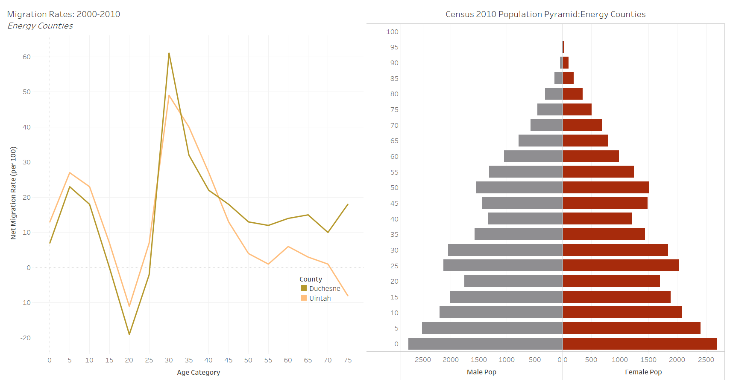
Results: County Typologies and Migration Patterns
Energy Counties
Family Age Migration

Slide 14
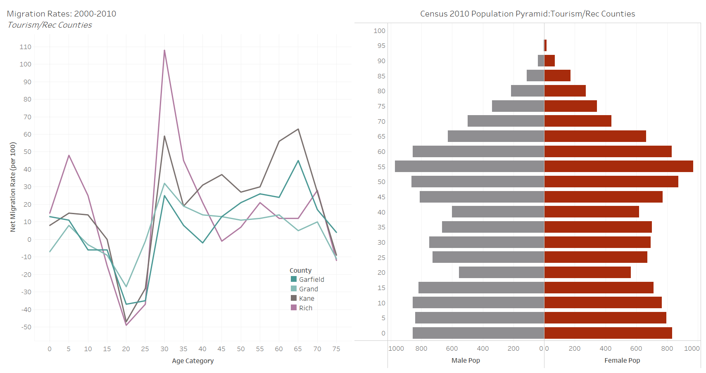
Results: County Typologies and Migration Patterns
Tourism Counties
Family Migration
Retirement Migration

Slide 15
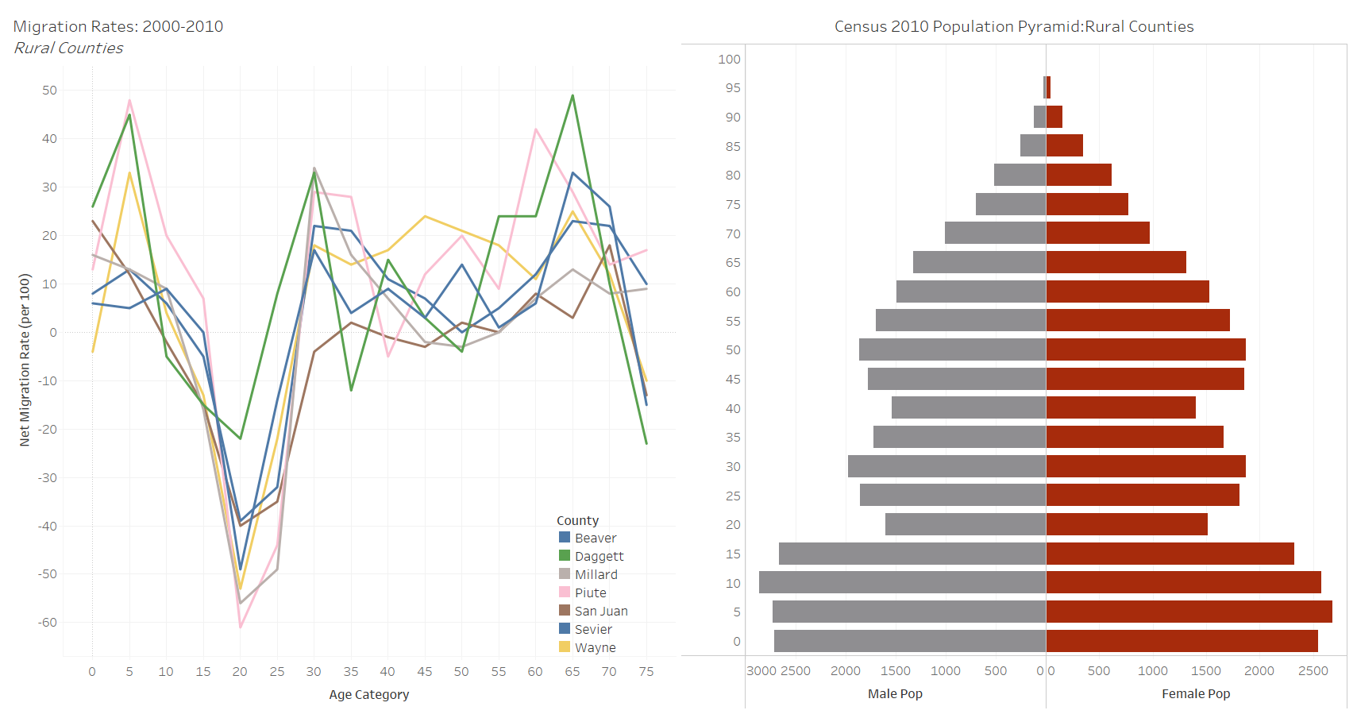
Results: County Typologies and Migration Patterns
Rural Counties
Significant Young Adult Out-Migration

Slide 16
Conclusion
Why should we care?
Utah and it’s counties continue to change, and migration is a key indicator
Demographics are an important component of local conditions
Policy makers could benefit from demographic analysis:
Migration patterns reveal county conditions (historical and current)
Do we want these patterns to continue? Or do we want to change them?
Services needed are heavily impacted by age structure and migration trends
So ready for Census 2020!

