Slide 1
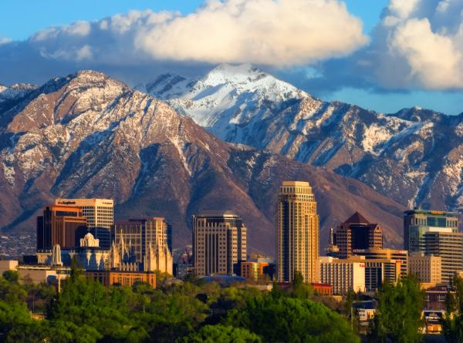
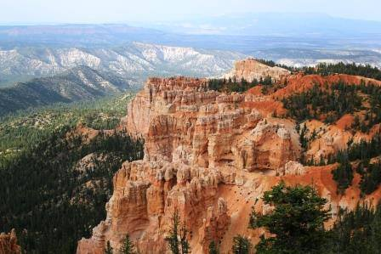
The Economic Contributions of Tourism in Utah: A Regional Comparison

Slide 2
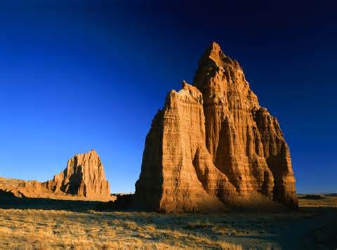
TOURISM ECONOMICS 101:

Slide 3
How are the economic contributions of tourism measured?

Slide 4
Visitor Spending
Tourism = “Export Industry”
Non-resident vs. Resident Spending
Non-local vs. Local Spending

Slide 5
Data Sources:
TNS Global / Utah Traveler Surveys
RRC Associates / Utah Skier Surveys
National Park Service / Visitor Services Project (VSP) Surveys
BEBR / Sundance Film Festival Surveys
BEBR / Convention Visitors Bureau (CVB) Surveys

Slide 6
How do Utah visitors spend their money?

Slide 7
Shares (%) of Total Nonresident Visitor Spending

Slide 8
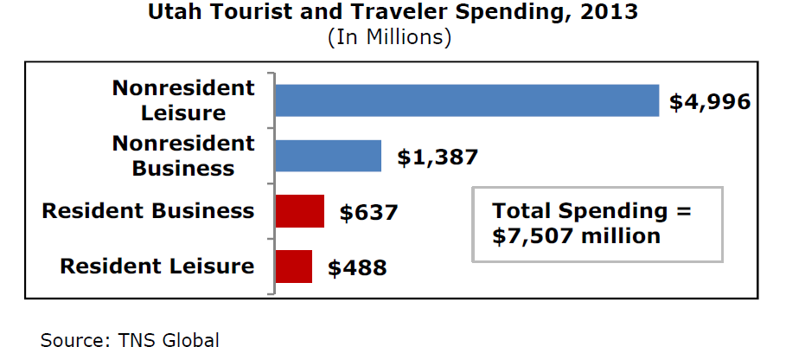

Slide 9
Estimating Economic Impact / Contributions of Tourism
Economic Modeling Software (e.g. IMPLAN, REMI)
RIMS II Multipliers: Bureau of Economic Analysis
Tourism indicators
-- Tourism-Related Sales Tax Revenue
Transient Room Tax (Accommodations)
Restaurant Tax
Short Term Vehicle Leasing Tax (Car Rental)
Resort Community Sales Tax
-- Tourism-related taxable sales
-- Tourism-related jobs
-- Hotel Occupancy, ADR, RevPAR
-- Visitation

Slide 10
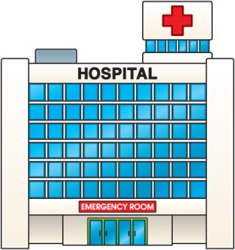
Other Tax Revenue Generated by Tourism Spending:
Other sales tax revenues include:
Local Sales Tax (1%) - state sales tax
County Option Sales Tax (0.25%) - state sales tax
Mass Transit Sales Tax (0.80%) - specified transit needs
Municipal Highways Sales Tax (0.30%) - construction/maintenance of highways
Rural Hospital Sales Tax (>1%) - rural county/city health care facilities
Fixed Guideway Sales Tax
County of 2nd Class Airport, Highway & Transit Sales Tax
Supplemental State Sales and Use Tax
Beer, Cigarette & Tobacco Taxes
Fuel Taxes
Income Taxes (Tourism Employees)
Property Taxes (Hotels, Ski Resorts)
Corporate Taxes (Tourism Businesses)

Slide 11
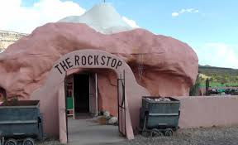
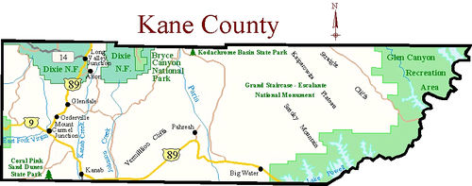
Gasoline
24.5 cents/gallon
Shopping in Orderville
Sales Tax (7.95%)
**Includes 1% RC tax
Groceries
Sales tax (3%+)
State Park Admission
Coral Pink Sand Dunes State Sales tax (4.7%)
Hotel Room
Sales tax (7.95%)
County transient room tax (4.25%)
Municipality transient room tax (1% - Kanab)
Restaurant
Sales tax (7.95%)
Restaurant tax (1%)
*Sales Tax of 7.95% includes: state (4.7%), local (1.0%), rural hospital (1.0%), county option (0.25%), resort community (Kanab) taxes (1.0%)

Slide 12
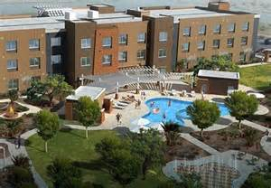
Tourism-Generated Employment
Direct Employment

Slide 13
Tourism-Generated Employment
Direct Employment
Indirect Employment

Slide 14
Tourism-Generated Employment
Direct Employment
Indirect Employment
Induced Employment: when all direct and indirect employees spend their paychecks, it supports even more jobs

Slide 16
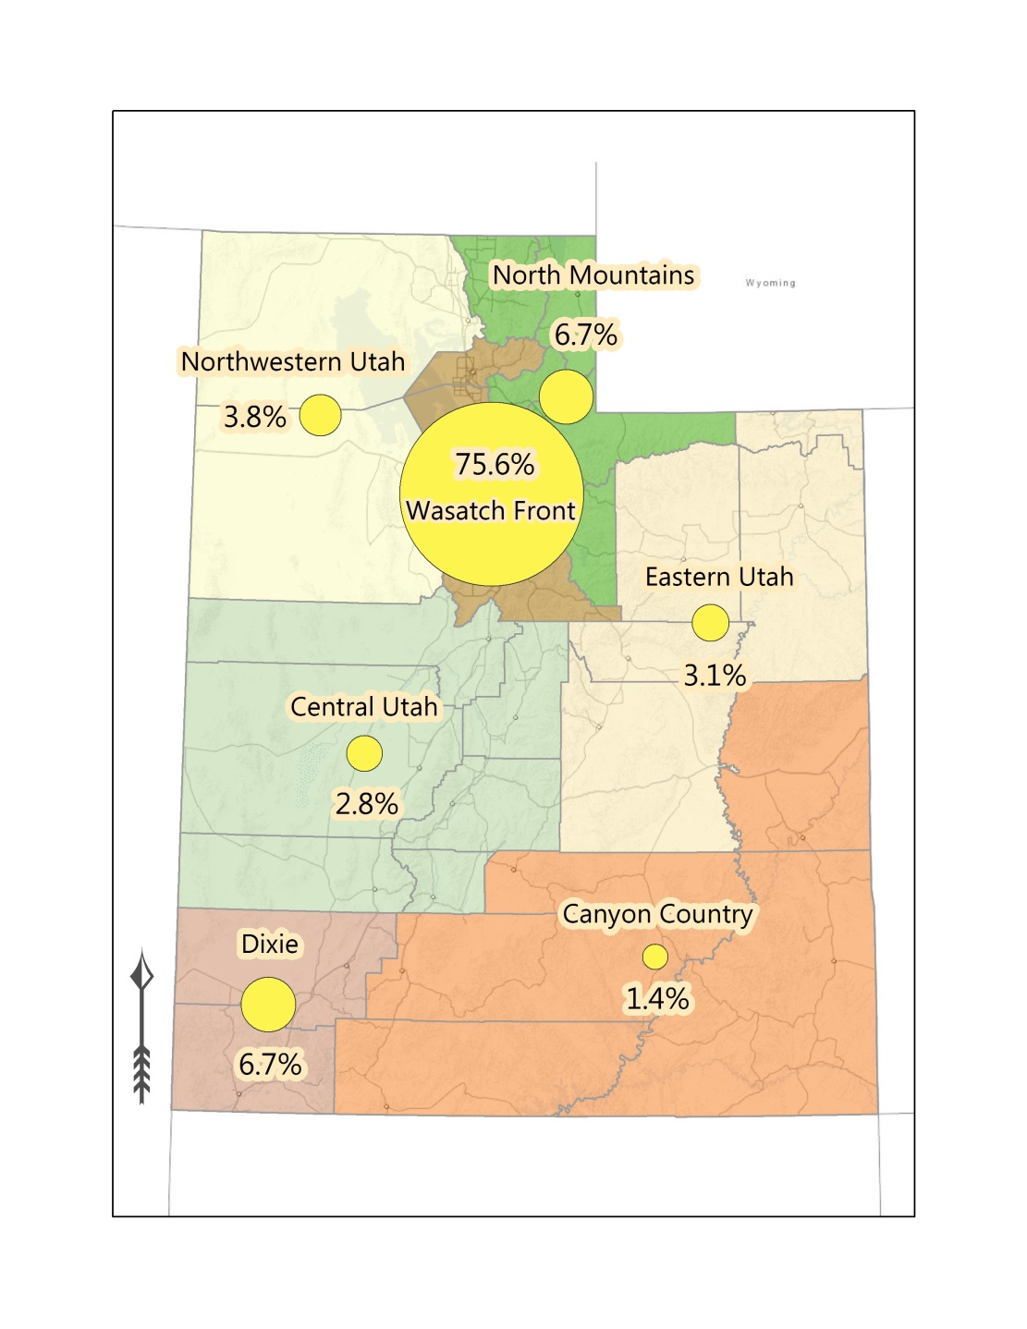
Urban = 90+% of the total county population resides in U.S. Census defined “urban areas” (50,000+ people) or “urban clusters” (2,500-50,000 people).
Rural = all other non-urban counties

Slide 17
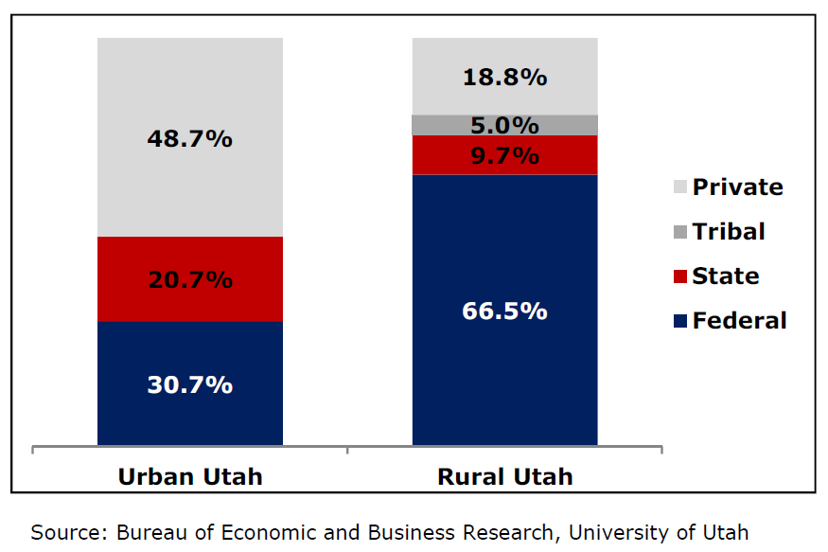
Utah Land Ownership, 2014

Slide 18
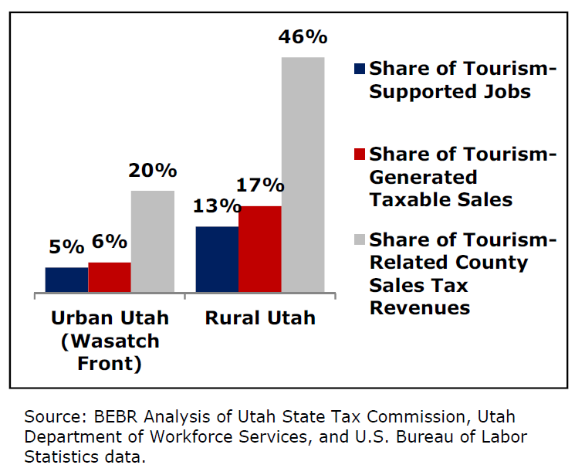
Tourism Indicators, 2013

Slide 19
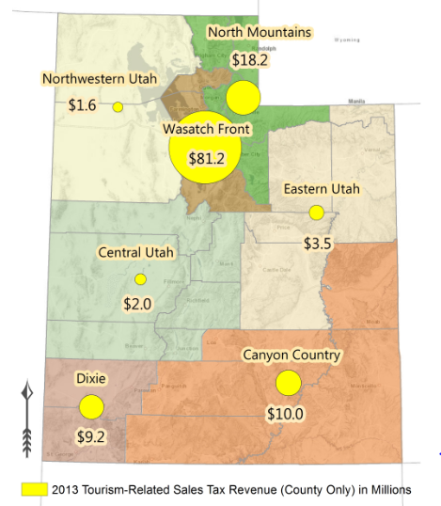

Slide 20
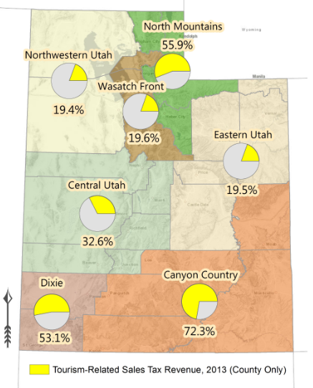

Slide 21
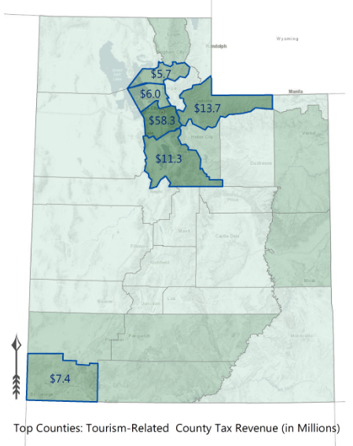

Slide 22
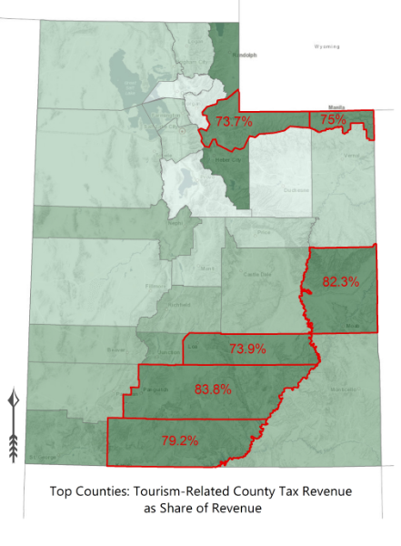

Slide 23
Tourism-Supported Jobs, 2013 (Direct; Private Sector)
Source: BEBR Analysis of Bureau of Labor Statistics data.

Slide 24
Estimated Tourism-Generated Employment (Direct, Private)
More rural jobs than urban tourism-generated jobs in:
--Gas stations (with or without convenience stores)
--Performing arts/spectator sports
--Recreational gear rental
A relatively large number of rural jobs in:
--Accommodations (rural = 8,462; urban = 8,632)
--Amusement & recreation
--Tourism-related retail
--Foodservice (restaurants/bars)

Slide 25
Estimated Tourism-Generated Employment (Direct, Private)
More urban than rural tourism-generated jobs in:
--Car / truck / RV rental
--Auto repair & maintenance
--Parking lots / garages
--Transportation (air, bus, taxi, train, etc.)
--Travel reservations & arrangements
--Museums/parks/historic sites

Slide 26
UTAH TOURISM DATA Produced by BEBR / The Policy Institute
Urban/Rural Research Brief
County Tourism Profiles
Annual Utah Tourism Report
Interactive County Maps
Interactive Visitation Maps

Slide 27
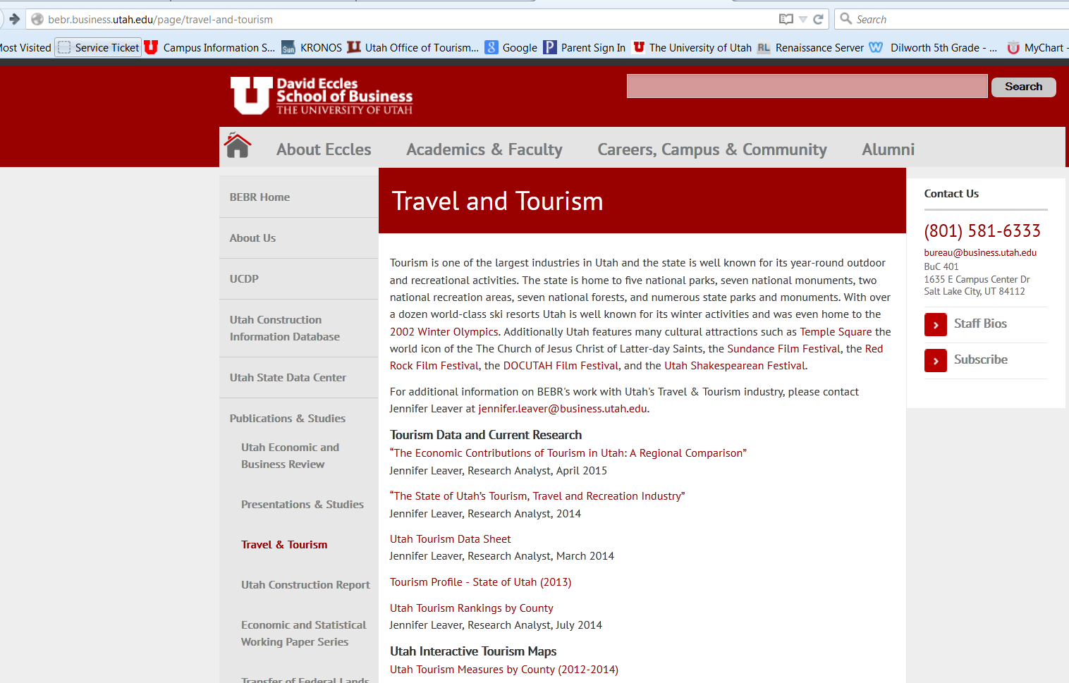
bebr.business.utah.edu

Slide 28
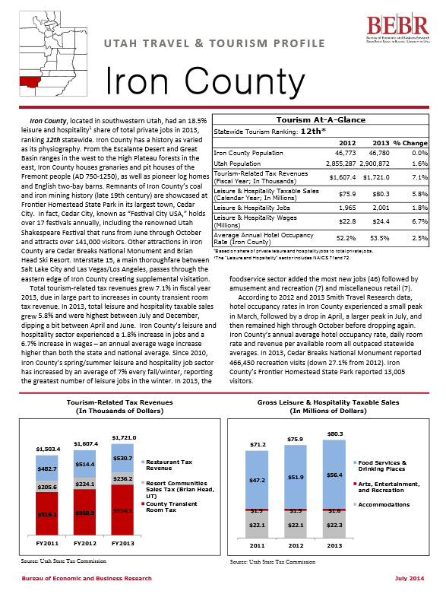
County Tourism Profiles

Slide 29
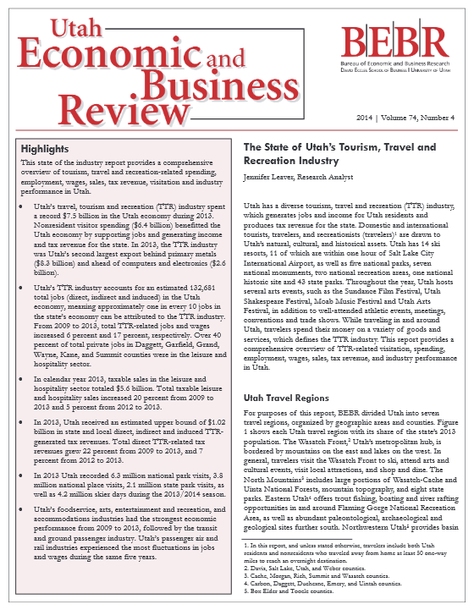
Tourism Annual Report

Slide 30
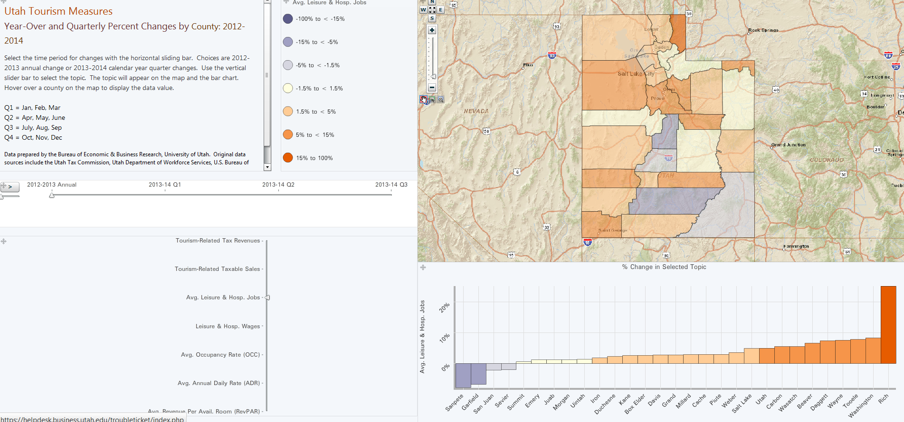
County Tourism Measures Quarter to Quarter Annual Comparisons

Slide 31
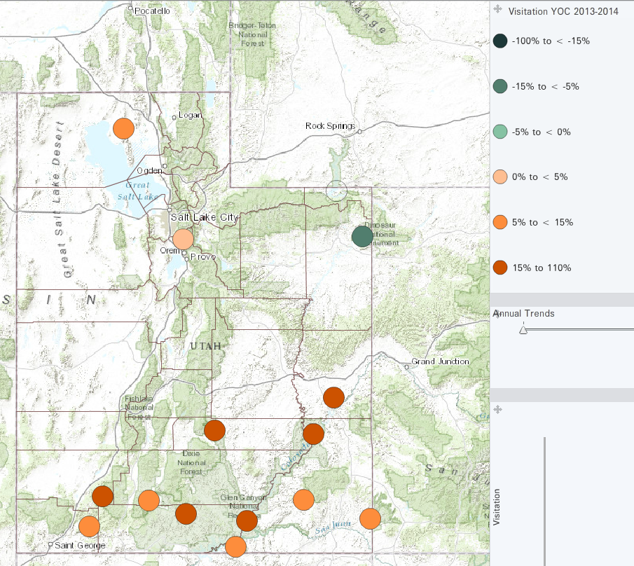
National Park Visitation Quarter to Quarter Annual Comparisons

Slide 32
2014 Utah Tourism by the Numbers
$7.8 billion in visitors spending
$1.07 billion in estimated tax revenue
137,192 private jobs (1,097,465 total jobs)
$3.9 billion in wages
3,661,226 skier visits (down 5.2%)
7,239,149 national park visits (up 14.4%)

Slide 33
Thank You!

